Slide 1
Belize slave-owners and the University College London slavery database
Barbara Bulmer-Thomas
October 3, 2015

Slide 2
Legacies of British slave-owners database
Catherine Hall, Nicholas Draper, Keith
McClelland, Katie Donnington, Rachel
Lang
Belize slave owners

Slide 3
Steps to freedom
Abolition of the slave trade 1808
Emancipation Bill 1834
Emancipation day in the Caribbean 1 Aug 1838
£20,000,000 mil paid in compensation to
slave owners. Estimates range in current prices from £1.6bn (Retail Price Index) to £17 bn (Earnings Index).

Slide 4
Understanding the ecology of slavery
economic benefits affecting Victorian prosperity in the UK.
Commercial Legacies:
Banking and the City
Railways: John Moss, Nathaniel Snell Chauncey
Cultural legacies:
Country house building: Harewood House
Connoisseurship: Hibbert, Bernal, Angerstein
Philanthropy and institutions: Kings College London
Societies and Clubs: The London Institution, Roxburgh club
Religious institutions and churches

Slide 5
Example of Belize Slavery Database
Claim No | First Names | Surname | Note | No. of Slaves | £ | shillings | pence
1 | Catherine | Robinson |  | 15 | 1001 | 5 | 4
10 | Henry Charles | Smith |  | 1 | 81 | 19 | 5
100 | Ann | Meigham | Widow | 5 | 229 | 11 | 3
101 | Robert | Wagner |  | 3 | 59 | 14 | 9
102 | Lucy | Pattinett |  | 3 | 141 | 14 | 2
103 | Sarah | Keefe |  | 10 | 529 | 17 | 0
104 | Rebecca | Lindo |  | 3 | 123 | 14 | 0
105 | Sarah | Keefe |  | 31 | 1520 | 11 | 7
106 | Joseph | Jones |  | 2 | 59 | 14 | 9

Slide 6
Belize
£100,000 paid in compensation to 257 slave owners for 1,896 slaves (average 7.4 per owner)
Modern equivalent in the range £8.6 million to
£313.9 million (see www.measuringworth.com/poweruk)
Belize dollar equivalent today ranges from
$27.5 million-$1000 million
cf. today’s government budget of $900million

Slide 7
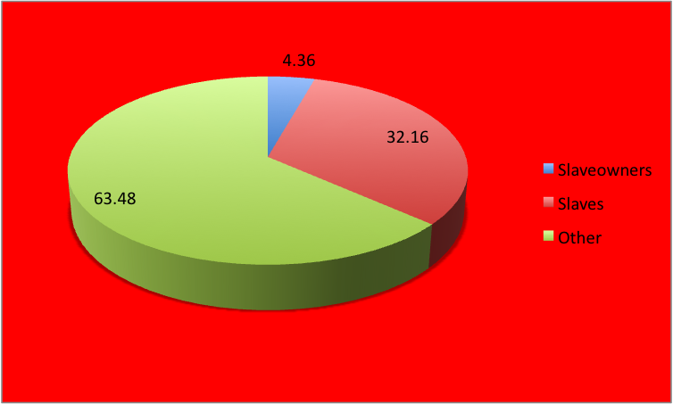
Slave Owners, Slaves and Others as %age of Belize Population, 1834

Slide 8
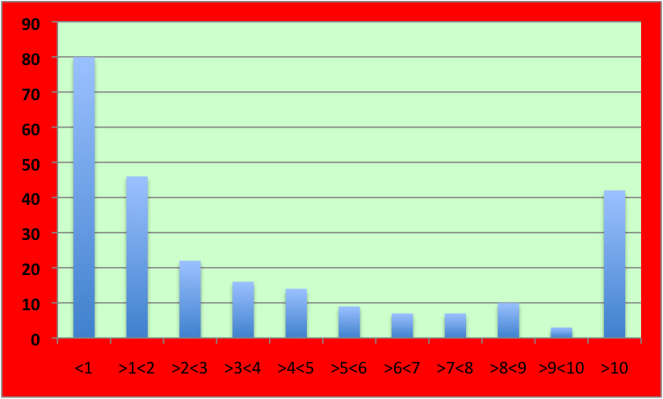
Belize Slave Owners by Number of Slaves Owned, 1834

Slide 9
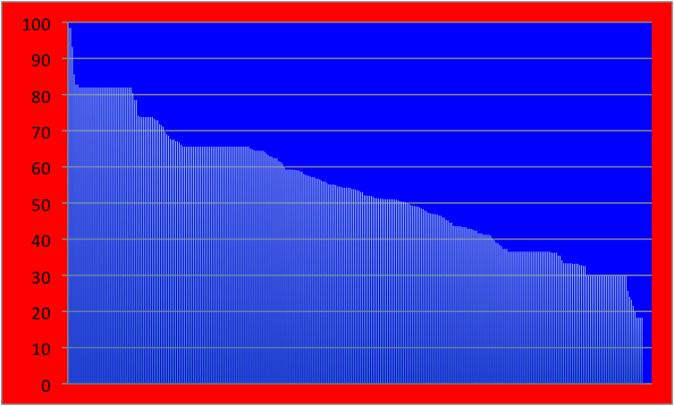
Ranking of Slave Value in Belize 1834(£) By Compensation Received

Slide 10
Who were the beneficiaries?
Many of those not using agents were women residing in the UK while their husbands remained in Belize.
Some were ‘spinsters’ or widows – did they own the slaves outright?
A few signed with an ‘x’ implying illiteracy.

Slide 11
Unanswered questions
What happened to the money paid in compensation?
Why did some slave owners stay on in Belize while others left never to return?
How did the distribution of slave among slave owners compare to other parts of the Caribbean?
Did more women own slaves in Belize than elsewhere?

Slide 12
References
Catherine Hall et al, Legacies of British slave-ownership, CUP, UK 2014
Graham Trust, John Moss of Otterspool
(1782-1856), Authorhouse, UK 2011
Hilary Beckles, Britain’s Black Debt, 2013
Legacies of British slave-ownership database
hhtp/www.ucl.ac.uk/lbs

