Slide 1
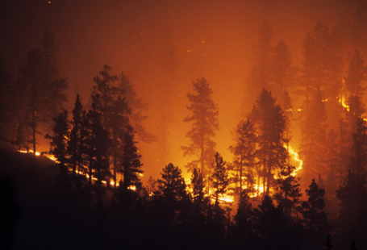
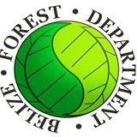
Conserving pine woodland biodiversity in Belize through community fire management
Notes:
The full grant is for around BZ$900,000. Of this, about 1/3 will come to TIDE.

Slide 2
Aim
To engage communities in stewardship of pine woodlands/savannas in Toledo by creating economic incentives and facilitating community fire management.

Slide 3
Why might managing fire enhance pine woodland biodiversity?
Theory of change:
Problem (current situation)
Proposed solution
Loss of biodiversity and forest resources
Poor stewardship
Unwanted fires
Livelihoods using savanna resources sustainably
Motivation for stewardship
Active fire management
Recovery of biodiversity and forest resources
Training in fire management
Capacity for stewardship
Notes:
The full grant is for around BZ$900,000. Of this, about 1/3 will come to TIDE.

Slide 4
Conservation of pine woodland biodiversity in Belize through community fire management
Main activities:
1 Establish biodiversity and resource baselines and build national capacity for biodiversity / resource monitoring
Survey Caribbean pine in Payne’s Creek National Park and palmetto palm in Payne’s Creek, Deep River Forest Reserve and Swasey-Bladen Forest Reserve
Develop protocols for monitoring pine woodland resources (pine and palmetto) and biodiversity (yellow-headed parrots, birds, mammals, fiddlewood, Zamia prasina, and other endemic plants)
Establish biodiversity and wildfire baselines to measure project impact
Develop training materials for monitoring pine woodland resources and biodiversity and train ~30 PA personnel under the NTPPAM
Notes:
The full grant is for around BZ$900,000. Of this, about 1/3 will come to TIDE.

Slide 5
Conservation of pine woodland biodiversity in Belize through community fire management
2: Build capacity to implement fire management and sustainable forest use
Hold Community engagement meetings on managing wildfire
Produce materials to train ≥100 community members in fire management (50 in safe use of agricultural fire and 50 in fire management for savannas)
Train ≥15 trainers to train further community members in fire management
Train and equip community members to harvest palmetto palm sustainably
Create a plan for a sustainable extraction zone in PCNP, including evaluation of ecological and socio-economic costs and benefits
Meet with communities, FD, Agriculture Dept., NAVCO and DAVCO to agree improvements to governance of rural fire use
Notes:
The full grant is for around BZ$900,000. Of this, about 1/3 would come to TIDE.

Slide 6
Conservation of pine woodland biodiversity in Belize through community fire management
Work Package 3: Business development for poverty alleviation and long term viability of ecosystem management
Meetings to identify community members / groups interested in establishing small forest enterprises
Formalise license agreements with FD whereby community members are granted concessions to harvest NTFP in Forest Reserves
Establish and monitor NTFP concessions involving 50 community members
Develop business plans for ≥3 small forest enterprises
Provide training so TIDE staff and other NGOs can develop further small forest enterprises
Notes:
The full grant is for around BZ$900,000. Of this, about 1/3 would come to TIDE.

Slide 7
Progress to date
WP 1
Survey Caribbean pine in Payne’s Creek National Park and palmetto palm in Payne’s Creek, Deep River Forest Reserve and Swasey-Bladen Forest Reserve

Slide 9
Pine classes mapped based on land cover type and % canopy cover

Slide 13
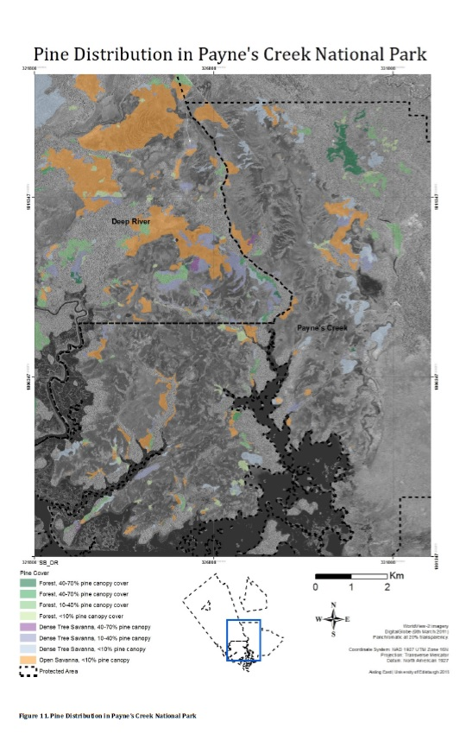

Slide 14
Progress to date
WP 2
Consultation with local communities
Consultation with Agriculture and Forest Department about revising the Agricultural Fires Act.
Build local capacity to implement fire management and sustainable forest use

Slide 15
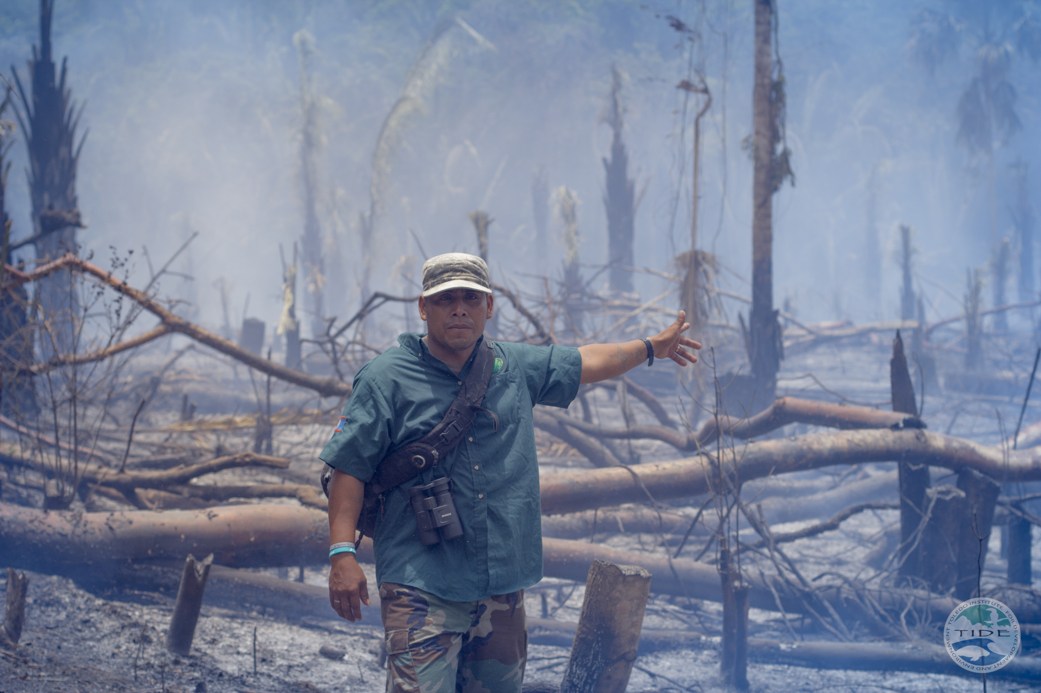
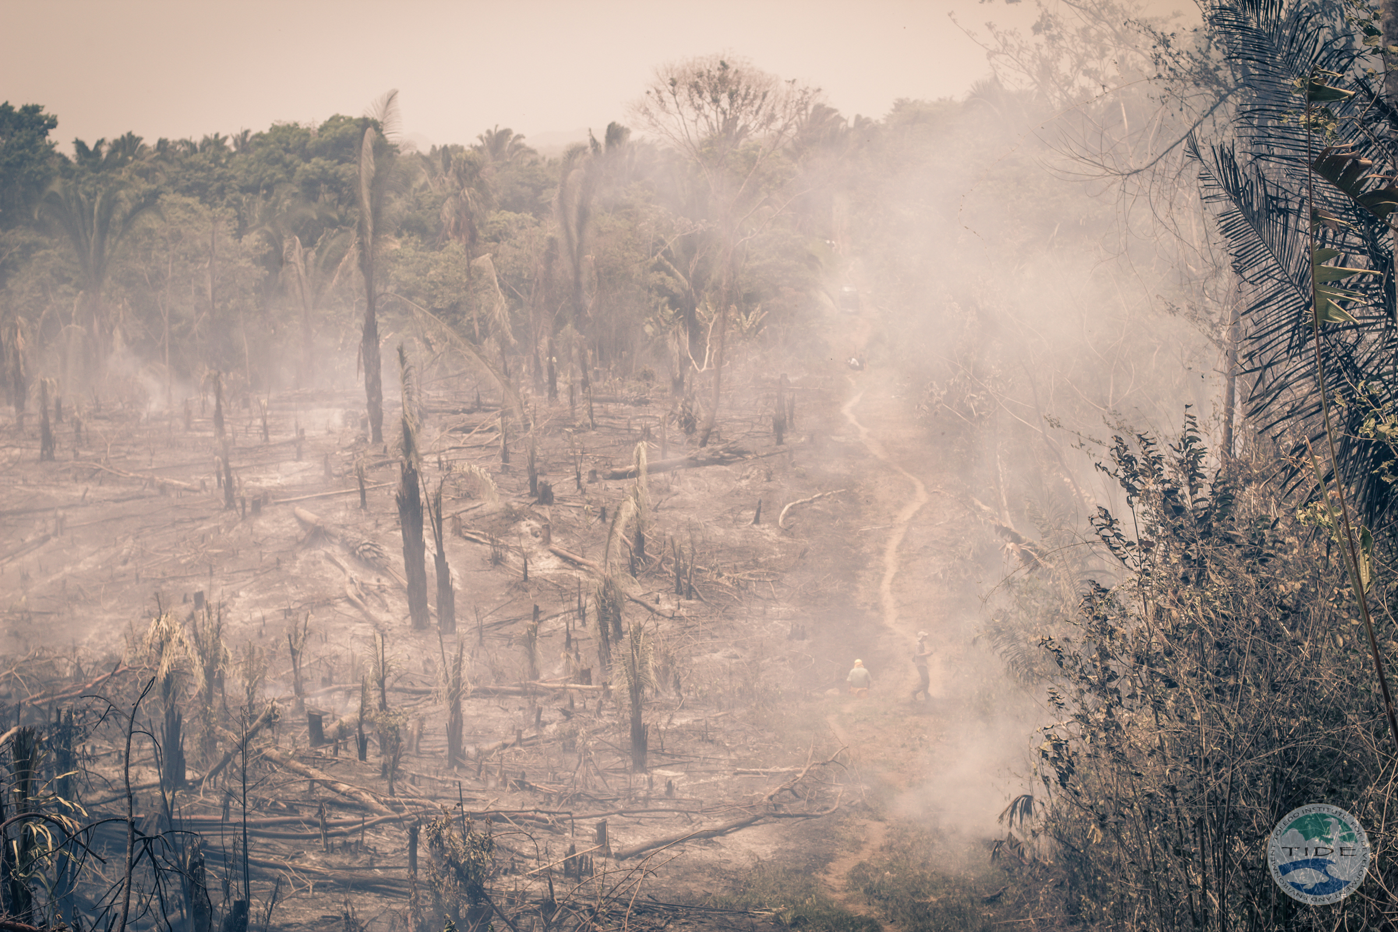
Agricultural Burn Training May 2013

Slide 18
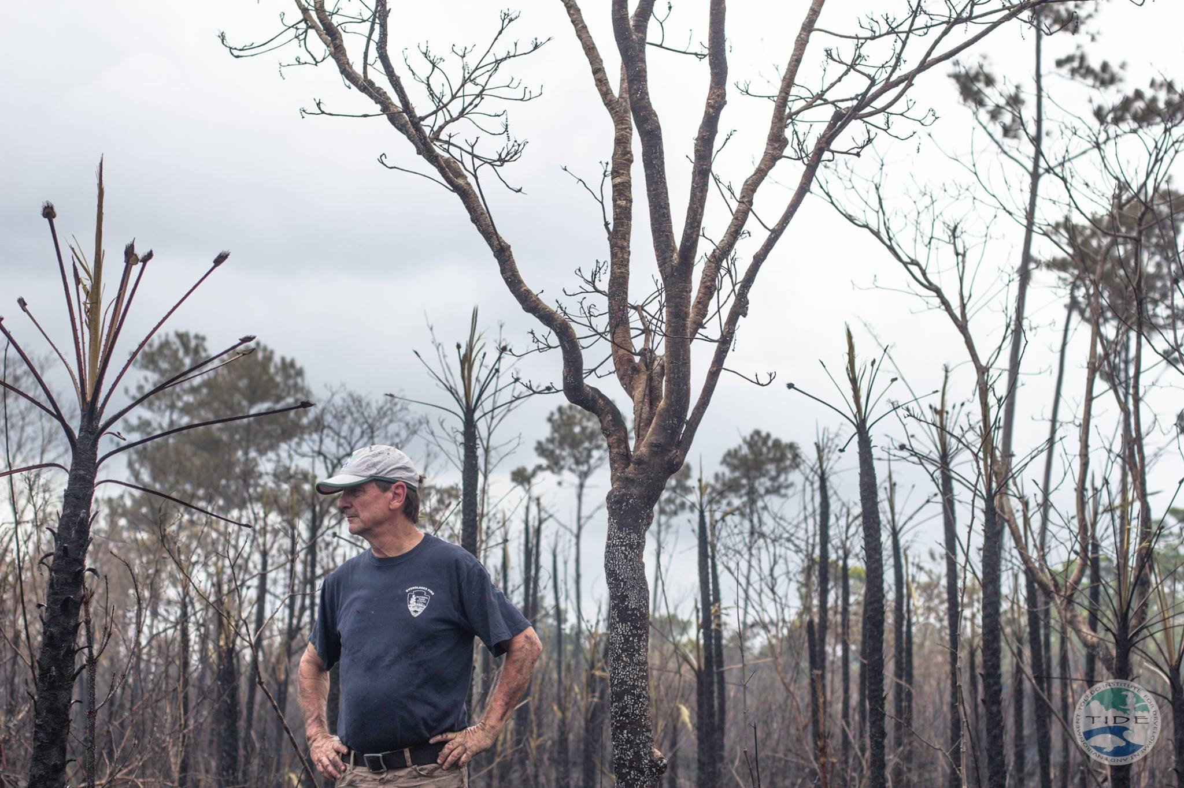
Specialist Advice: Everglades NPS

Slide 19
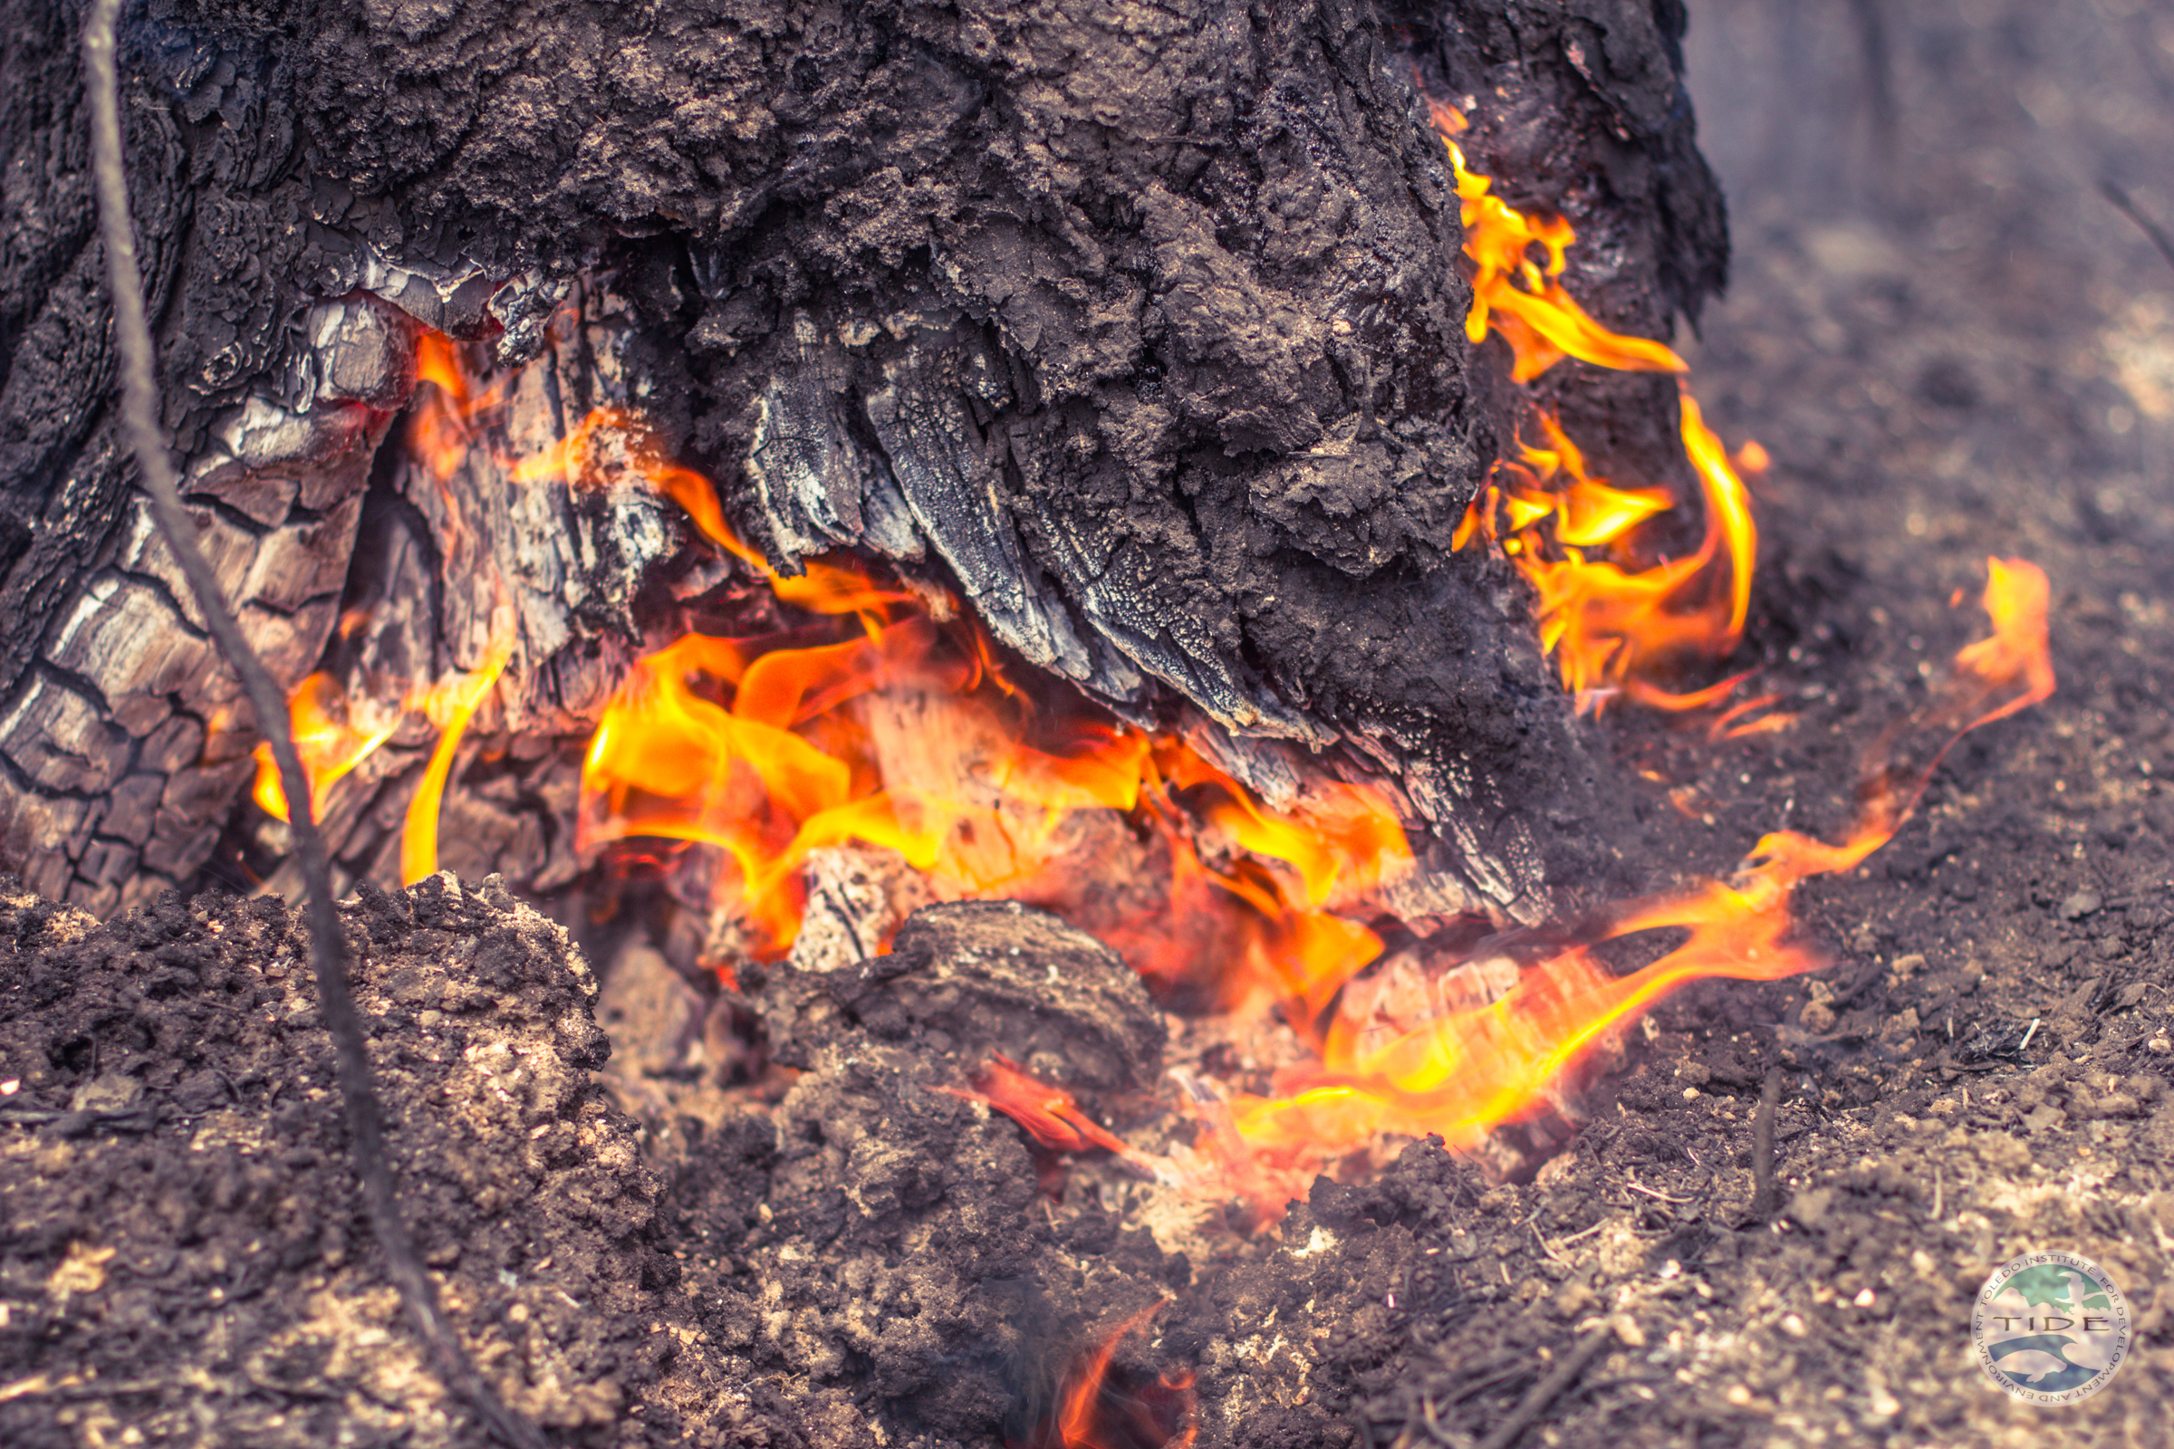
Less popta seeds this year!

Slide 21
Palmetto Palm

Slide 24
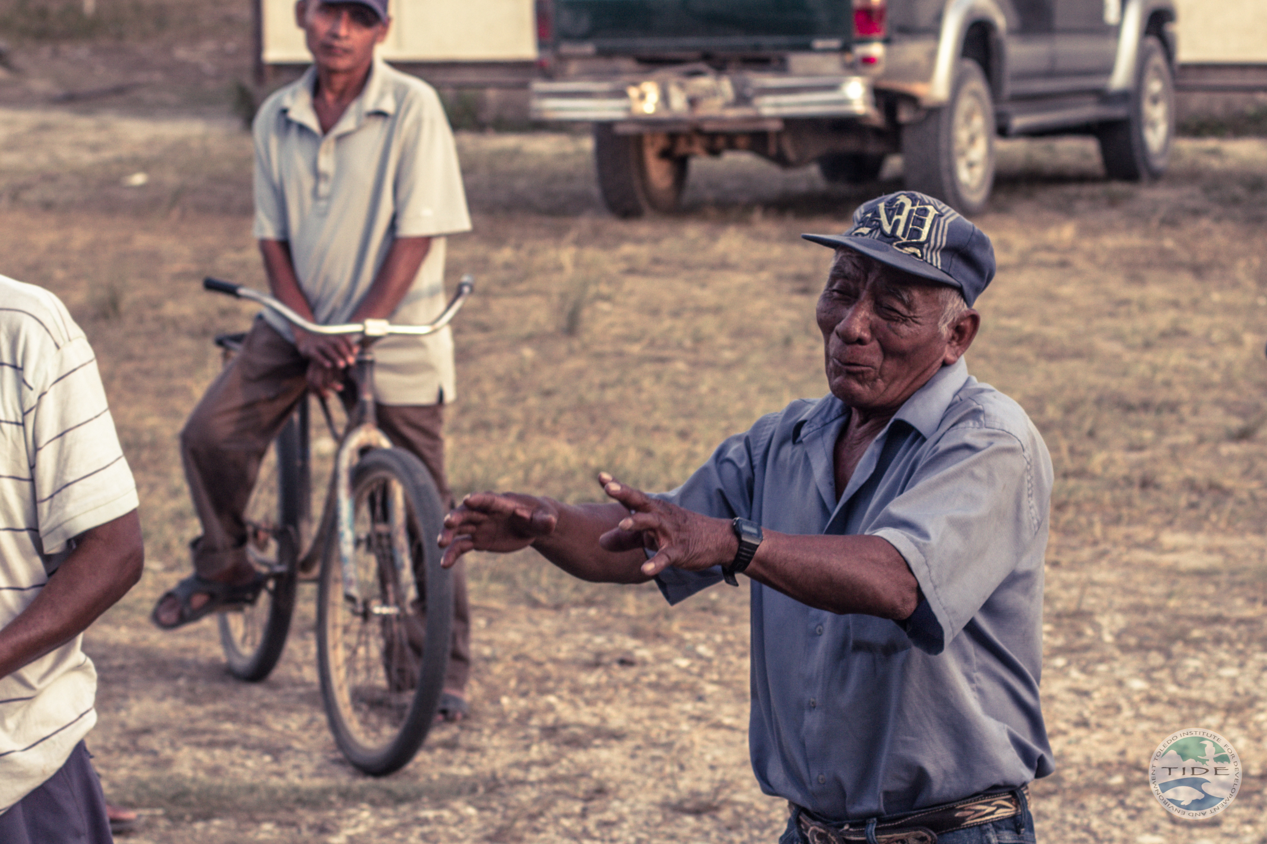
Community meeting in Trio

Slide 25
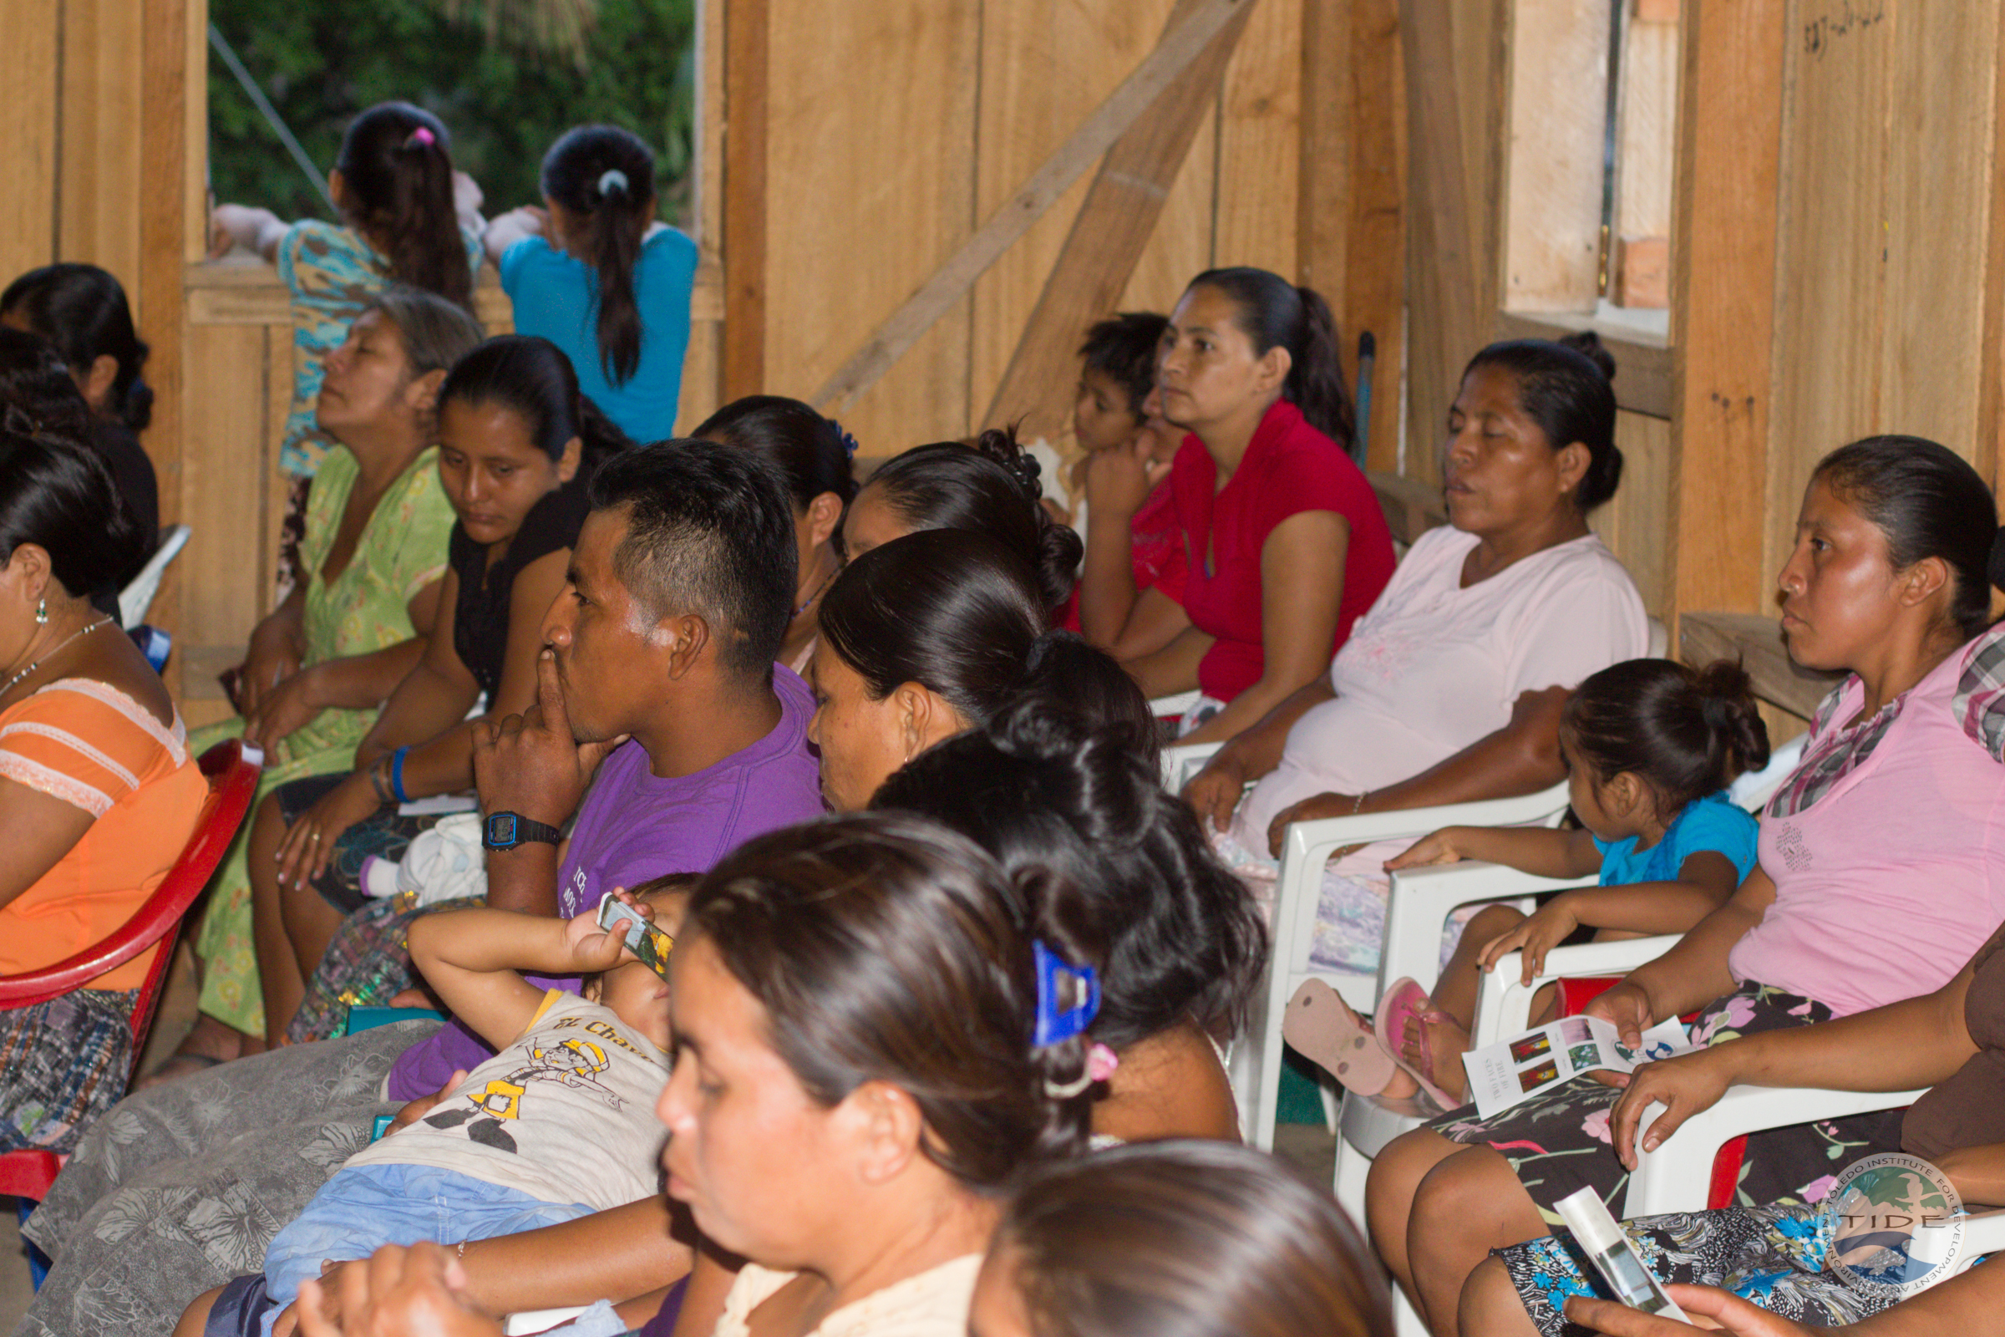
Community meeting in Bladen

Slide 26
‘Black lining’
Notes:
Black lining

Slide 27
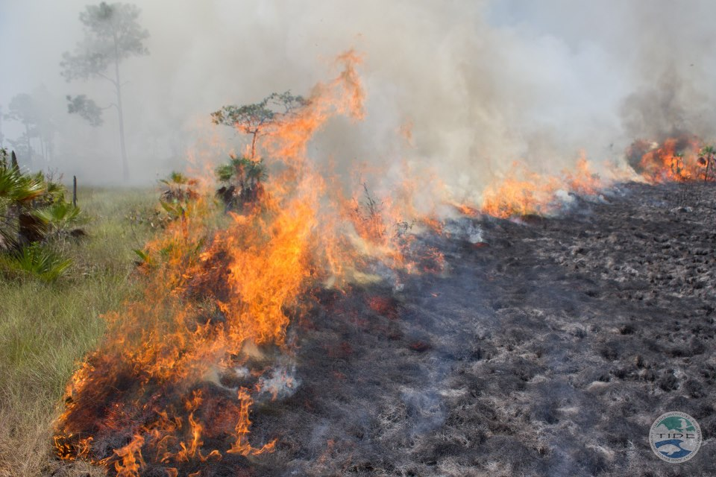
Prescribed burning
Notes:
Prescribed burning

Slide 28
Reflections
International donors seek evidence of a win-win between biodiversity conservation AND poverty reduction.
Fire management is of growing concern for savanna communities; intense, over frequent fire is a cause of biodiversity loss in savanna ecosystems.
Communities in Toledo are motivated to get involved in controlling wildfires.
What motivates communities to participate in fire management may be more than economic incentives.

Slide 29
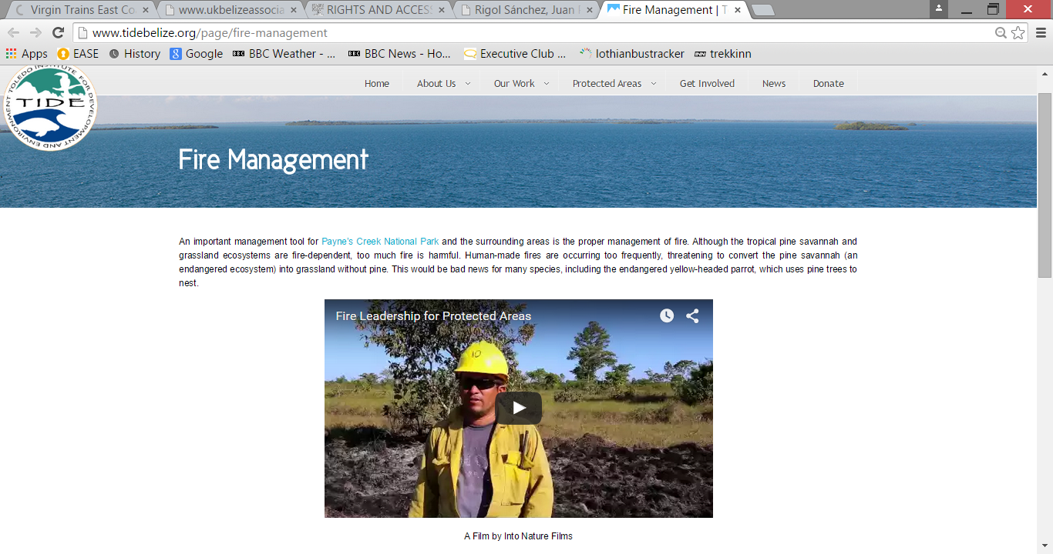
Notes:
http://www.tidebelize.org/page/fire-management

