Slide 1
Forest Ecology and Management in Northwest Belize
Nicholas Brokaw, Sheila E. Ward, Laura K. Snook

Slide 2
Research questions
How do the distributions and abundances of tree species and the distribution of forest types vary as a function of:
  Topography
  Soil
  Ancient Maya land use?
How is the tree species composition of the forest changing, and why?
How can we promote the regeneration of mahogany (Swietenia macrophylla) for sustainable harvest and forest conservation?

Slide 3
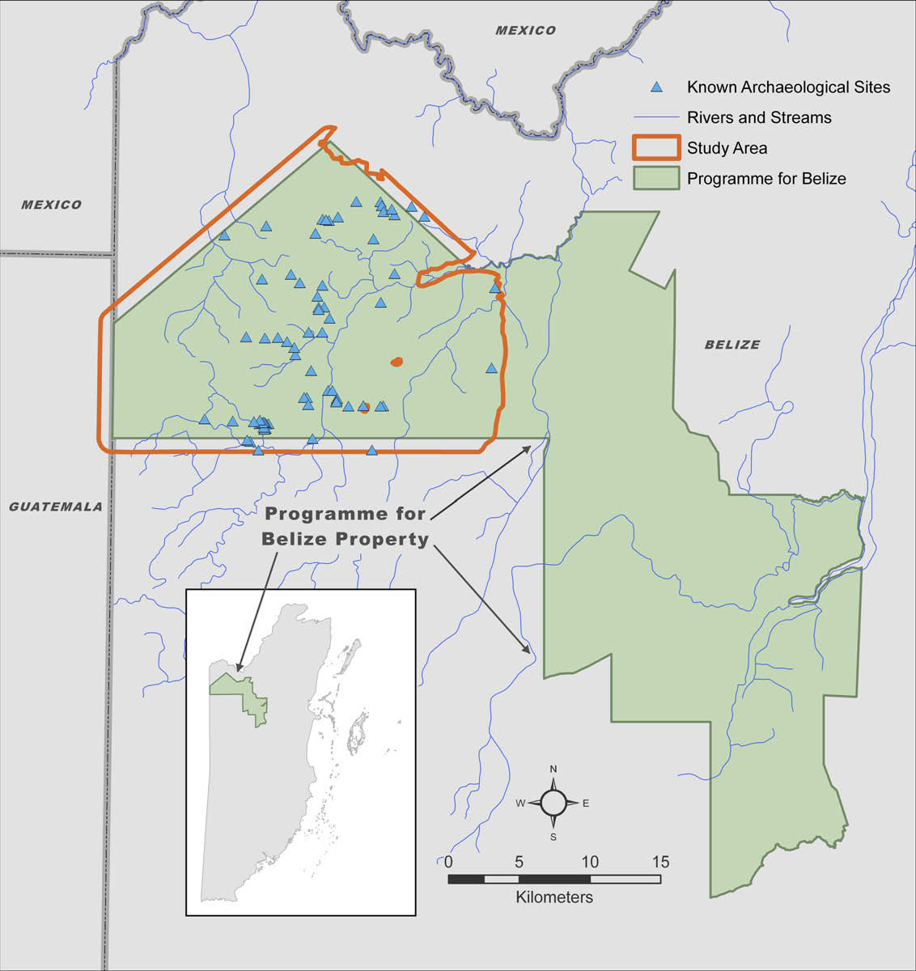
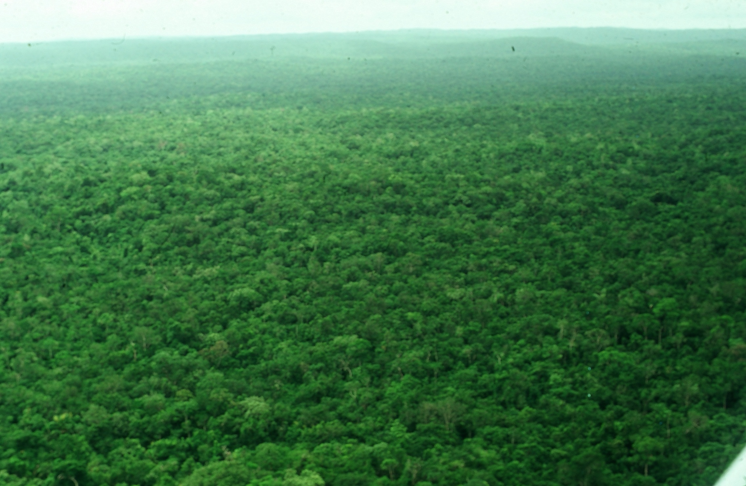
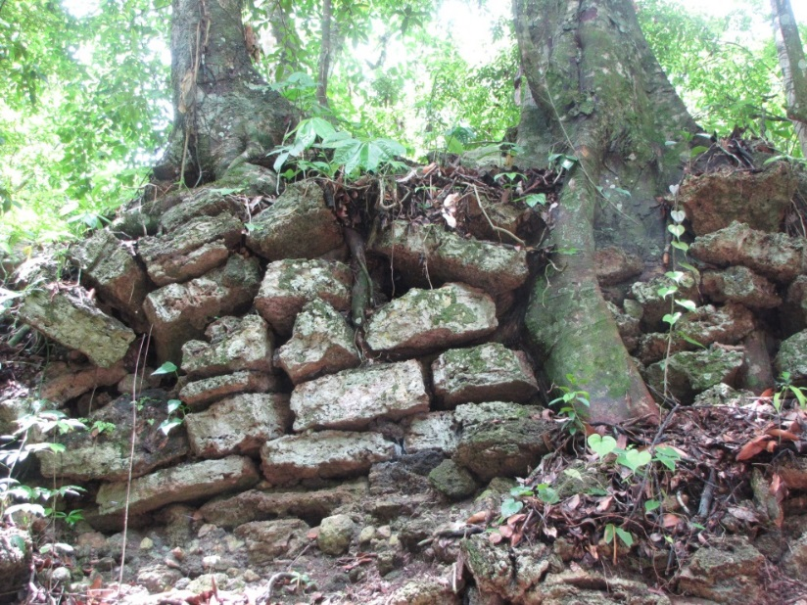
Rio Bravo Conservation and Management Area
Programme for Belize
100,000 ha, Old-growth forest on an ancient, intensely worked landscape
La Milpa
Hill Bank
(Vaughn & Crawford)
Notes:
3
RBCMA in northwest Belize near Guatemala and Mexico.
Work takes place in the La Milpa are and the Hill Bank area.

Slide 4
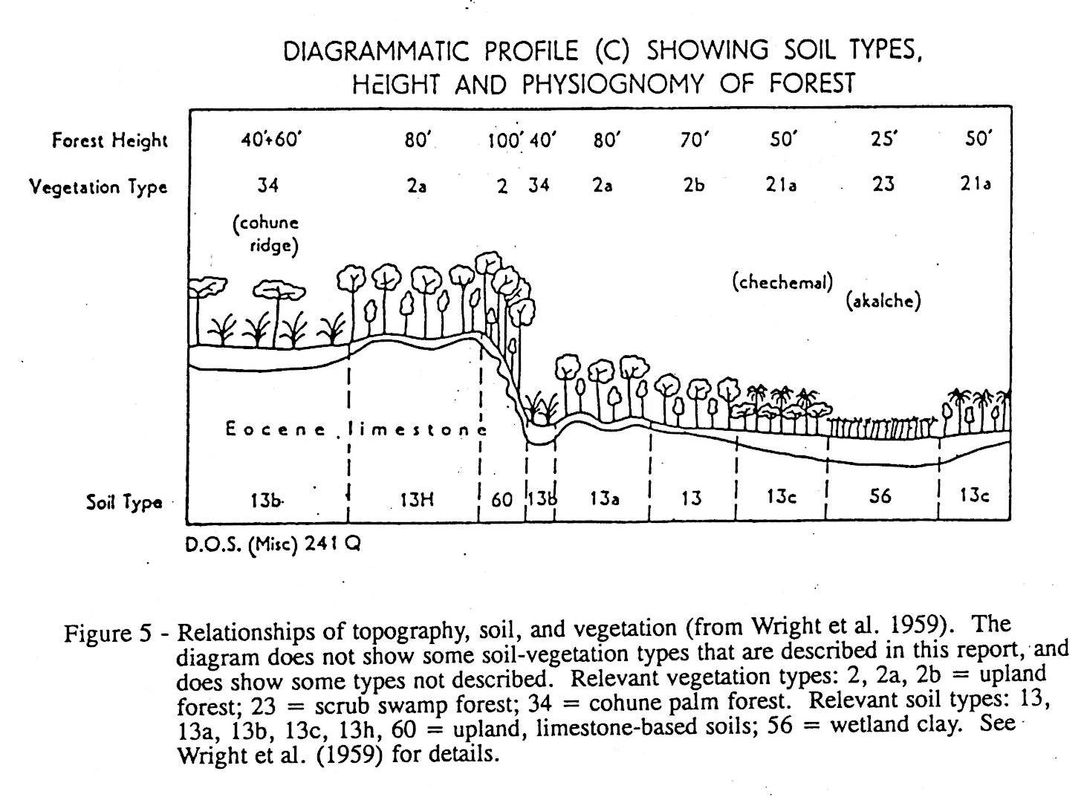
Topography-forest mosaic
(Charles Wright, et al. 1959. Land in British Honduras)
Notes:
Diagram from Charles Wright et al., Land in British Honduras (1959).
Shows topography, soil, and forest types in northwest Belize.
Forest types strongly related to topography and soil.
Our data and observations verify Wright’s model.

Slide 5
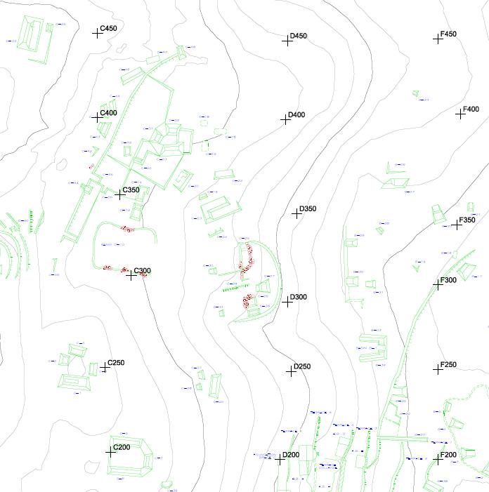
Our study of trees, environment, Maya features
209 sample plots
Trees
Soil and topography
Maya features
At Chawak But’u’ob (Walling) and the Dos Hombres – Gran Cacao Transect (Cortes-Rincon)
100 m
Chawak But’u’ob
Notes:
Plots 400 m^{2.}
All trees ≥ 10 cm dbh identified.
Topography coded.
Soil sample analyzed.
Ancient Maya remains mapped (but LIDAR will supersede this, see later).

Slide 6
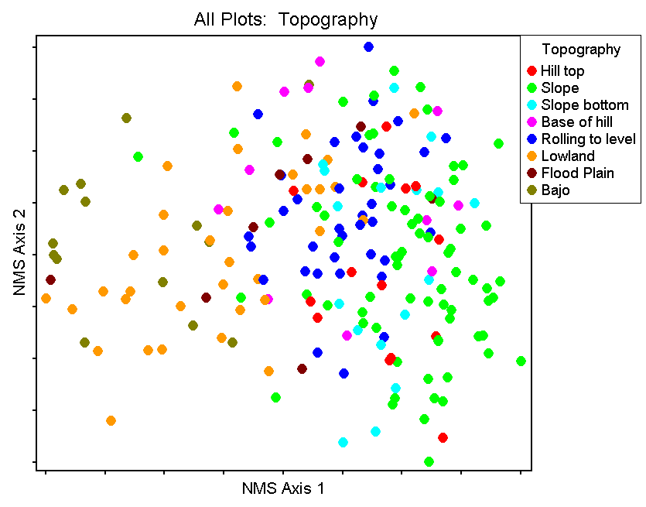
All plots: Soil variation coded by topography
Notes:
209 plots, arrayed by similarity of soil variables, coded by topography.
NMS shows how soil type varies with topography, e.g., slope (green) versus lowland (orange).

Slide 7
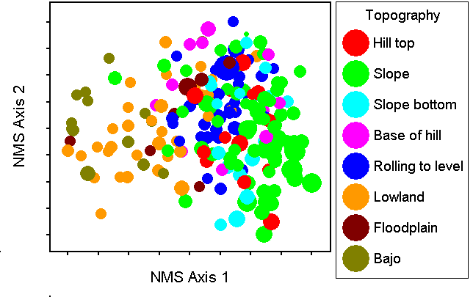
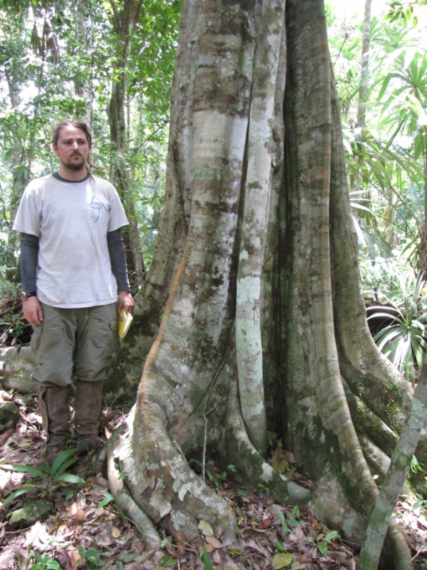
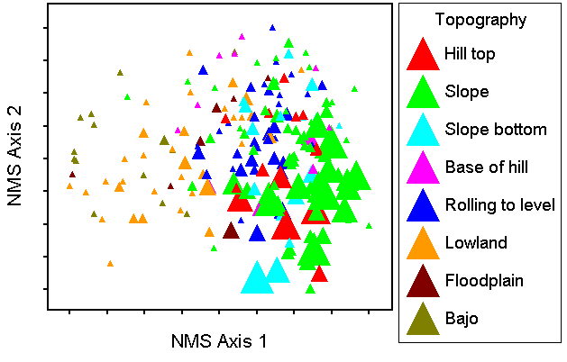
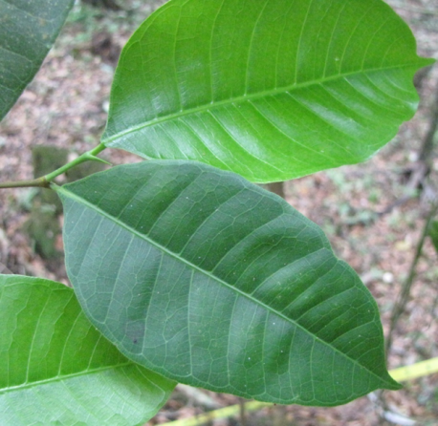
nitrogen
Brosimum alicastrum
Notes:
Example of an important species and its distribution relative to topography, and the soil content of N relative to topography.
Color codes as before.
Size of symbol indicates tree abundance, N content of soil samples.
Other species and soil parameters also show related patterns.
TOPOGRAPHY AND SOIL STRONGLY RELATED TO TREE SPECIES DISTRIBUION.

Slide 8
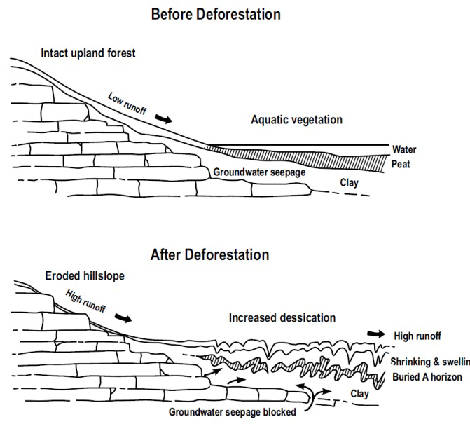
The Maya strongly and ubiquitously modified topography and soil.
Present spatial distributions of trees strongly relate to topography and soil.
Charles Wright et al. 1959
(Wright)
(Tim Beach et al.)
Notes:
Tim Beach model of catenas before and after ancient Maya.
Ancient Maya caused lots of erosion.
Maya had big effect on soils.
BECAUSE TREE SPECIES STRONGLY RELATED TO SOIL, MAYA THEREFORE HAVE HAD BIG EFFECT ON PRESENT TREE SPECIES DISTRIBUTIONS AND FOREST TYPES.

Slide 9
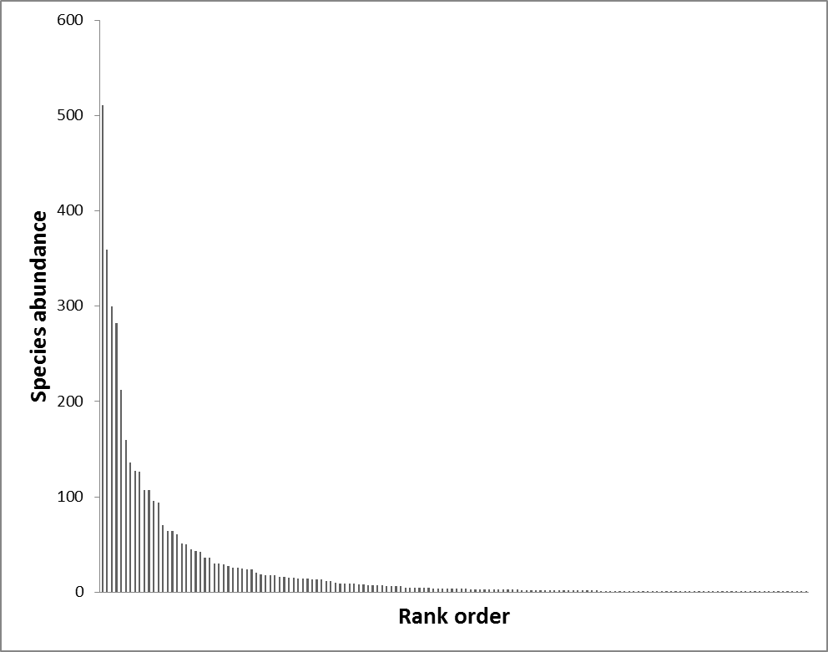
Impact of ancient Maya husbandry on modern forest? Provisional results: We estimate that about 30% of the tree species and stems in modern forest are evident in ancient remains at Tikal (similar forest).
trees ≥ 10 cm dbh (n = 3,969, ~150 species)
Number Individuals / species
Notes:
Nanci Ross’s work and Bronwen Whitney’s work show probable local effects of ancient Maya husbandry.
Looking for landscape-wide effects.
Community structure of trees in the 209 plots.
Typical curve of relative abundance.
On right, a long tail of species represented by few, or just one, stem.
Full analysis to come.
Preliminary estimate based on ancient remains of plants at Tikal: 30% tree species and 30% stem represented among ancient remains at Tikal. Lenz 2013 Schulze and Whitaker 1999
Ancient remains suggests use.
Long-term impact hard to estimate.
Use may have increased, decreased, or had no effect on present abundances.

Slide 10
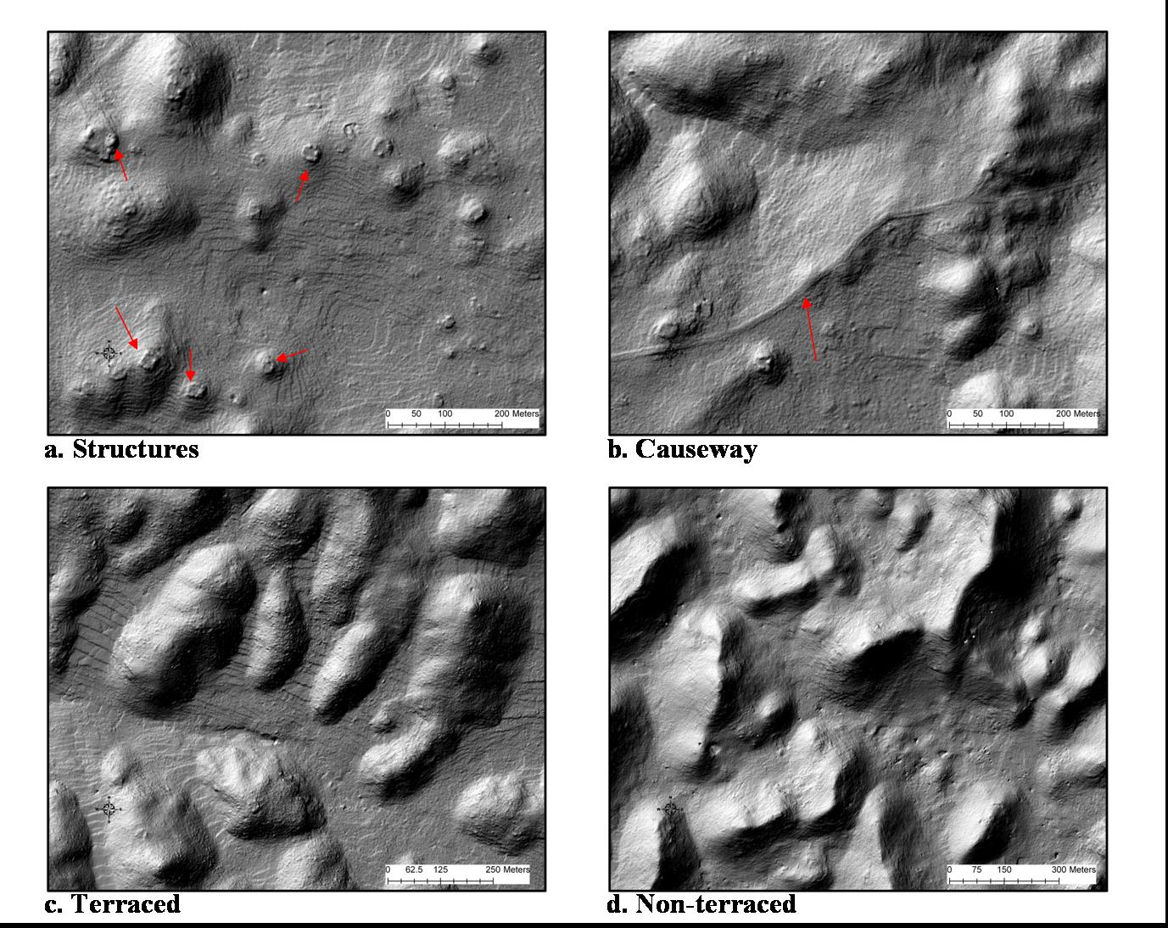
LIDAR imagery will help us see possible impact of husbandry
Managed landscape at Caracol
John Weishampel
Jessica
Hightower
Notes:
Can clearly see topography and ancient Maya structures.
Now have this for RBCMA.
Will be able to use with our tree data to relate to tree species distribution to topography and to density of Maya structure.

Slide 11
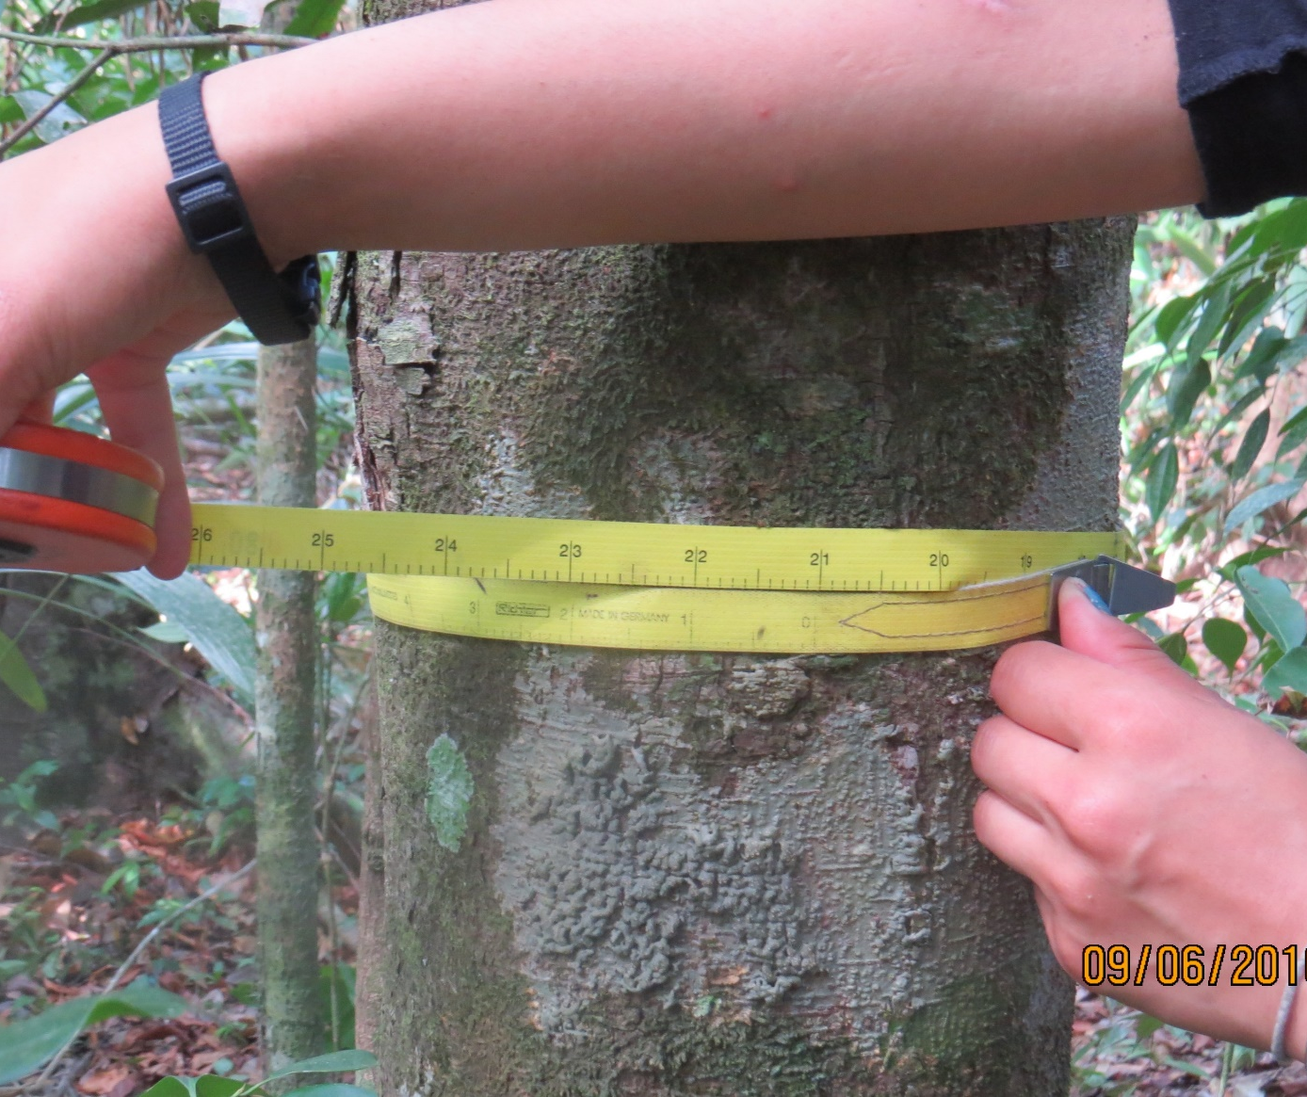
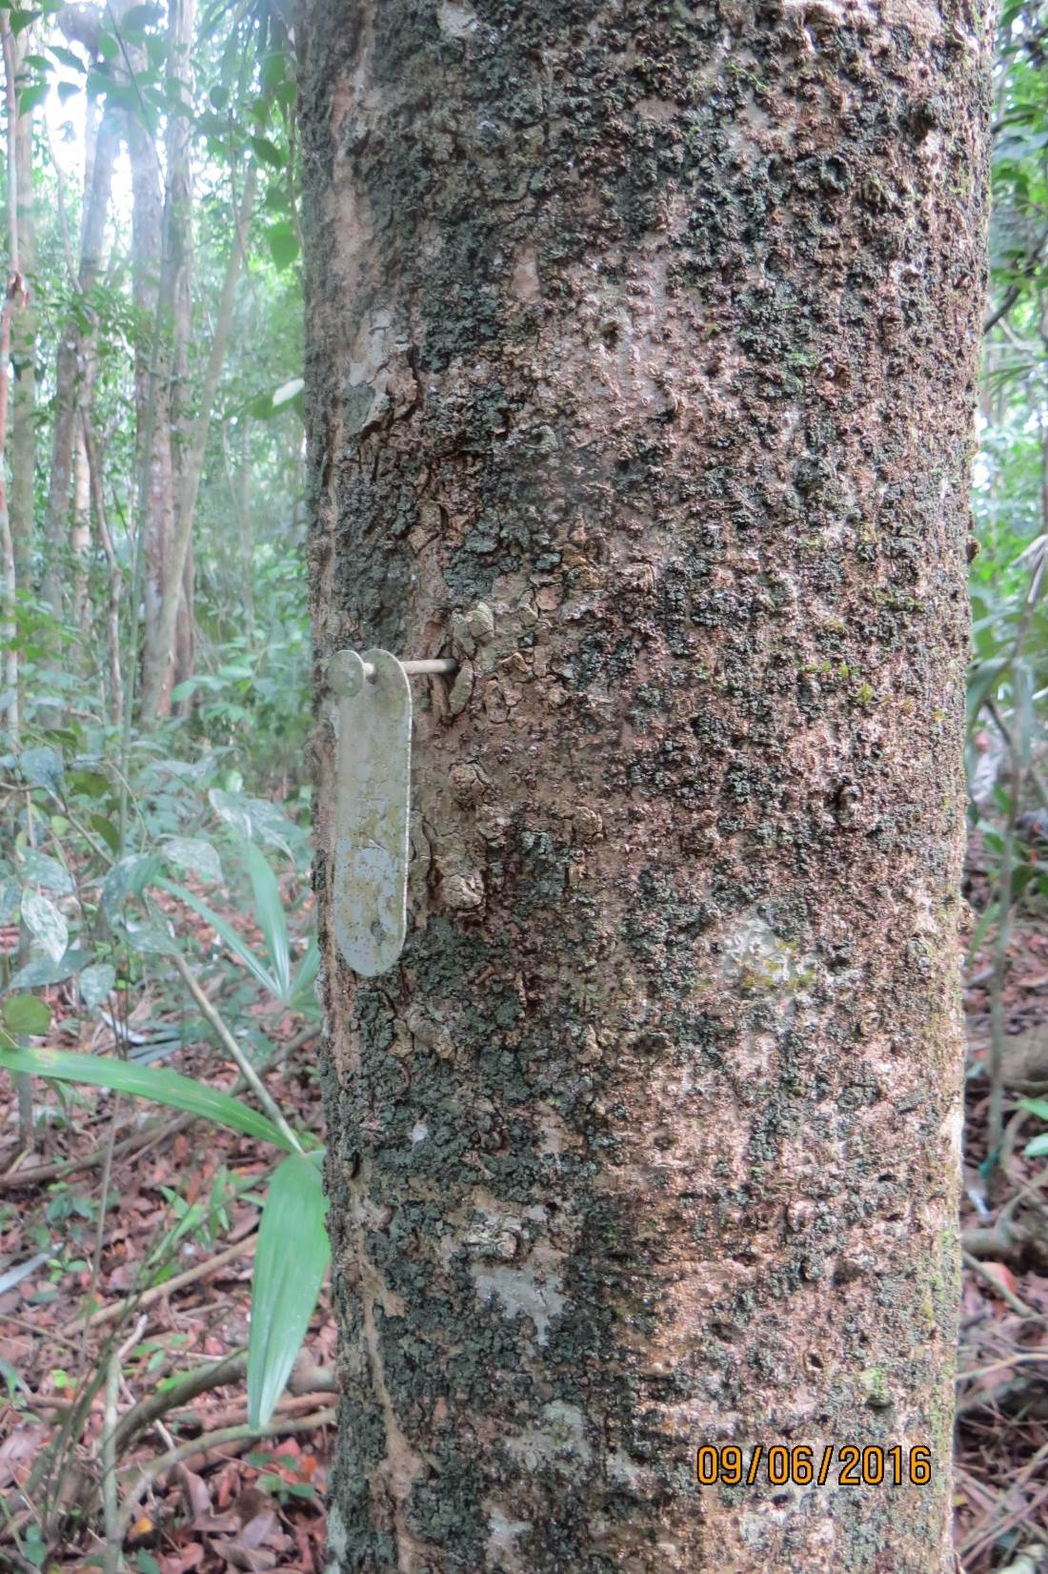
Long-term forest dymamics
1-ha inventory plots established in 1991 and recently re-inventoried
Four forest types
Mesic upland
Dry upland
Cohune
Riparian
All trees ≥ 10 cm diameter
Marked
Measured
Mapped
Identified to species
Preliminary results
Plots on deep, rich soil, including riparian are more dynamic: faster growth, higher mortality and recruitment, not just different species

Slide 12
Snook et al. research on mahogany at Hill Bank
Three studies to be remeasured starting in 2018, when they are approximately 20 years old. Previous remeasurement in 2003.
1) Survival and growth of mahogany from planted seedlings and sown seed on patch cuts of different sizes
Mahogany planted in 1996 and mahogany seed was sown in 1997.
8 replicates of each of 4 sizes of opening, 500 m² to 5000 m²
Smaller patch cuts opened in 1996 by clear felling.
The largest patch cuts (5000 m², ½ ha) cleared in part by felling and in part by bulldozing, with a planted/sown plot on each type of clearing.
In 1998, the mahogany seedlings on half of the blocks were cleaned.

Slide 13
Research on mahogany at Hill Bank, 2
2) Post-logging silvicultural treatments downwind of 20 mahogany seed trees (established 1998)
4 different methods of opening quarter circles of 60 m radius downwind of mahogany seed trees
5 replicates of each treatment (bulldozer clearing, complete felling, girdling of standing trees, and clearing the underbrush)
Mahogany seedlings planted
Monitoring of natural regeneration
3) Survival and growth of mahogany in 60 post-logging gaps of different initial sizes
Mahogany seedlings planted 1998
Mahogany seeds sown 1999

Slide 14
Summary
Tree species and forest types relate to topography and soil
Long-term forest dynamics varies among forest types
Strong impact of ancient Maya on topography and soil and thus on forest types and dynamics
(impact of ancient Maya husbandry being studied)
Mahogany grows better in larger gaps (2003 results).

Slide 15
Final Points
ecologynwbelize.org
Includes field guide to trees of La Milpa area
International Society of Tropical Foresters (ISTF) being reactivated
Contact: sheila.emily.ward@gmail.com
Orphaned tropical forest data
Contact: sheila.Emily.ward@gmail.com

