Slide 1
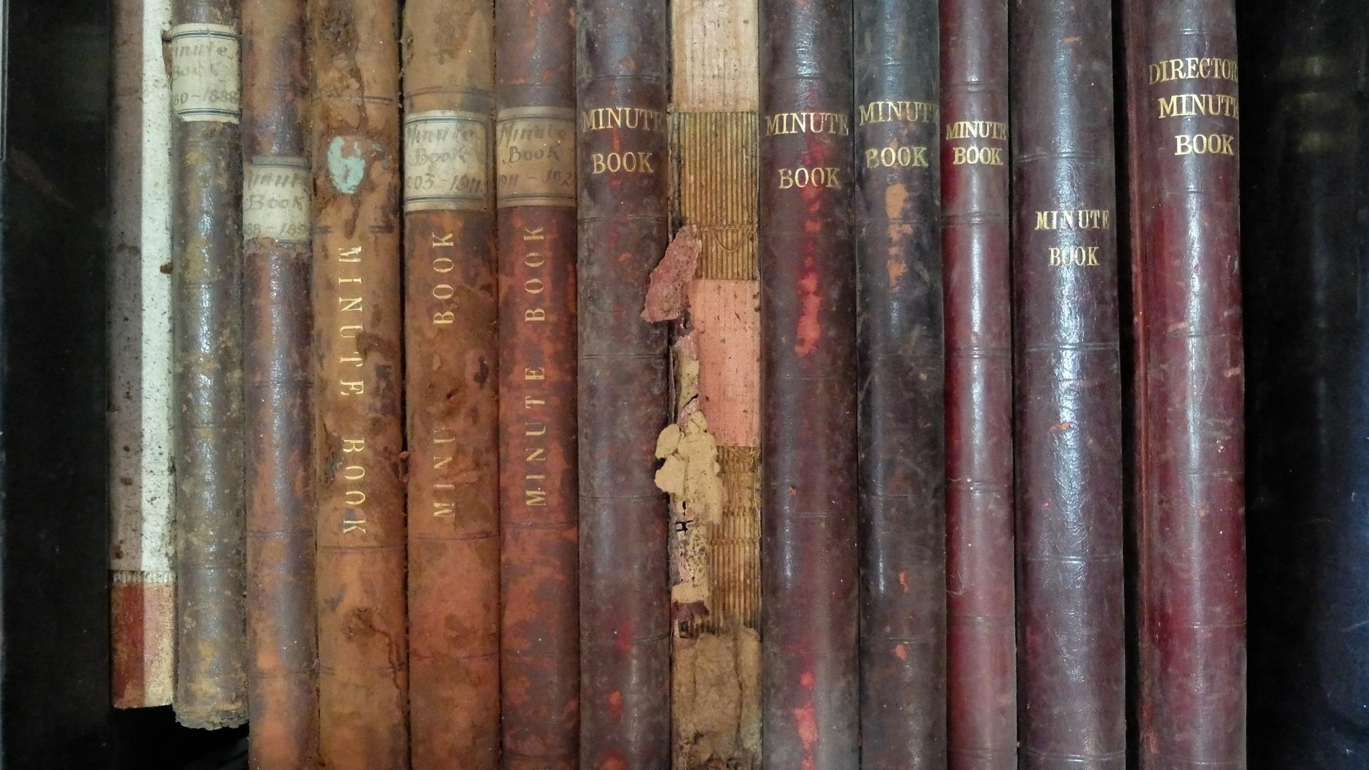
Accessing Belizean History
Cathy Smith, University of Edinburgh
cathysmith1166@gmail.com

Slide 2
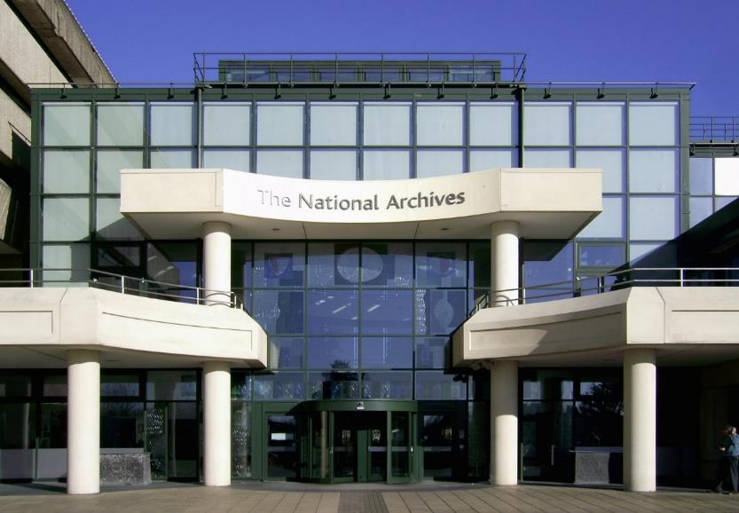
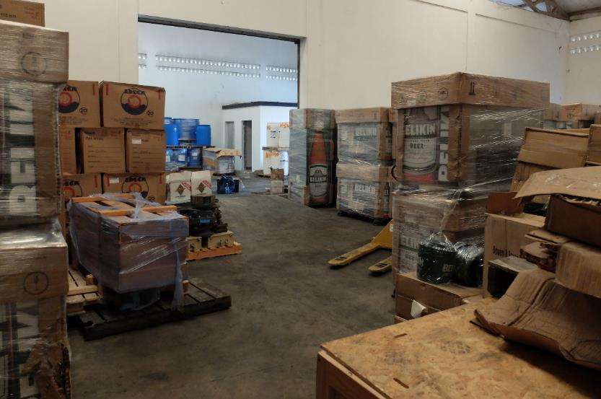
My archival fieldwork
The Belize National Archives, Belmopan
Colonial Office records at the UK National Archives, London (Picture right, top)
The Kew Gardens archive, London
Special collections, Weston Library, Oxford
Royal Geographical Society Archives, London
Wesleyan Methodist missionary society archive, SOAS, London
Royal Commonwealth Society archives, Cambridge University Library
Belize National Heritage library, Belmopan
Belize Estate and Produce Company records, held at the Belikin factory in Ladyville, Belize, (Picture right, bottom)
Belize Forest Department records at Belmopan office, Mountain Pine Ridge and Machaca Forest Stations
E-books, online newspaper collections

Slide 3
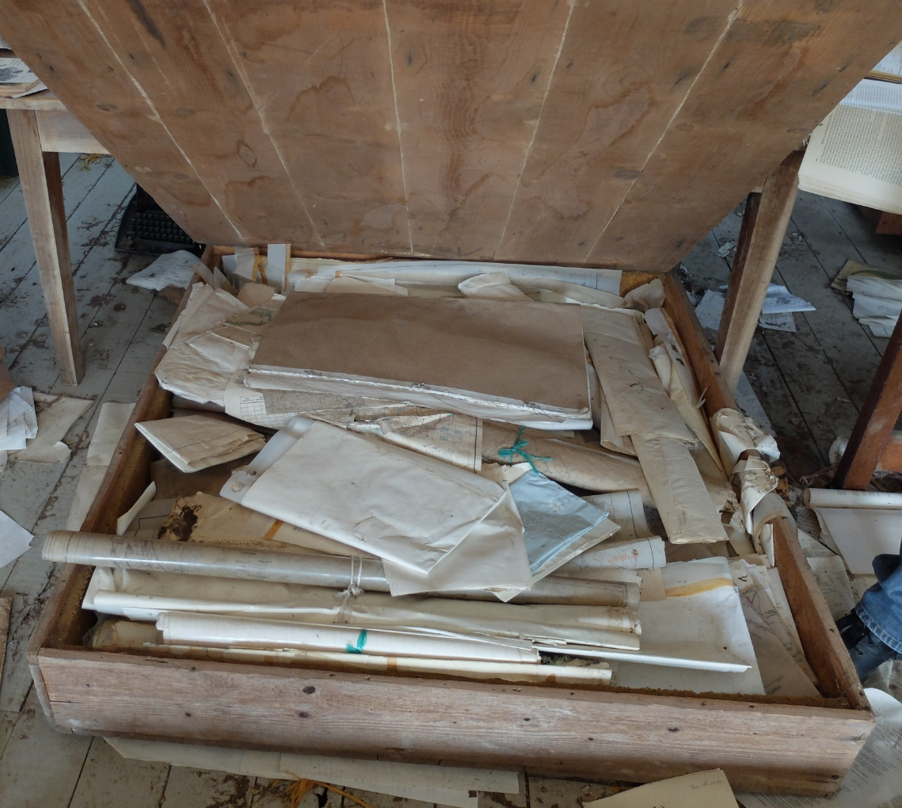
Dimensions to ‘’accessing’’ history
Record creation
Record preservation and archivisation
Record interpretation
Maps at Augustine Forest Station, Mountain Pine Ridge

Slide 4
1. Record creation
‘I used to make my reports, monthly reports, and whenever I make out my report I get it type up and I send it to Melinda, there we have our—that used to be our headquarters.’
Retired Forest Ranger,
interviewed 16/06/2017, Independence
‘I think it is something that you know, the Belizean people, if they want a job, they need to keep a record’
Ex-Forest Guard,
interviewed 15/06/2017, San Pedro Columbia
Aerial photographs at Augustine Forest Station, Mountain Pine Ridge

Slide 5
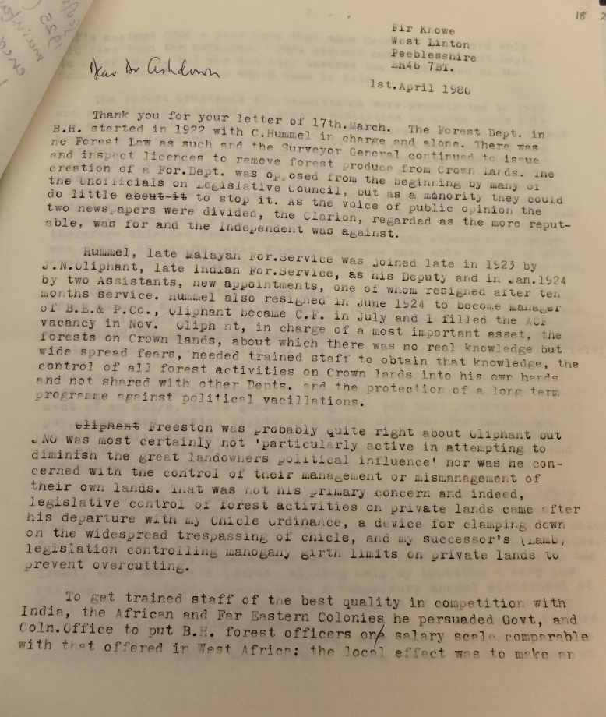
2. Record archivisation: Intent
‘Organized in folio forms, title pages provided long lists of cross-referenced dossiers and decisions that were abbreviated genealogies of what constituted relevance, precedent, and "reasons of state.“
Stoler, 2002
‘Archives then are not some pristine storehouse of historical documentation that has piled up, but a reflection of and often justification for the society that creates them.’
Schwartz and Cook, 2002
‘We have a place that we call Melinda and after I retire you know everything that they didn’t want in there, turn up everything, give away the books them. I checked back there last few months ago because I find it open. Nothing in there.’
Retired Forest Guard, interviewed 16/06/2017, Independence
Neil Stevenson writing to Peter Ashdown
Oxford Weston Library, MSS.W.Ind.s.56
Stoler, A. L. (2002). Colonial Archives and the Arts of Governance. Archival Science, 2, 87–109.
Cobain, I. (2016). The History Thieves: secrets, lies and the shaping of a modern nation. Portobello Books.
Schwartz, J. M., & Cook, T. (2002). Archives, Records, and Power: The Making of Modern Memory. Archival Science, 2, 1–19.

Slide 6
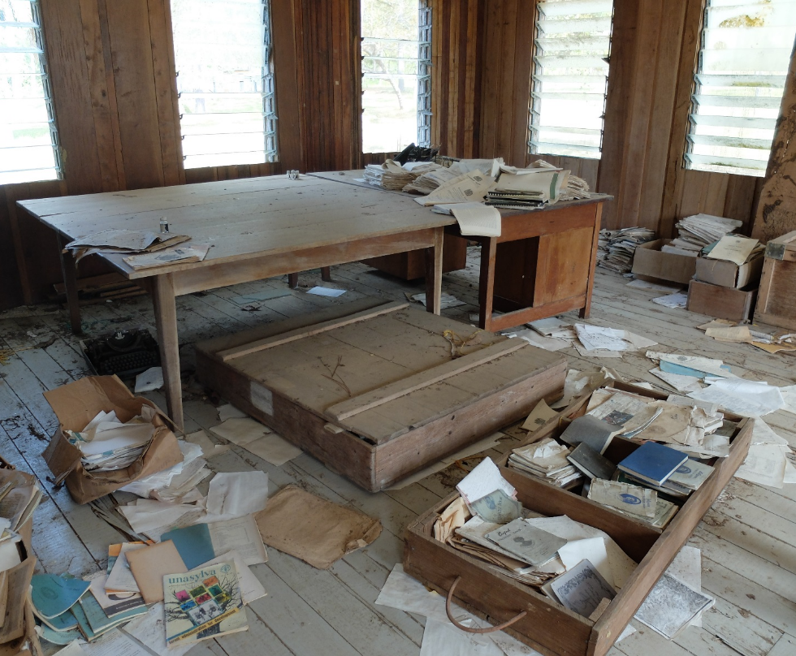
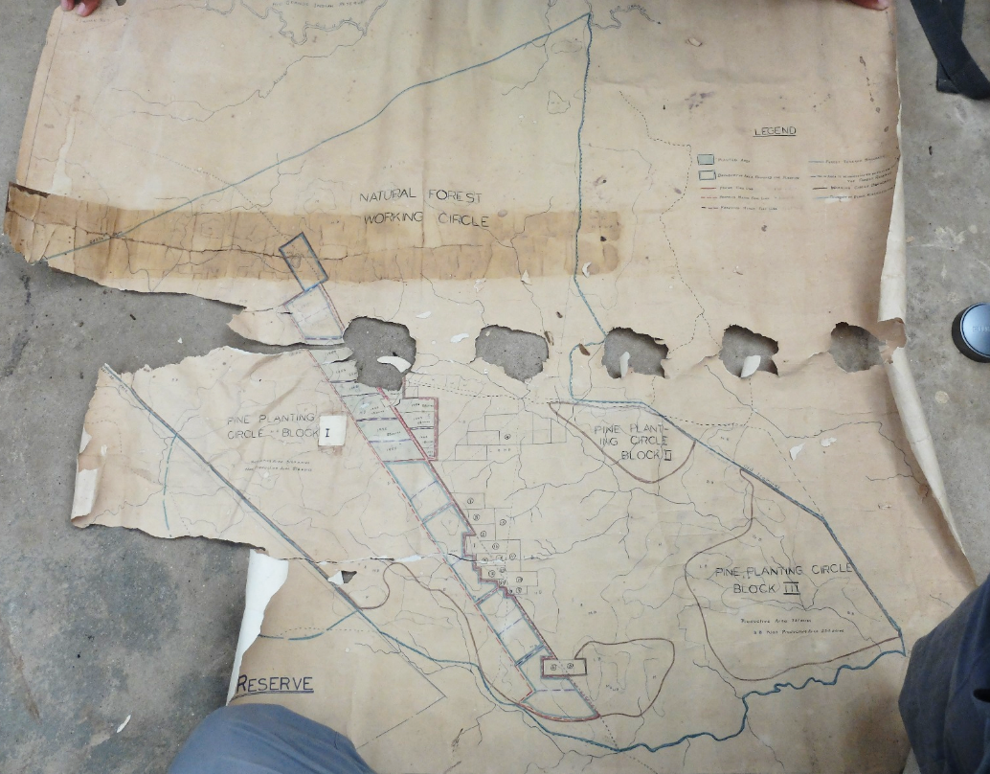
2. Record archivisation: Physical preservation
Old Forest Office, Augustine Forest Station, Mountain Pine Ridge
Map at Machaca Forest Station

Slide 7
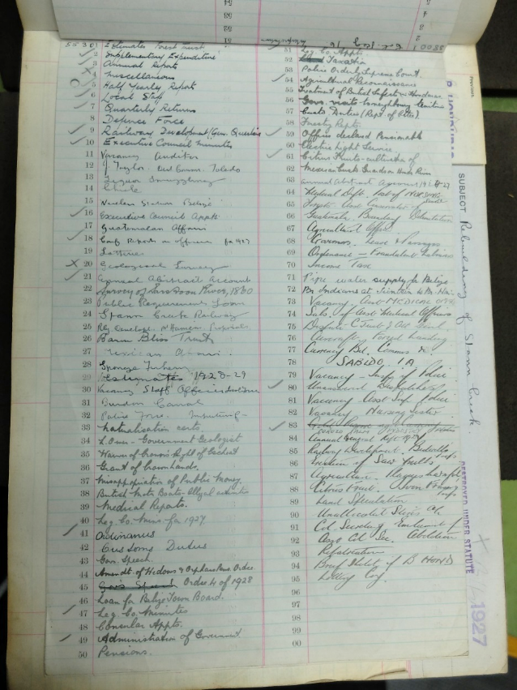
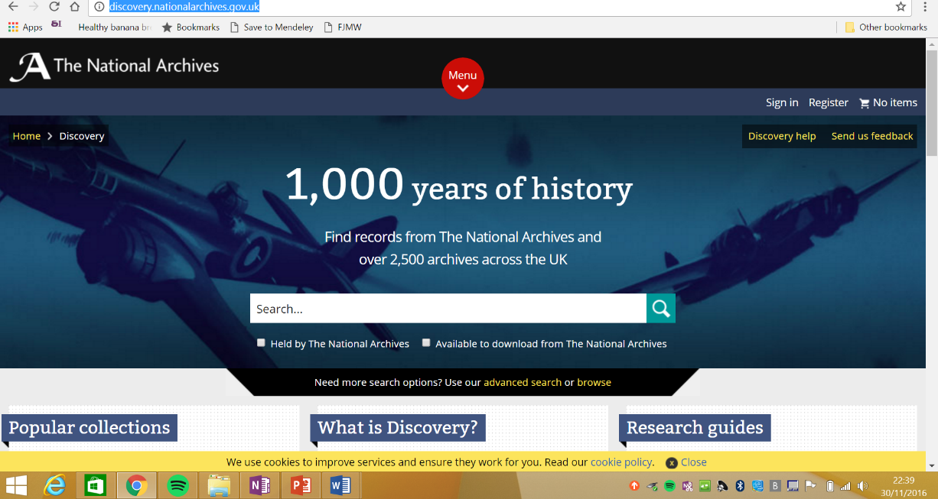
2. Record archivisation: Cataloguing
‘’Discovery’’, the online catalogue of the UK National Archives
Register of correspondence in the UK National Archives

Slide 8
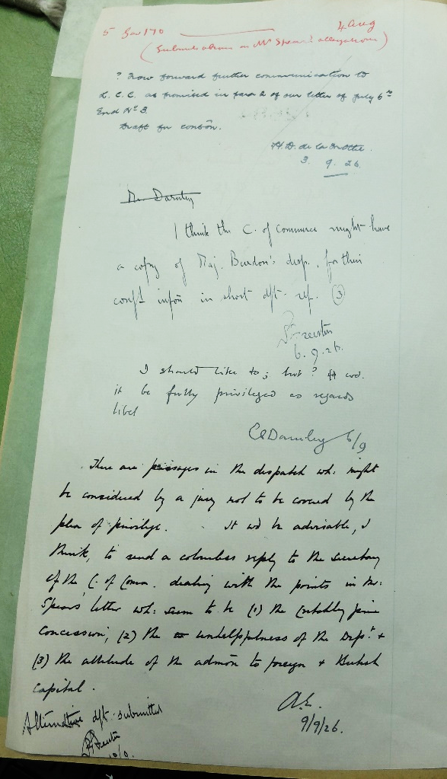
3. Record interpretation
‘Colonial governors and missionaries, settlers and technocrats, cast their gaze across the globe, but the question remains: to what extent were their visions clear or powerful enough to remake it?‘
Cooper and Stoler, 1989
‘We have developed the annual land use plans, national land use plans, and we have developed a lotta plans, good plans and they are just sitting on shelves.’
NGO staff member, interviewed 24/02/2017,
Payne’s Creek National Park
Cooper, F., & Stoler, A. L. (1989). Introduction. Tensions of Empire : Colonial Control and Visions of Rule. American Ethnologist, 16(4), 609–621.
Banton, M. (2008). Administering the Empire, 1801-1968: A Guide to the Records of the Colonial Office in the National Archives of the UK. University of London, Institute of Historical Research.
Minute sheet, UK National Archives

Slide 9
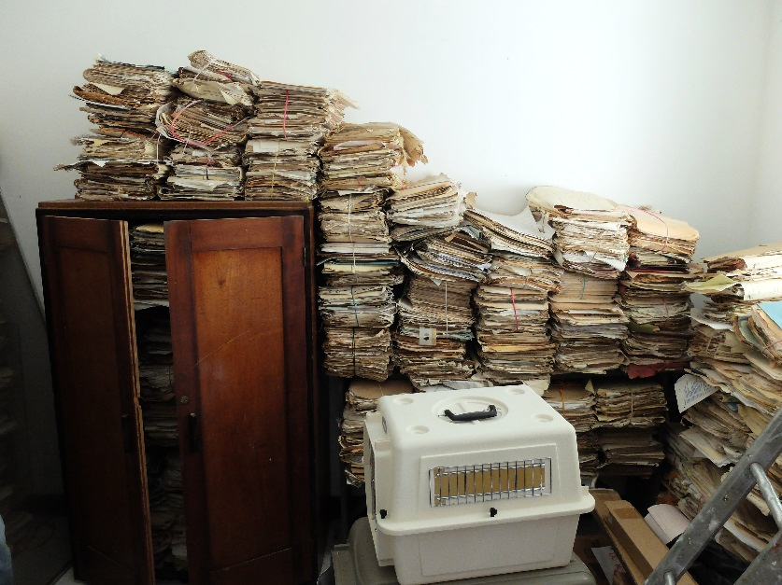
Discrepancies of access: Who can write Belizean history?
Physical access
Interpretive access
Interest
Unsorted records at Augustine Forest Station, Mountain Pine Ridge

Slide 10
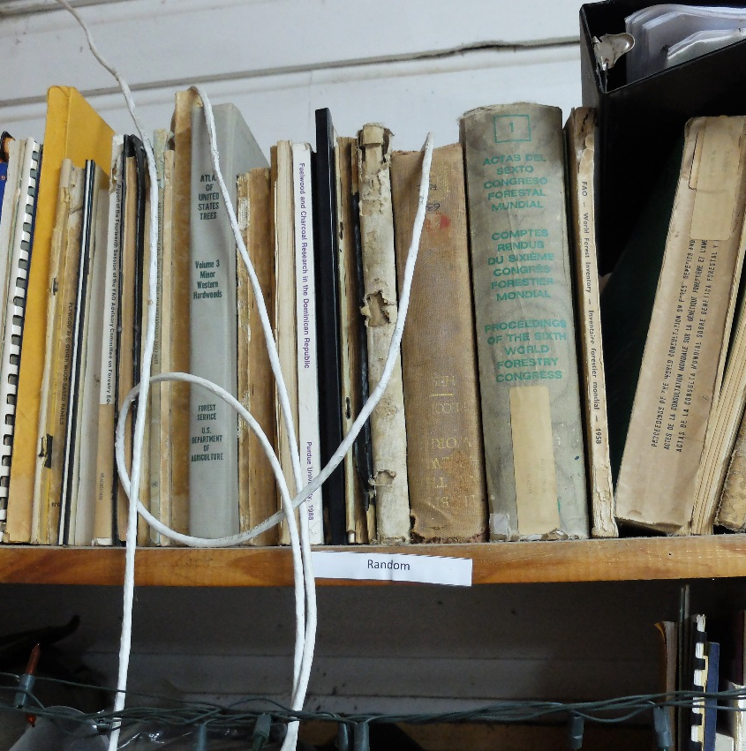
Why/ Does this matter?
Important to understand positionality and privilege when writing history?
Let the dead bury their dead?
‘Random’ items at the Forest Department’s Belmopan office

Slide 11
Thanks for listening!
Many thanks to the staff at the archives and government departments who have helped me to access these records!
Many thanks also to Neil Stuart, Janet Fisher and Charlie Withers at the University of Edinburgh
Cathy Smith, University of Edinburgh
cathysmith1166@gmail.com

