Slide 1
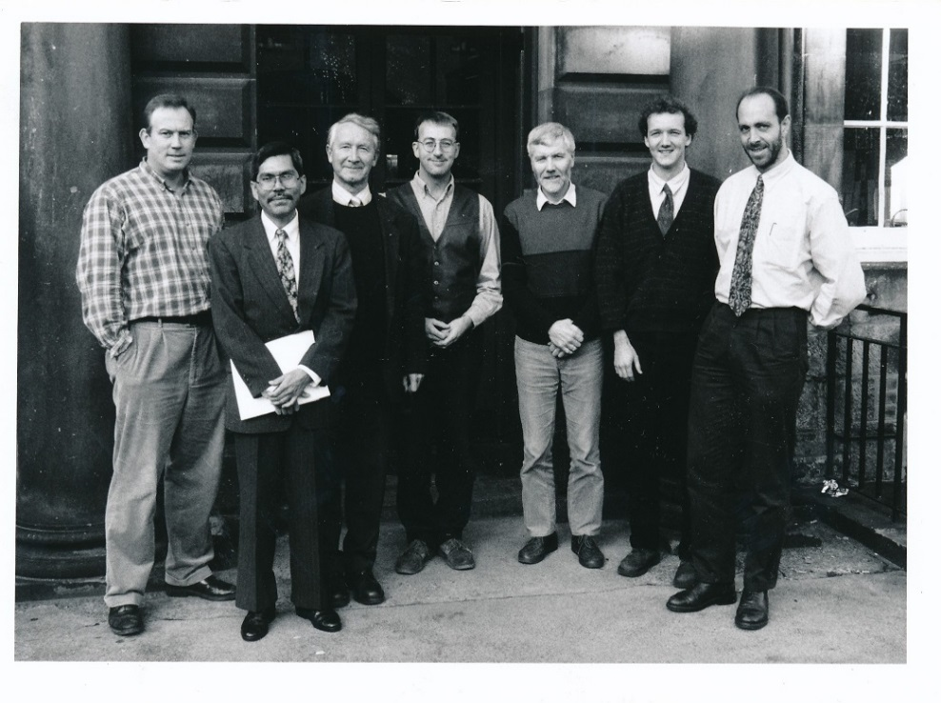
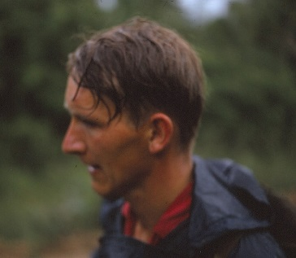
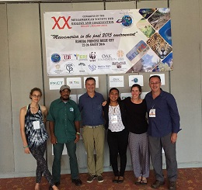
Edinburgh University: Celebrating 50 years of research in Belize
UK-Belize Association 19th Annual meeting. 1st October 2016. Institute of Geography, University of Edinburgh

