Slide 1
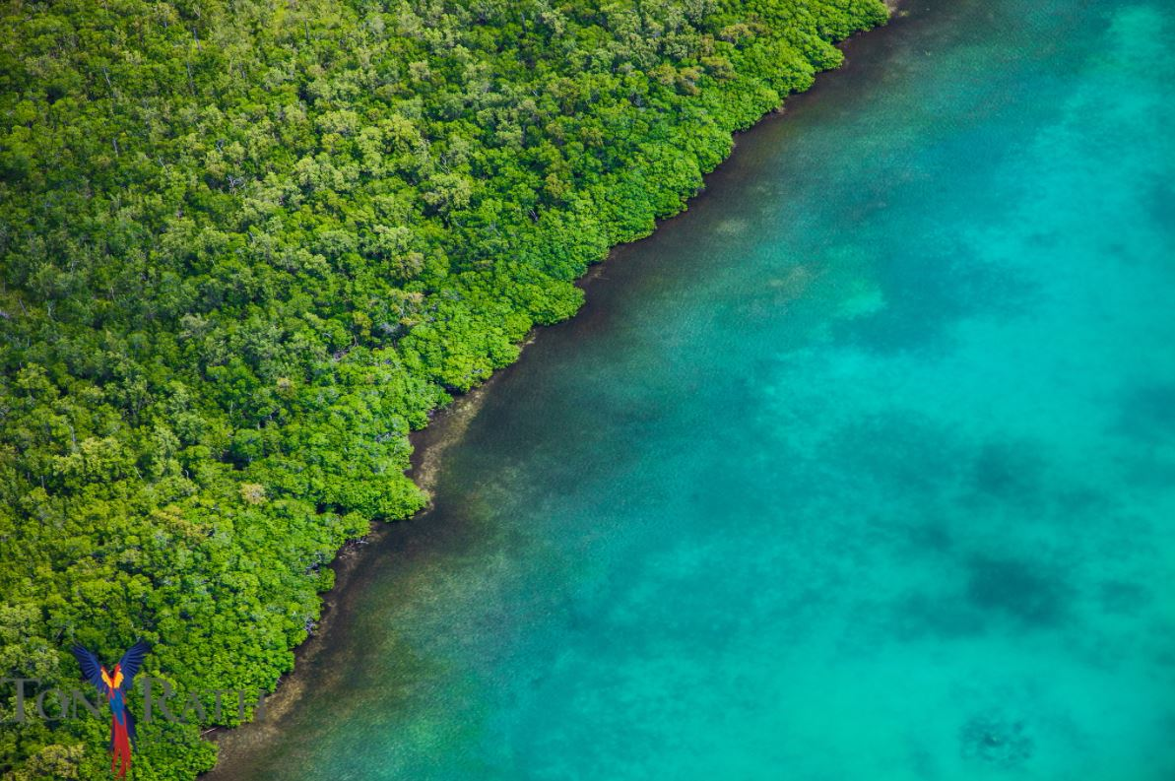
Economy and Biodiversity in Belize
25th Annual Meeting
2nd December 2022 University of Oxford and online

Slide 2
Our Mission
“Provide a focus for research and interaction between people from the UK working in Belize and for Belizeans at home and in Europe”

Slide 3
What we do
create opportunities for Belizeans and Britons to work together
act as a network for those working in Belize to share news of their projects with others - from any field of interest
help Belizeans living in the UK and Britons working in Belize to keep up to date on news and current events from Belize
organise an annual meeting and work with our partners throughout the year to promote Belize as a location for research, education, eco-tourism, capacity building and human resource development.

Slide 4
So, who’s in the UKBA?
Authors
Educators
Expedition groups
Film Producers and Broadcasters
Government Officials and Diplomats
Musicians
NGOs working in Belize
Researchers working in Belize in ANY discipline
School children and students
You .. and your network?

Slide 5
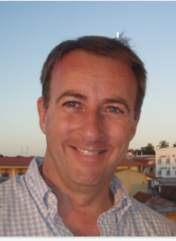
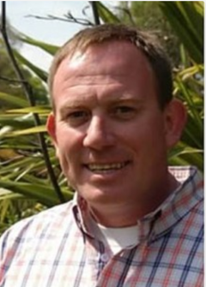
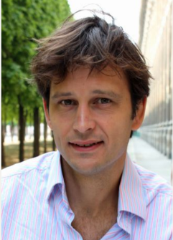
Who we are
Dr Neil Stuart University of Edinburgh
Dr David Howard University of Oxford
Mr Chris Minty MBE

Slide 6
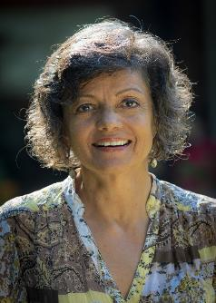
Who we are
Her Excellency Therese Rath High Commissioner to the UK
Dr Elma Kay – Director, Belize Maya Forest Trust
Barbara Bulmer Thomas

Slide 7
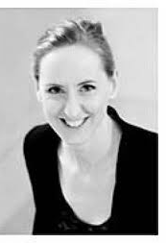
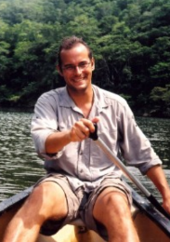
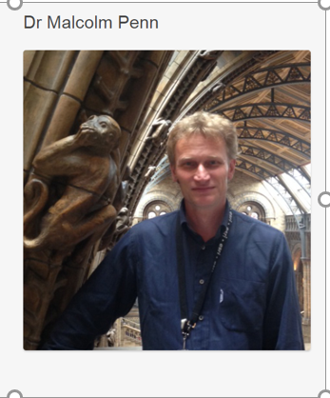
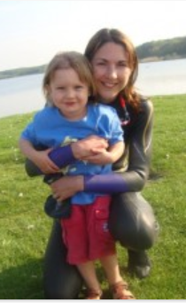
Who we are
Irene Bews Adventura Scotland
Dr Kate Quinn University of London
Dr Malcolm Penn Natural History Museum
Richard and Emma Wotton

Slide 8
Some of our partners
Adventura Scotland
Belize Botanical Gardens
Belize High Commission
British High Commission in Belize
Centre for Sustainable Forests & Landscapes
Friends for Conservation and Development
International Institute for Environment & Development
Natural History Museum London
Royal Botanical Gardens, Edinburgh and Kew
Selvana Trust
University College London
University of Belize
University of Edinburgh
University of Oxford
World Land Trust

Slide 9
And.. you!
No membership fee - just contribute your enthusiasm!
Can you offer to talk or to help with our next meeting?
Contact us by email today to express your interest
http://www.ukbelizeassociation.org/

Slide 10
