Slide 1
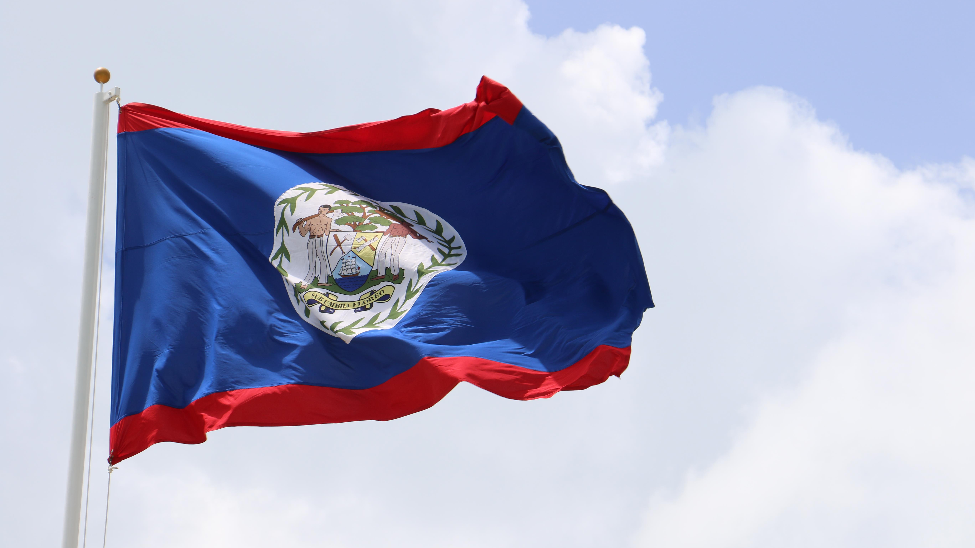
Belize: A Political and Economic Update
Jordan Craig
First Secretary
Belize High Commission in London
2 December 2022

Slide 2
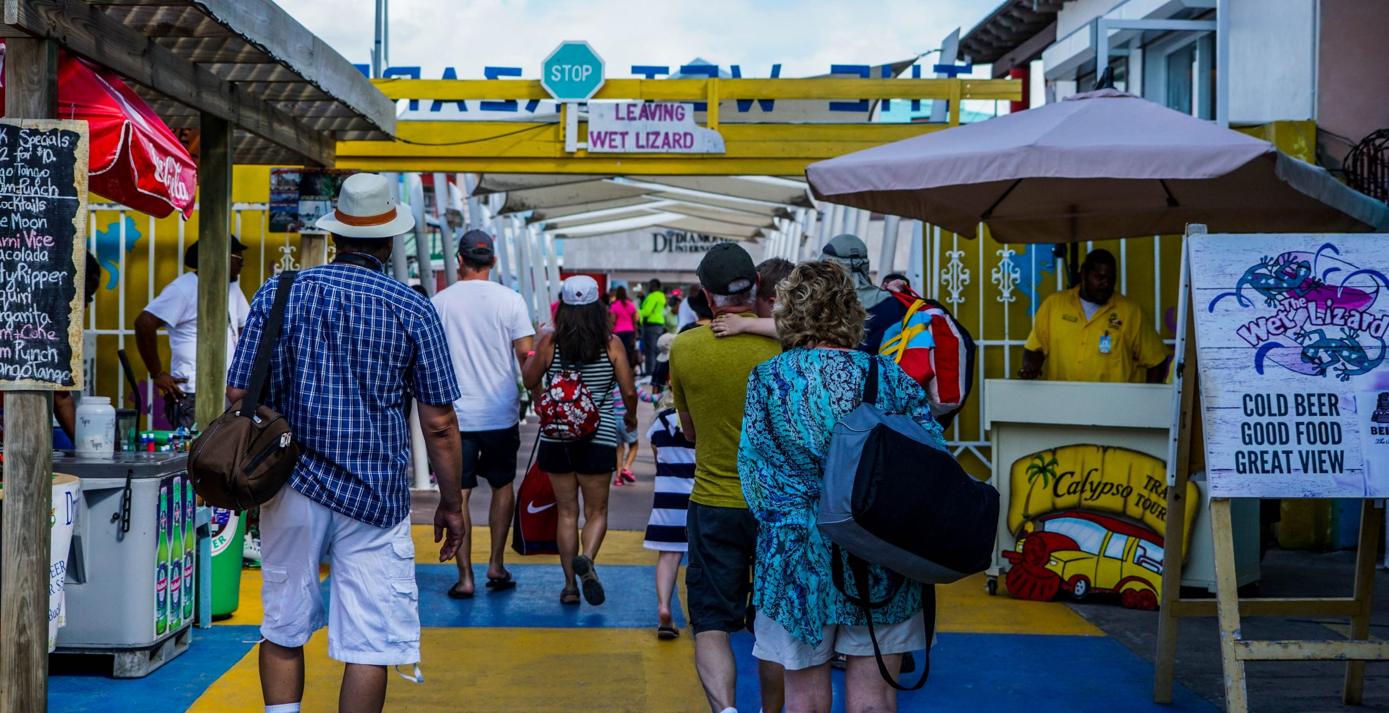
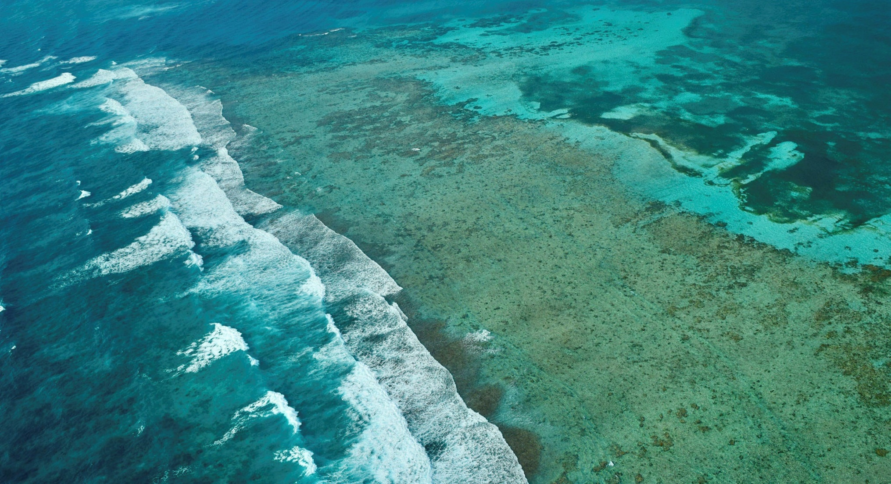
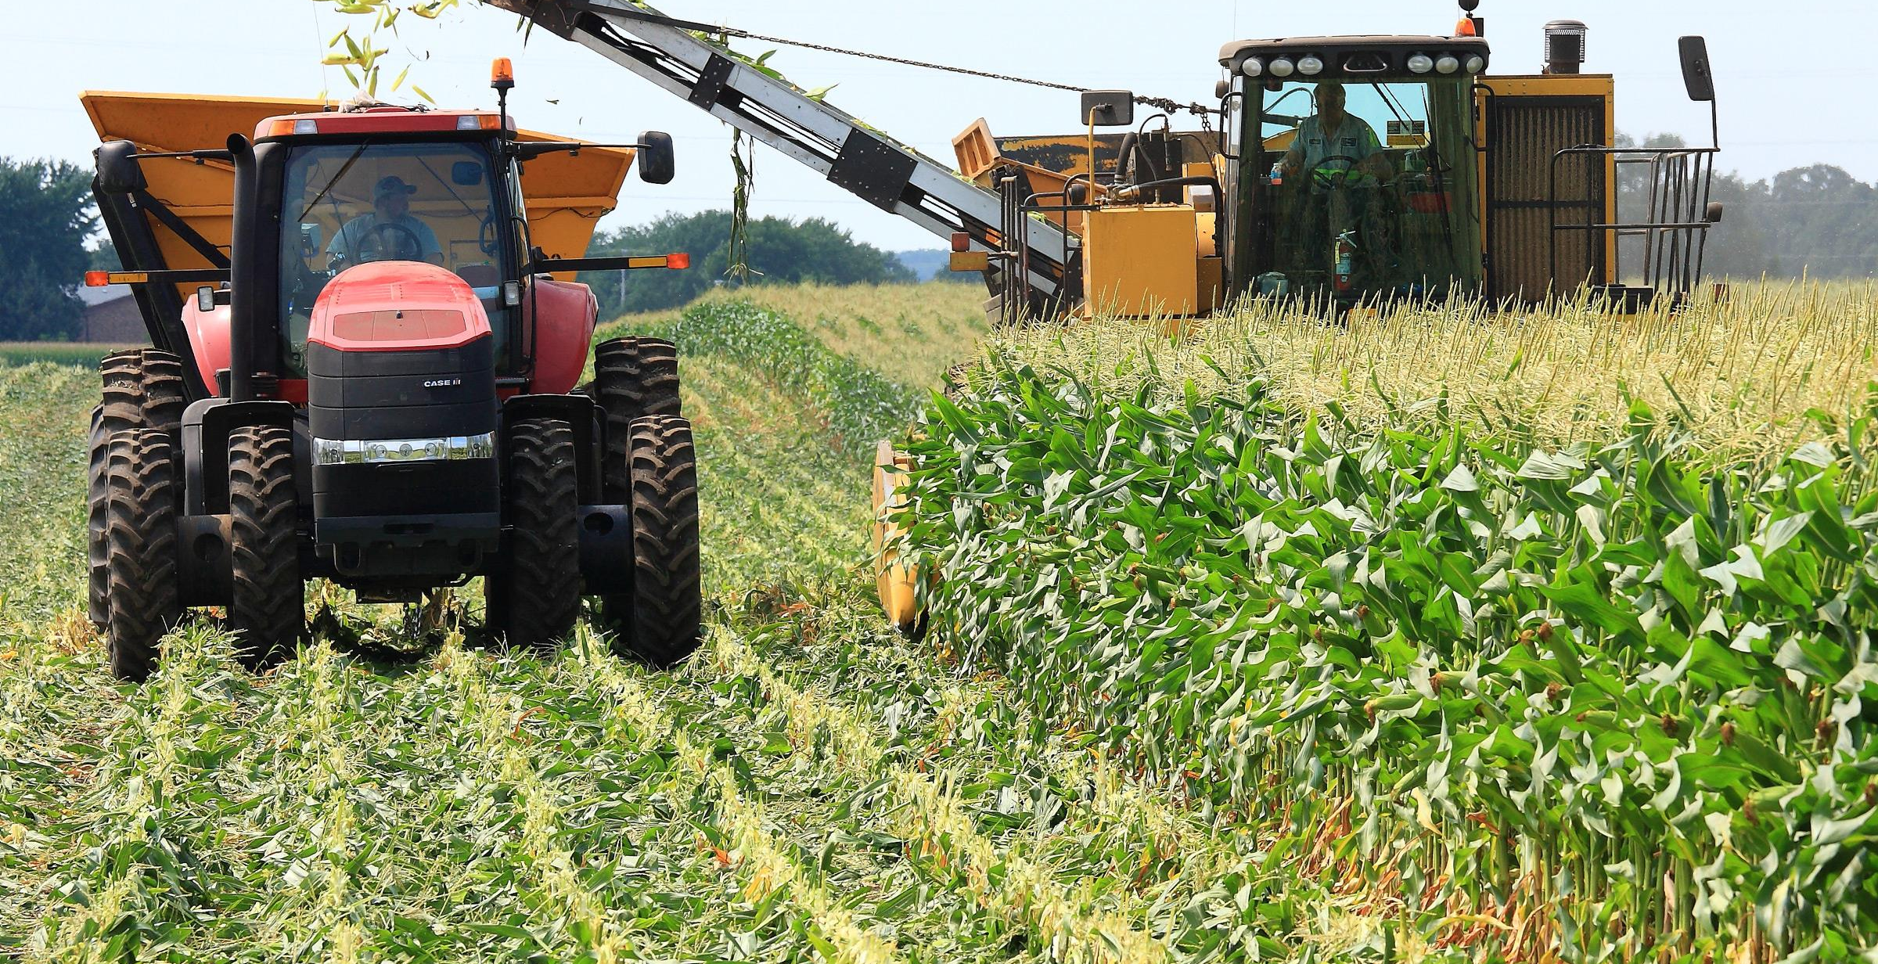
Economic Situation
Covid-19 led to a 16.7% contraction in real GDP + public debt of 133% of GDP.
Progress in restoring debt sustainability with fiscal consolidation and the Blue Bond.
Economic activity is recovering strongly, led by tourism. Growth expected to be 5.7% in 2022.
Inflation is 5.2% in 2022. External causes: war in Ukraine, related economic sanctions, elevated global energy & food prices.
Monetary policy during Covid-19 contributing to inflation: cutting interest rates and injection of money into the economy
De-risking:
Belize has lost 83% of corresponding banking relationships since 2015
Failure to rebuild relationships despite improvements in regulatory regimes.
GDP rebased to capture emerging activities like BPOs. Added economic value of 29%. Primary & secondary sectors larger than pre-pandemic.
Covid-19 is under control. About 63% of the population is vaccinated.
Unemployment has fallen to 8.2%

Slide 3
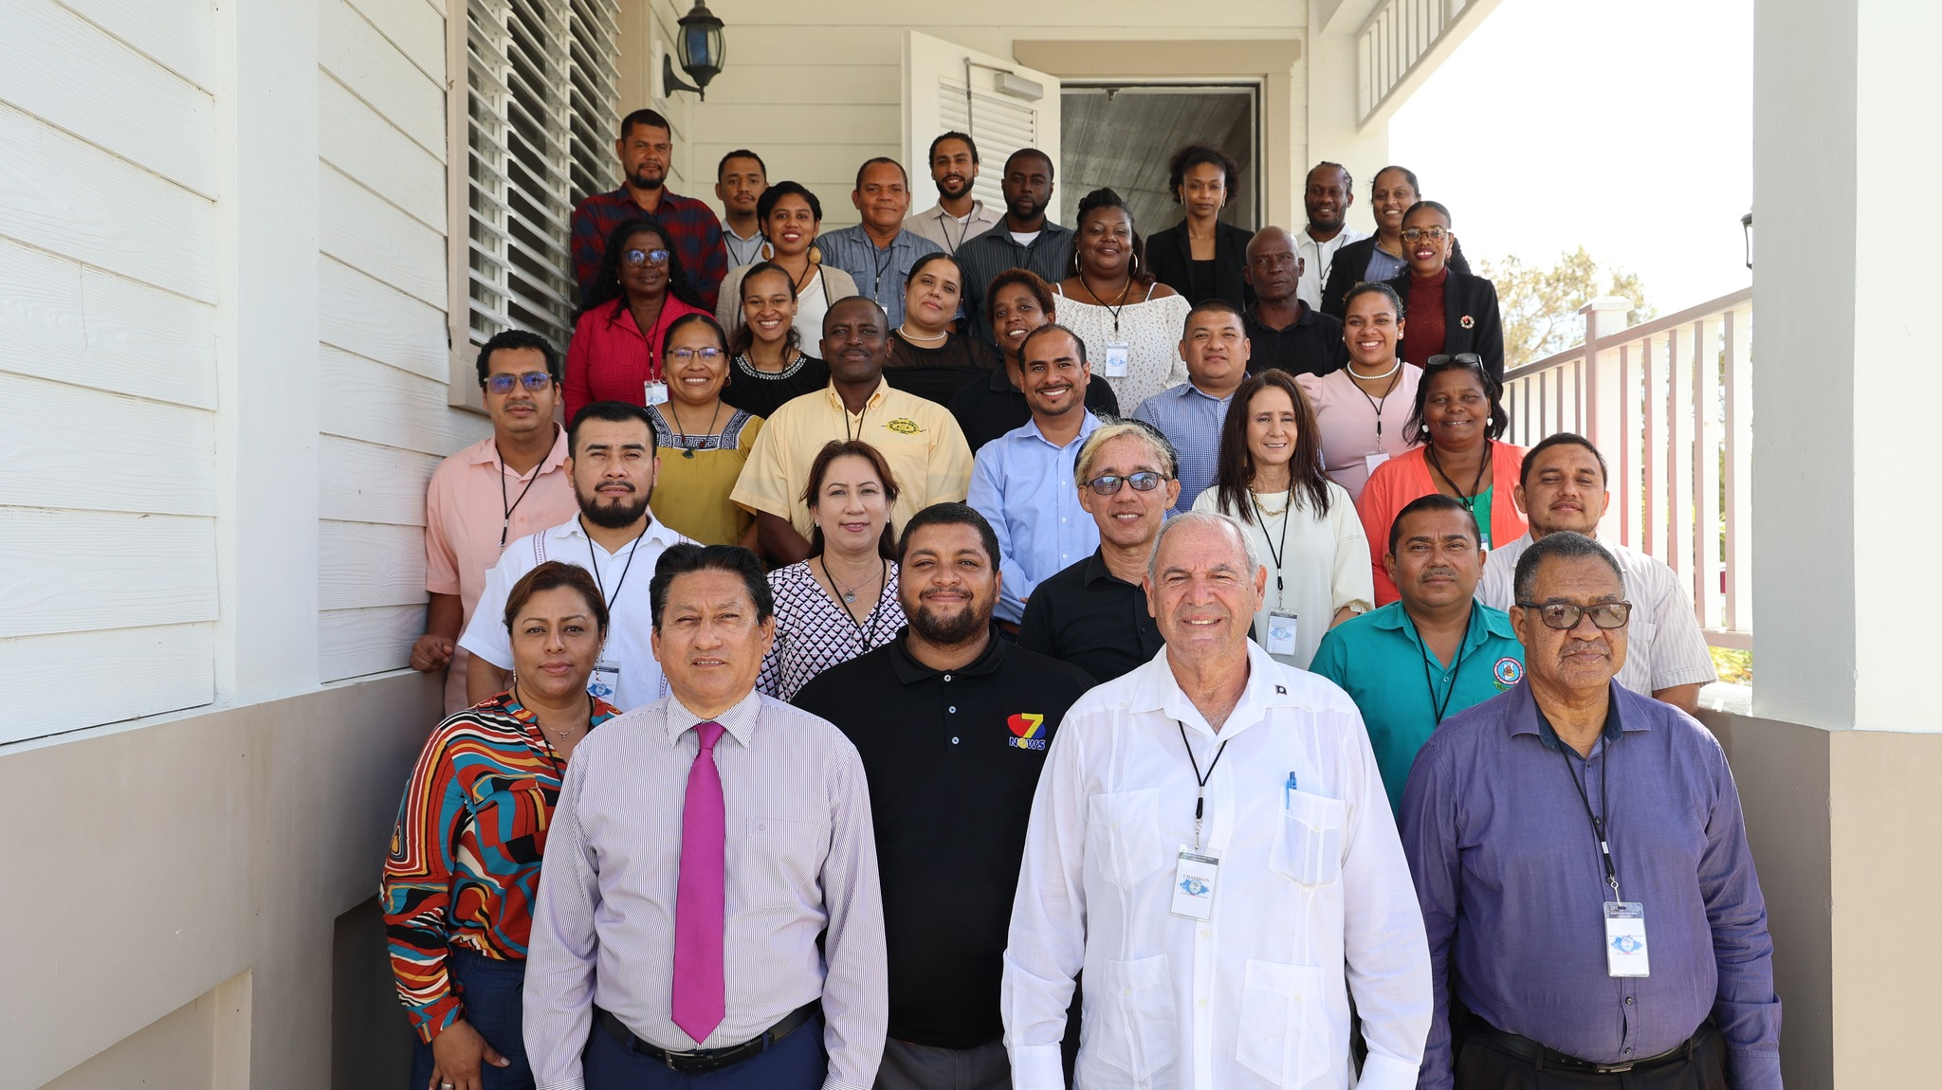
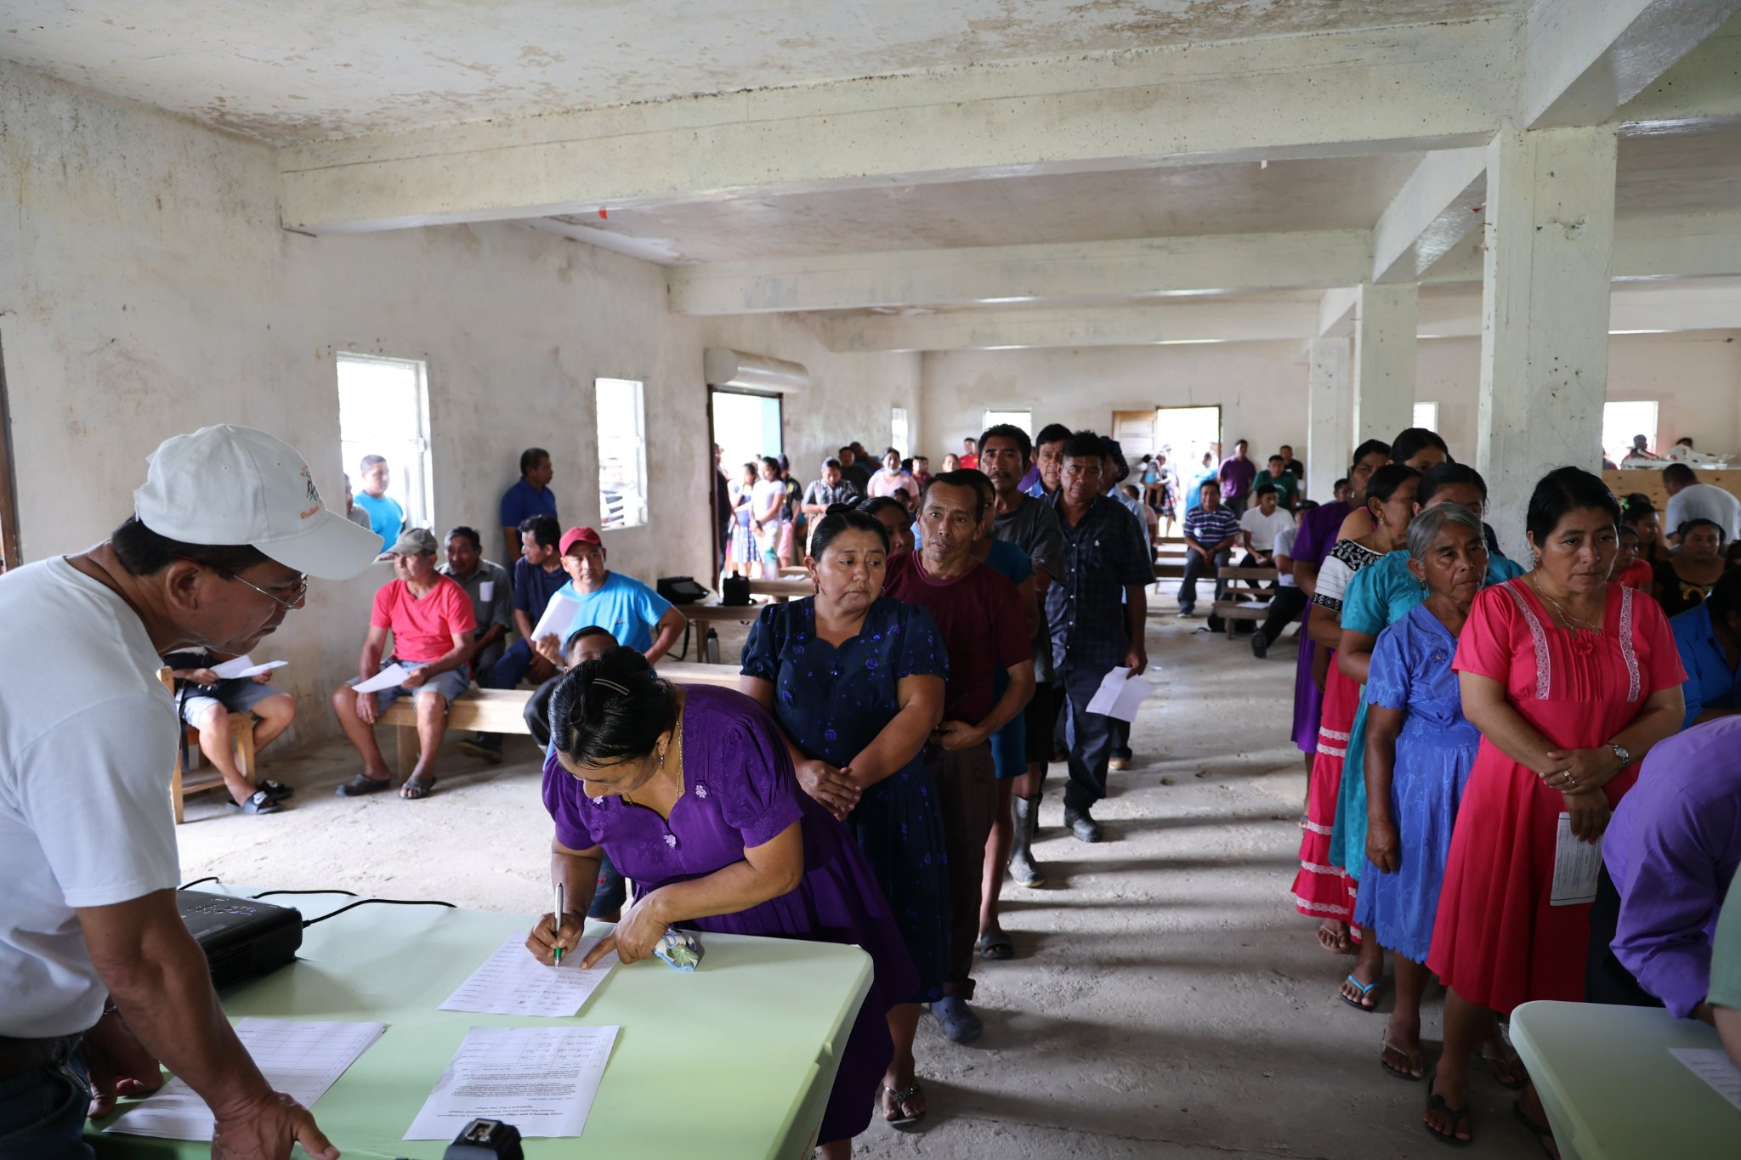
Political Developments
People’s Constitution Commission
Mandated to review the Belize Constitution & submit a findings report to the Prime Minister. Membership; functions
Free, Prior and Informed Consent Protocol
Filed with CCJ on 25 January 2022
Being implemented; agreements signed
Minimum wage increase
$5-dollar minimum wage increase will come in effect on 1 January 2023
Posthumous pardon of Norma Parham

Slide 4
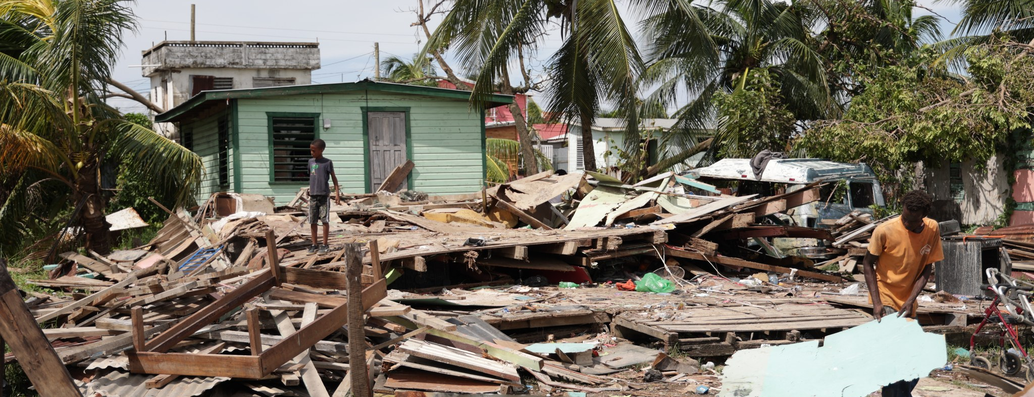
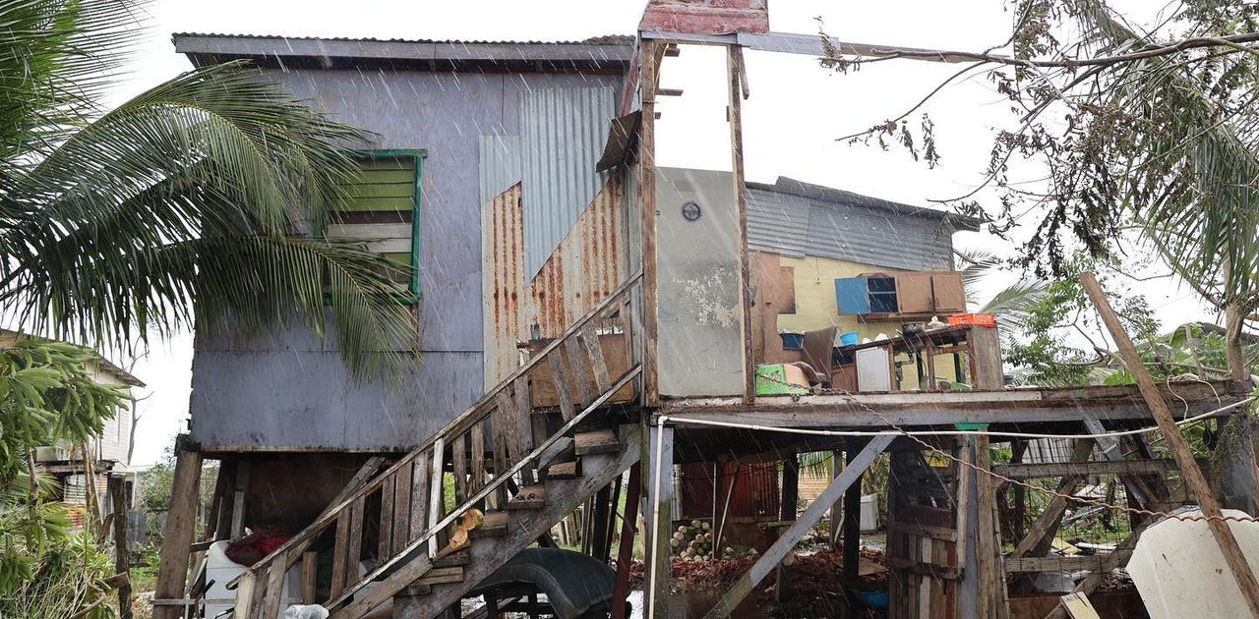
Natural Disasters
Hurricane Lisa
Landfall south of Belize City as a Category 1 hurricane on 2 November
Affected 39% of the population
Total loss and damage – BZ$75,711,229.51
International assistance secured but recovery is a long way off
Hurricane Julia
Landfall in Nicaragua on 8 October
Major flooding across southern and western Belize

Slide 5
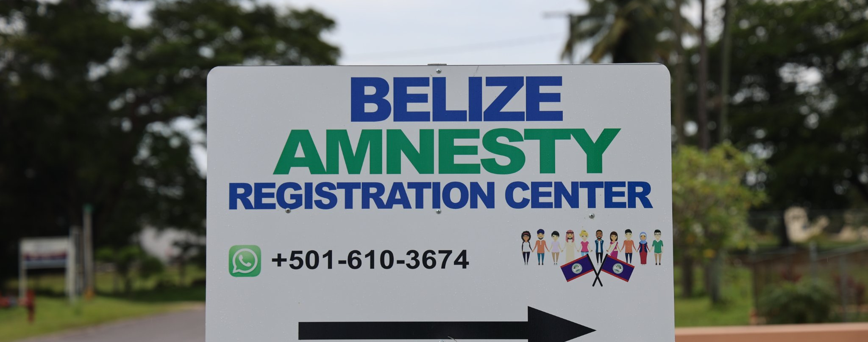
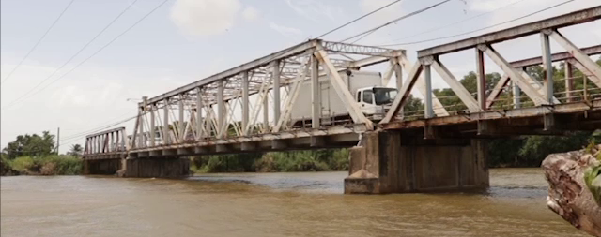
National Development Priorities
Immigration & Nationality
New Passport System
Amnesty Program 2022
E-Governance National Agenda
Adoption of public sector transformation projects and technologies
Six e-governance related legislations enacted
Health
Covid-19 vaccination
HPV vaccines in schools
Education
Return to in-person classes
New school buildings built
Public Infrastructure
Haulover Bridge replacement project

Slide 6
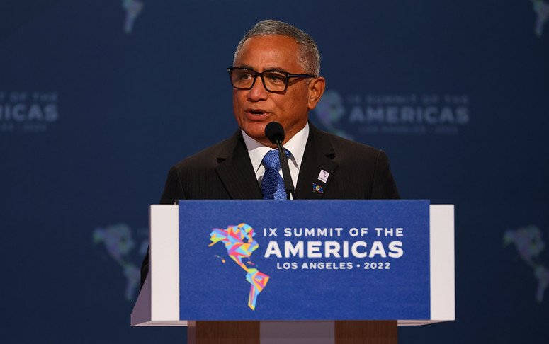
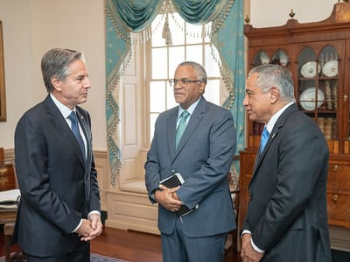
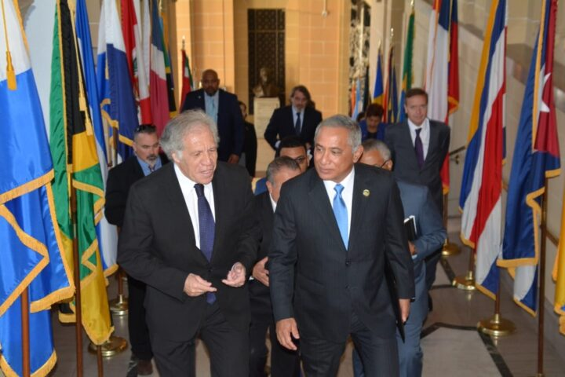
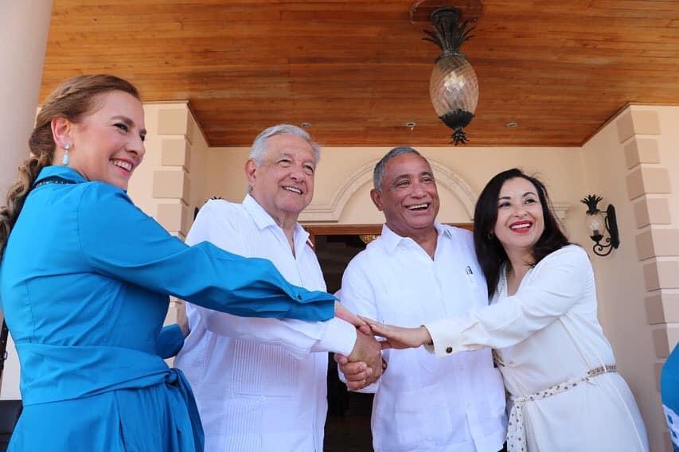
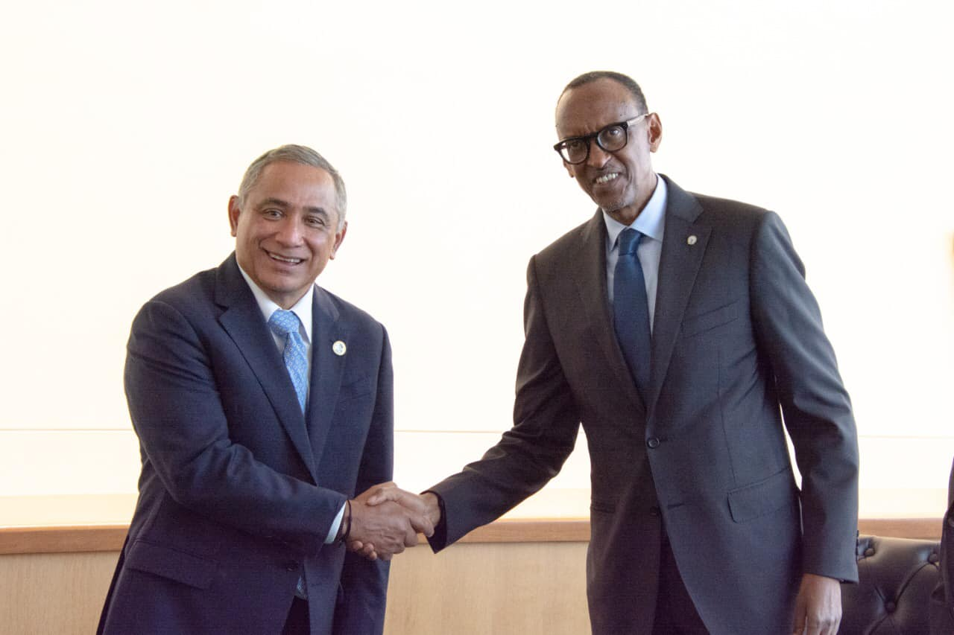
Foreign Policy
Strong hemispheric relations with a global outlook
Regional integration: CARICOM and SICA
OAS and CELAC
Mexico, United States and Canada
South America
Solidarity with Cuba
Building new relationships in Africa and Asia
Strengthening traditional partnerships with Taiwan, UK, Europe, Commonwealth countries and SIDS

Slide 7
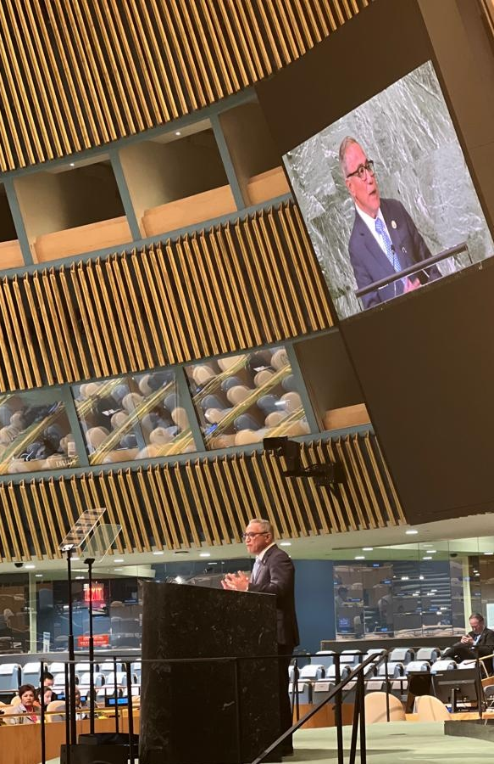
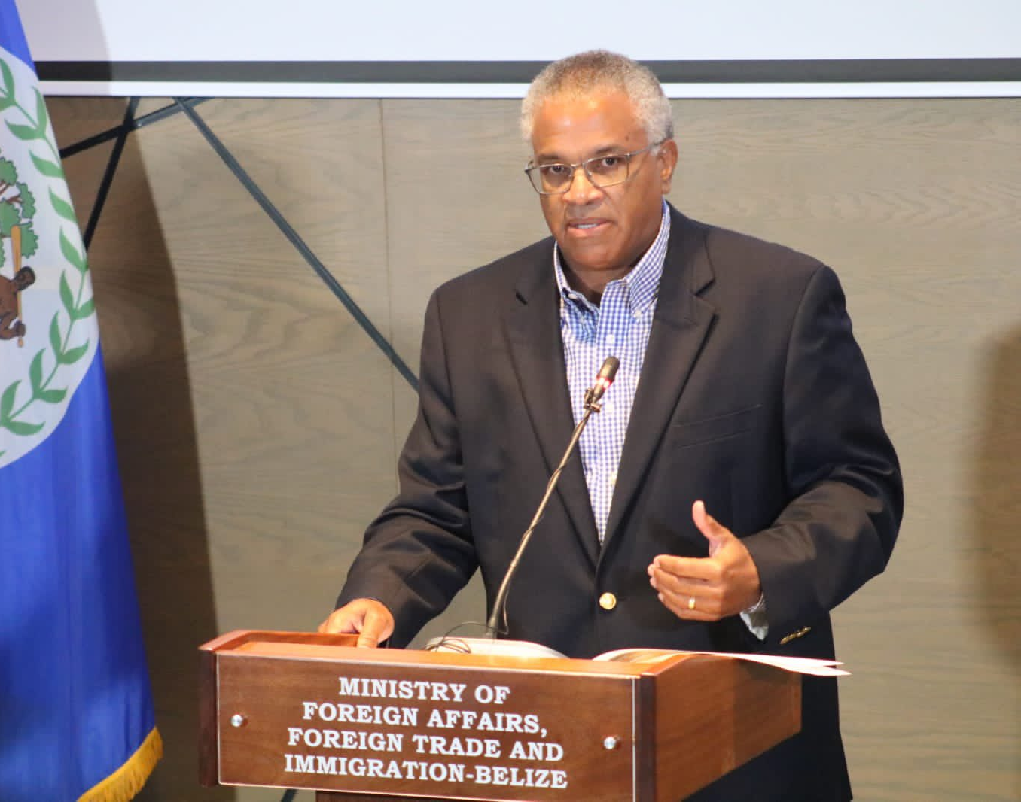
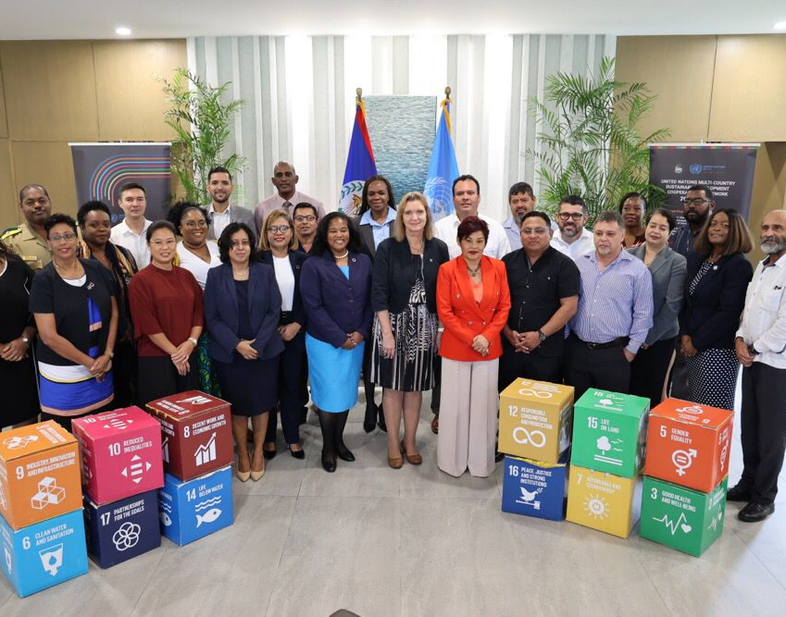
Foreign Policy
Active multilateralism
Small island developing states (SIDS)
Climate action
Debt reform
Commitment to Agenda 2030 and the SDGs
Promotion and protection of the principles governing the international order
Self-determination
Territorial integrity
Sovereignty
Non-interference
Notes:
Submission of Belize’s revised NDCs
Belize at COP27
Debt swaps for climate and nature

Slide 8
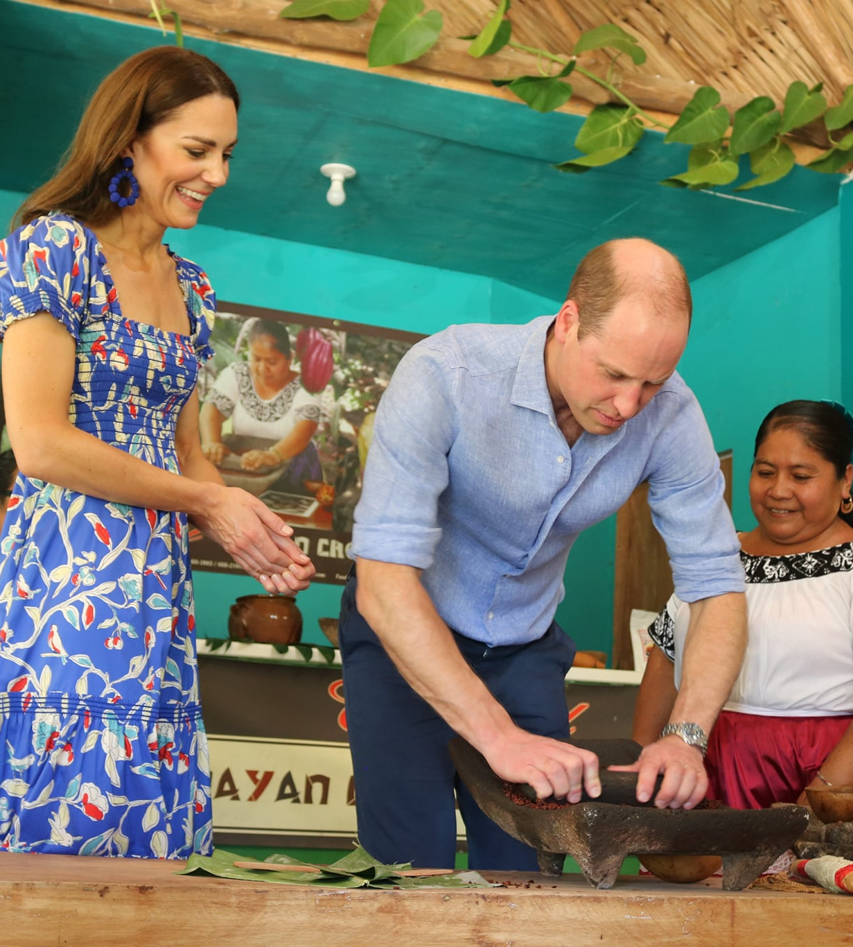
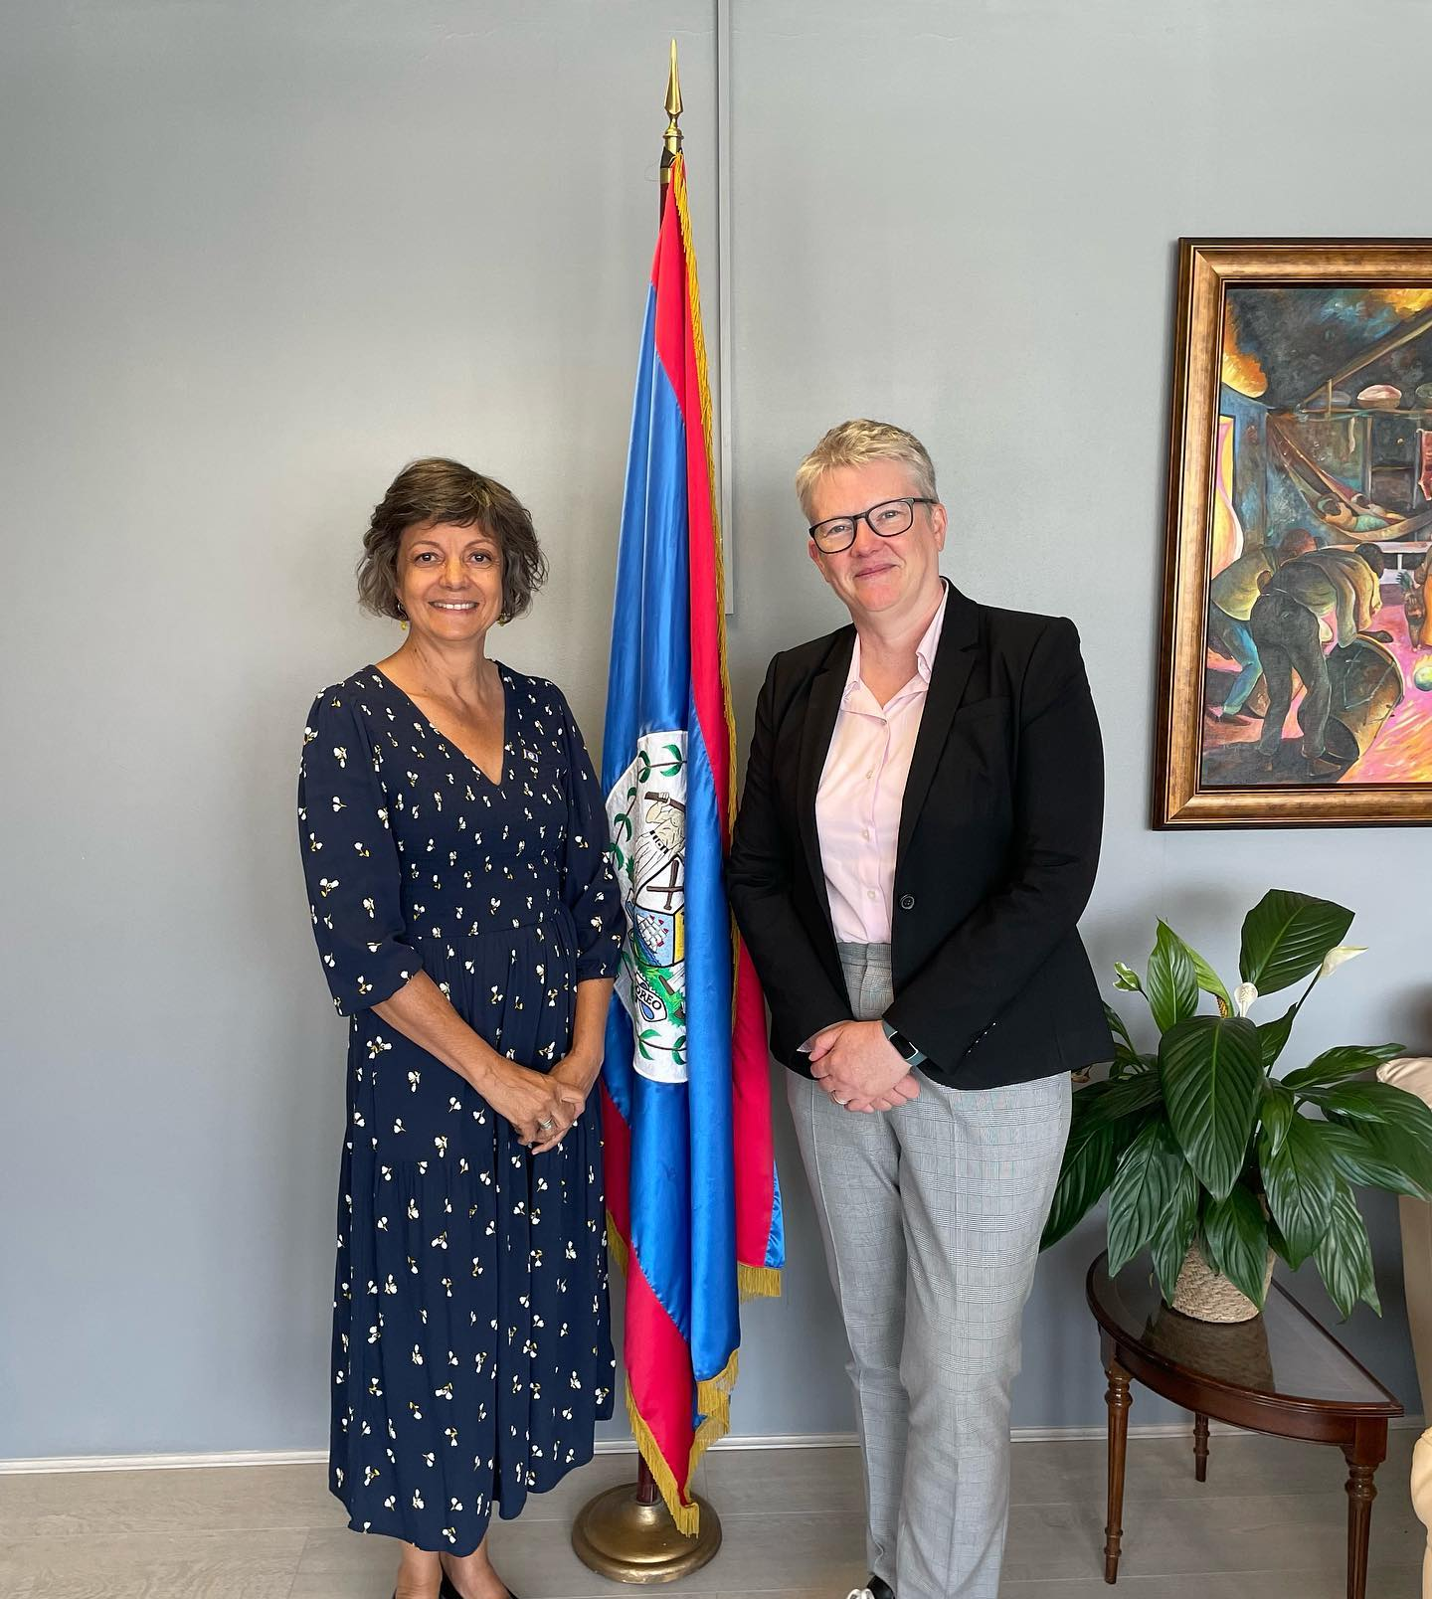
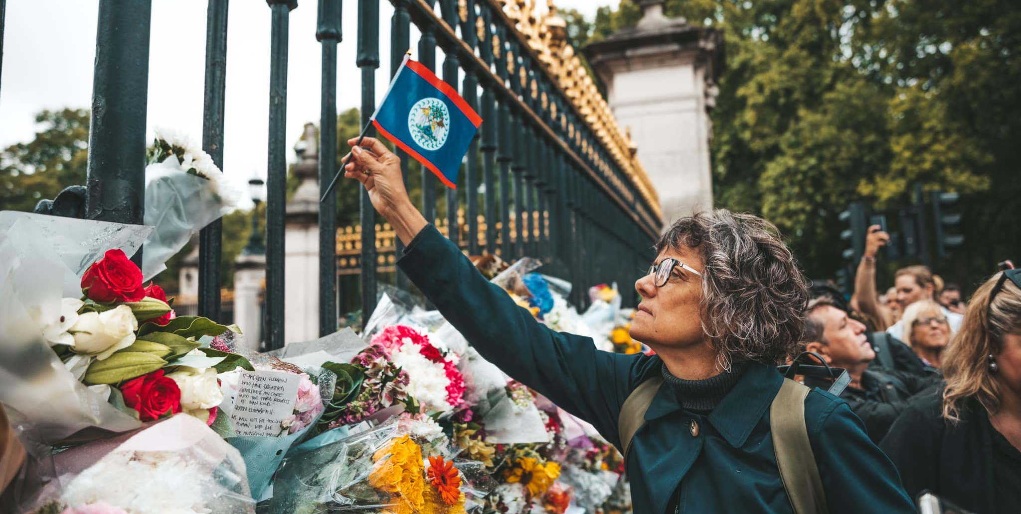
Belize-United Kingdom Relations
New developments:
King Charles III
Royal Tour by the then Duke and Duchess of Cambridge
New Minister for the Americas
Belize’s Maritime Economy Plan (MEP)
Traditional areas:
Security and BATSUB
Belize-Guatemala territorial dispute
CARIFORUM-UK Economic Partnership Agreement (EPA)
Commonwealth
Development Cooperation

Slide 9
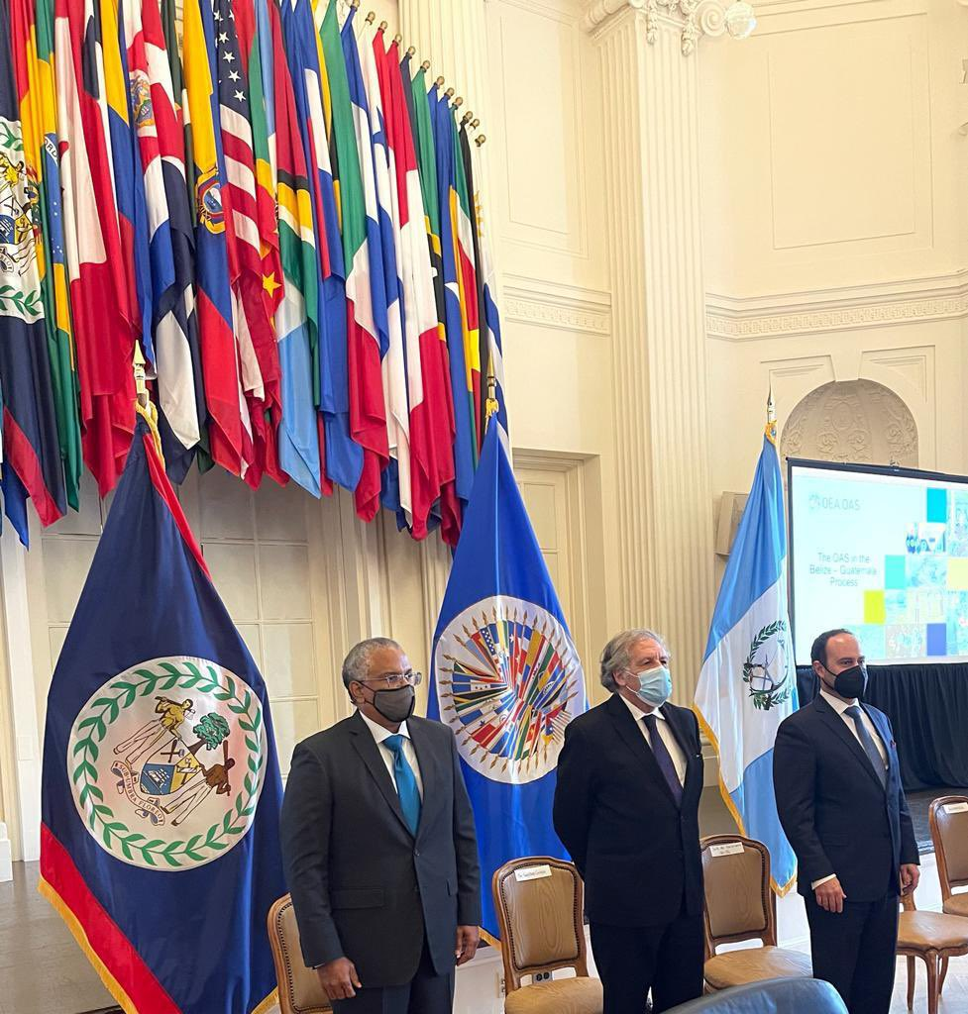
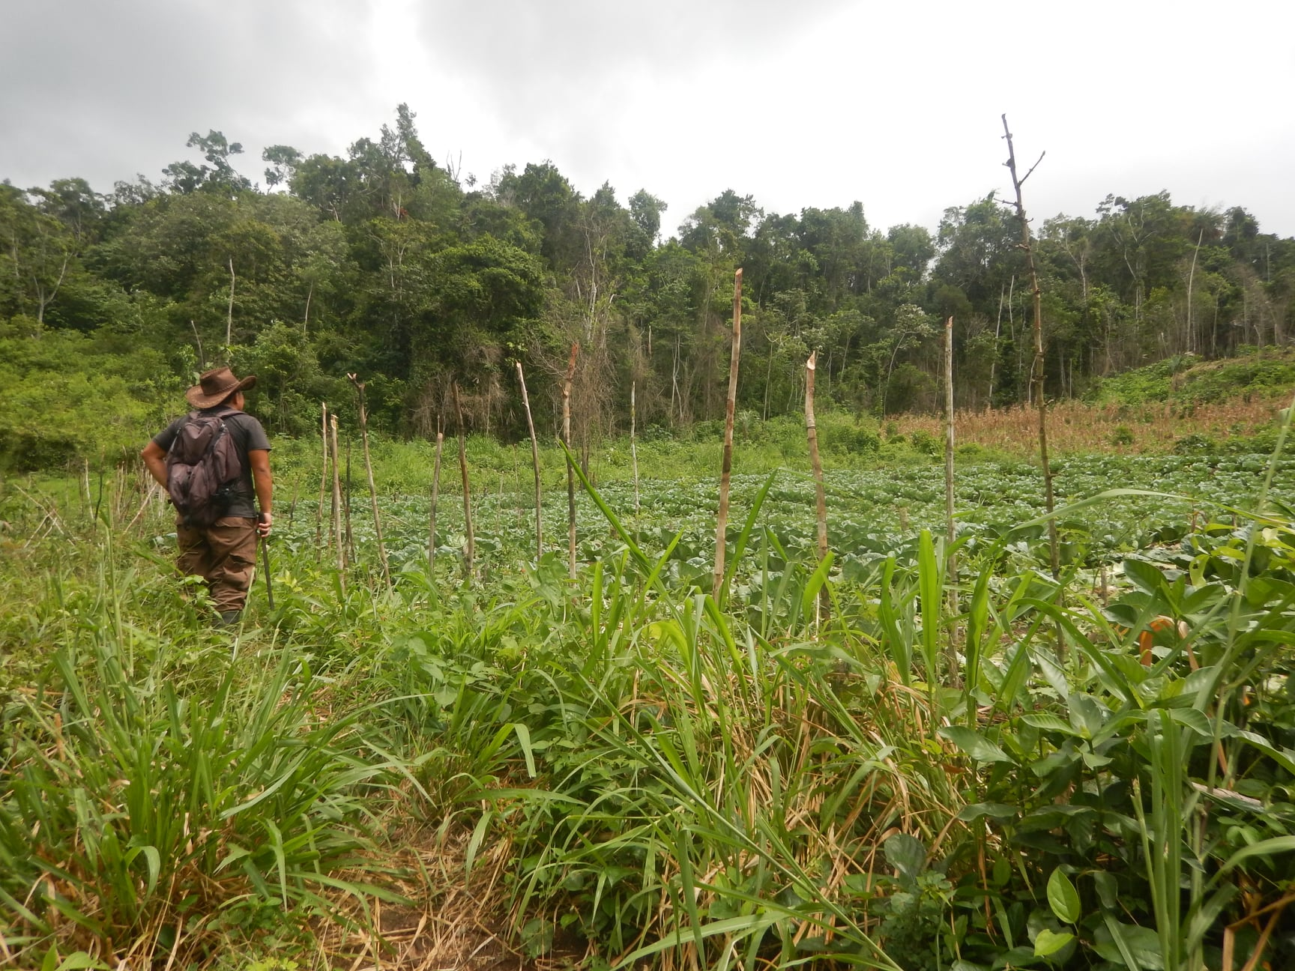
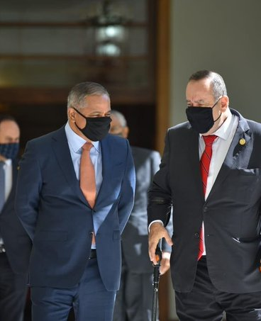
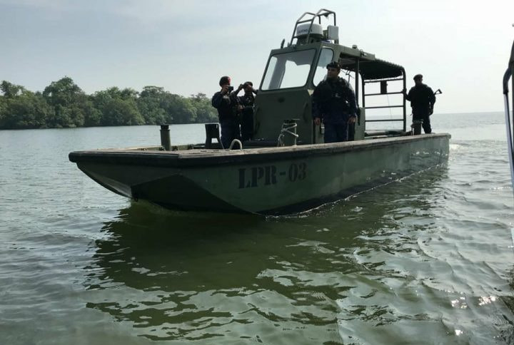
Belize-Guatemala Relations
Strengthening of bilateral relations
Challenges in the border areas
Status of the CBMs
Role of the OAS
Ongoing negotiations to expand the Belize-Guatemala Partial Scope Agreement (PSA)

Slide 10
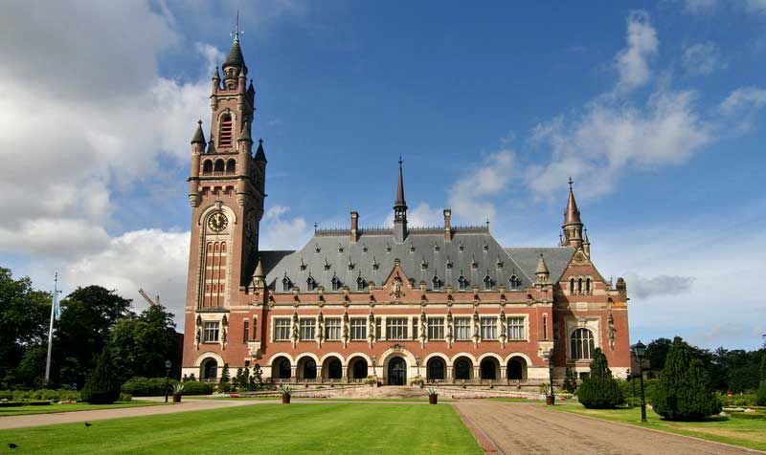
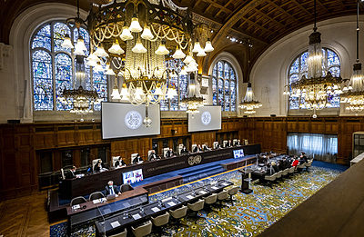
Belize at the ICJ
Guatemala
Belize submitted its counter-memorial to the ICJ on 3 June 2022. Guatemala is due to submit its reply in December 2022.
Honduras
On 16 November 2022, Belize sought a final and binding resolution to the dispute concerning sovereignty over the Sapodilla Cayes

Slide 11
Thank You
Belize High Commission in London

