Slide 1
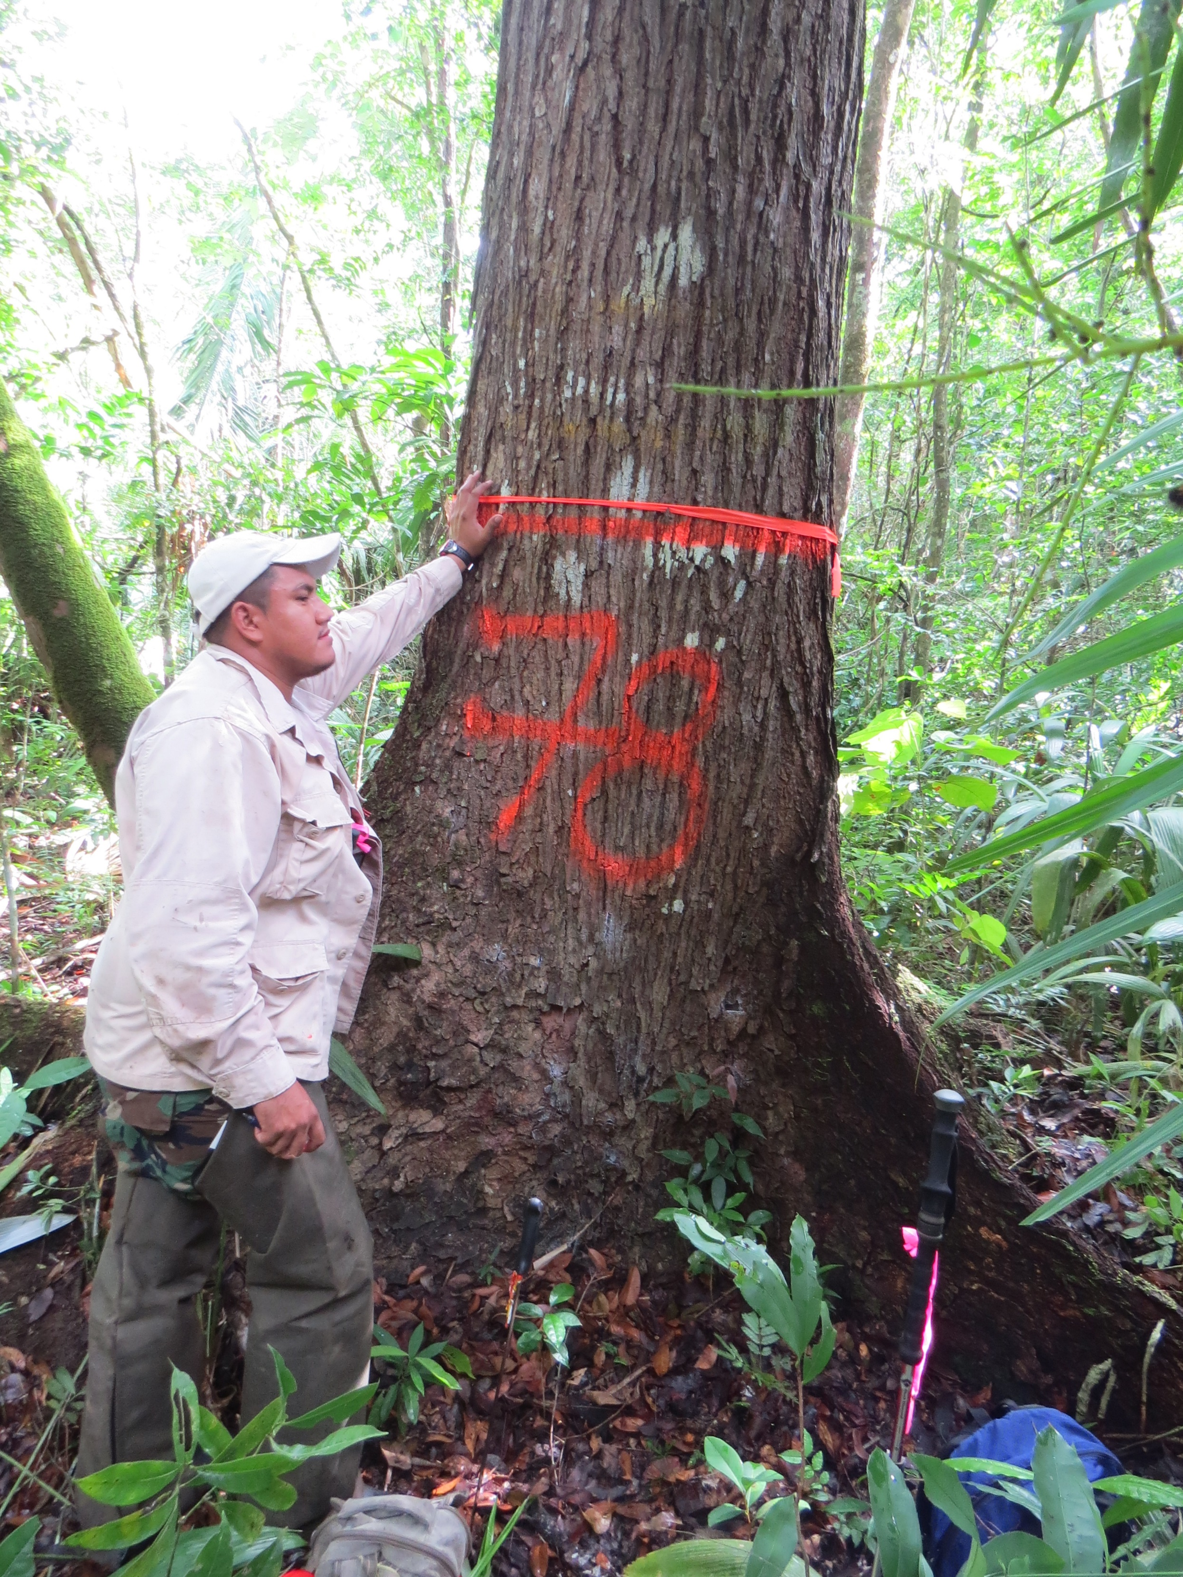
The need for rescue and safe harbor of another endangered species: legacy forest data and other resources for Belize
Sheila Ward and Nick Brokaw
San Juan, Puerto Rico

Slide 2
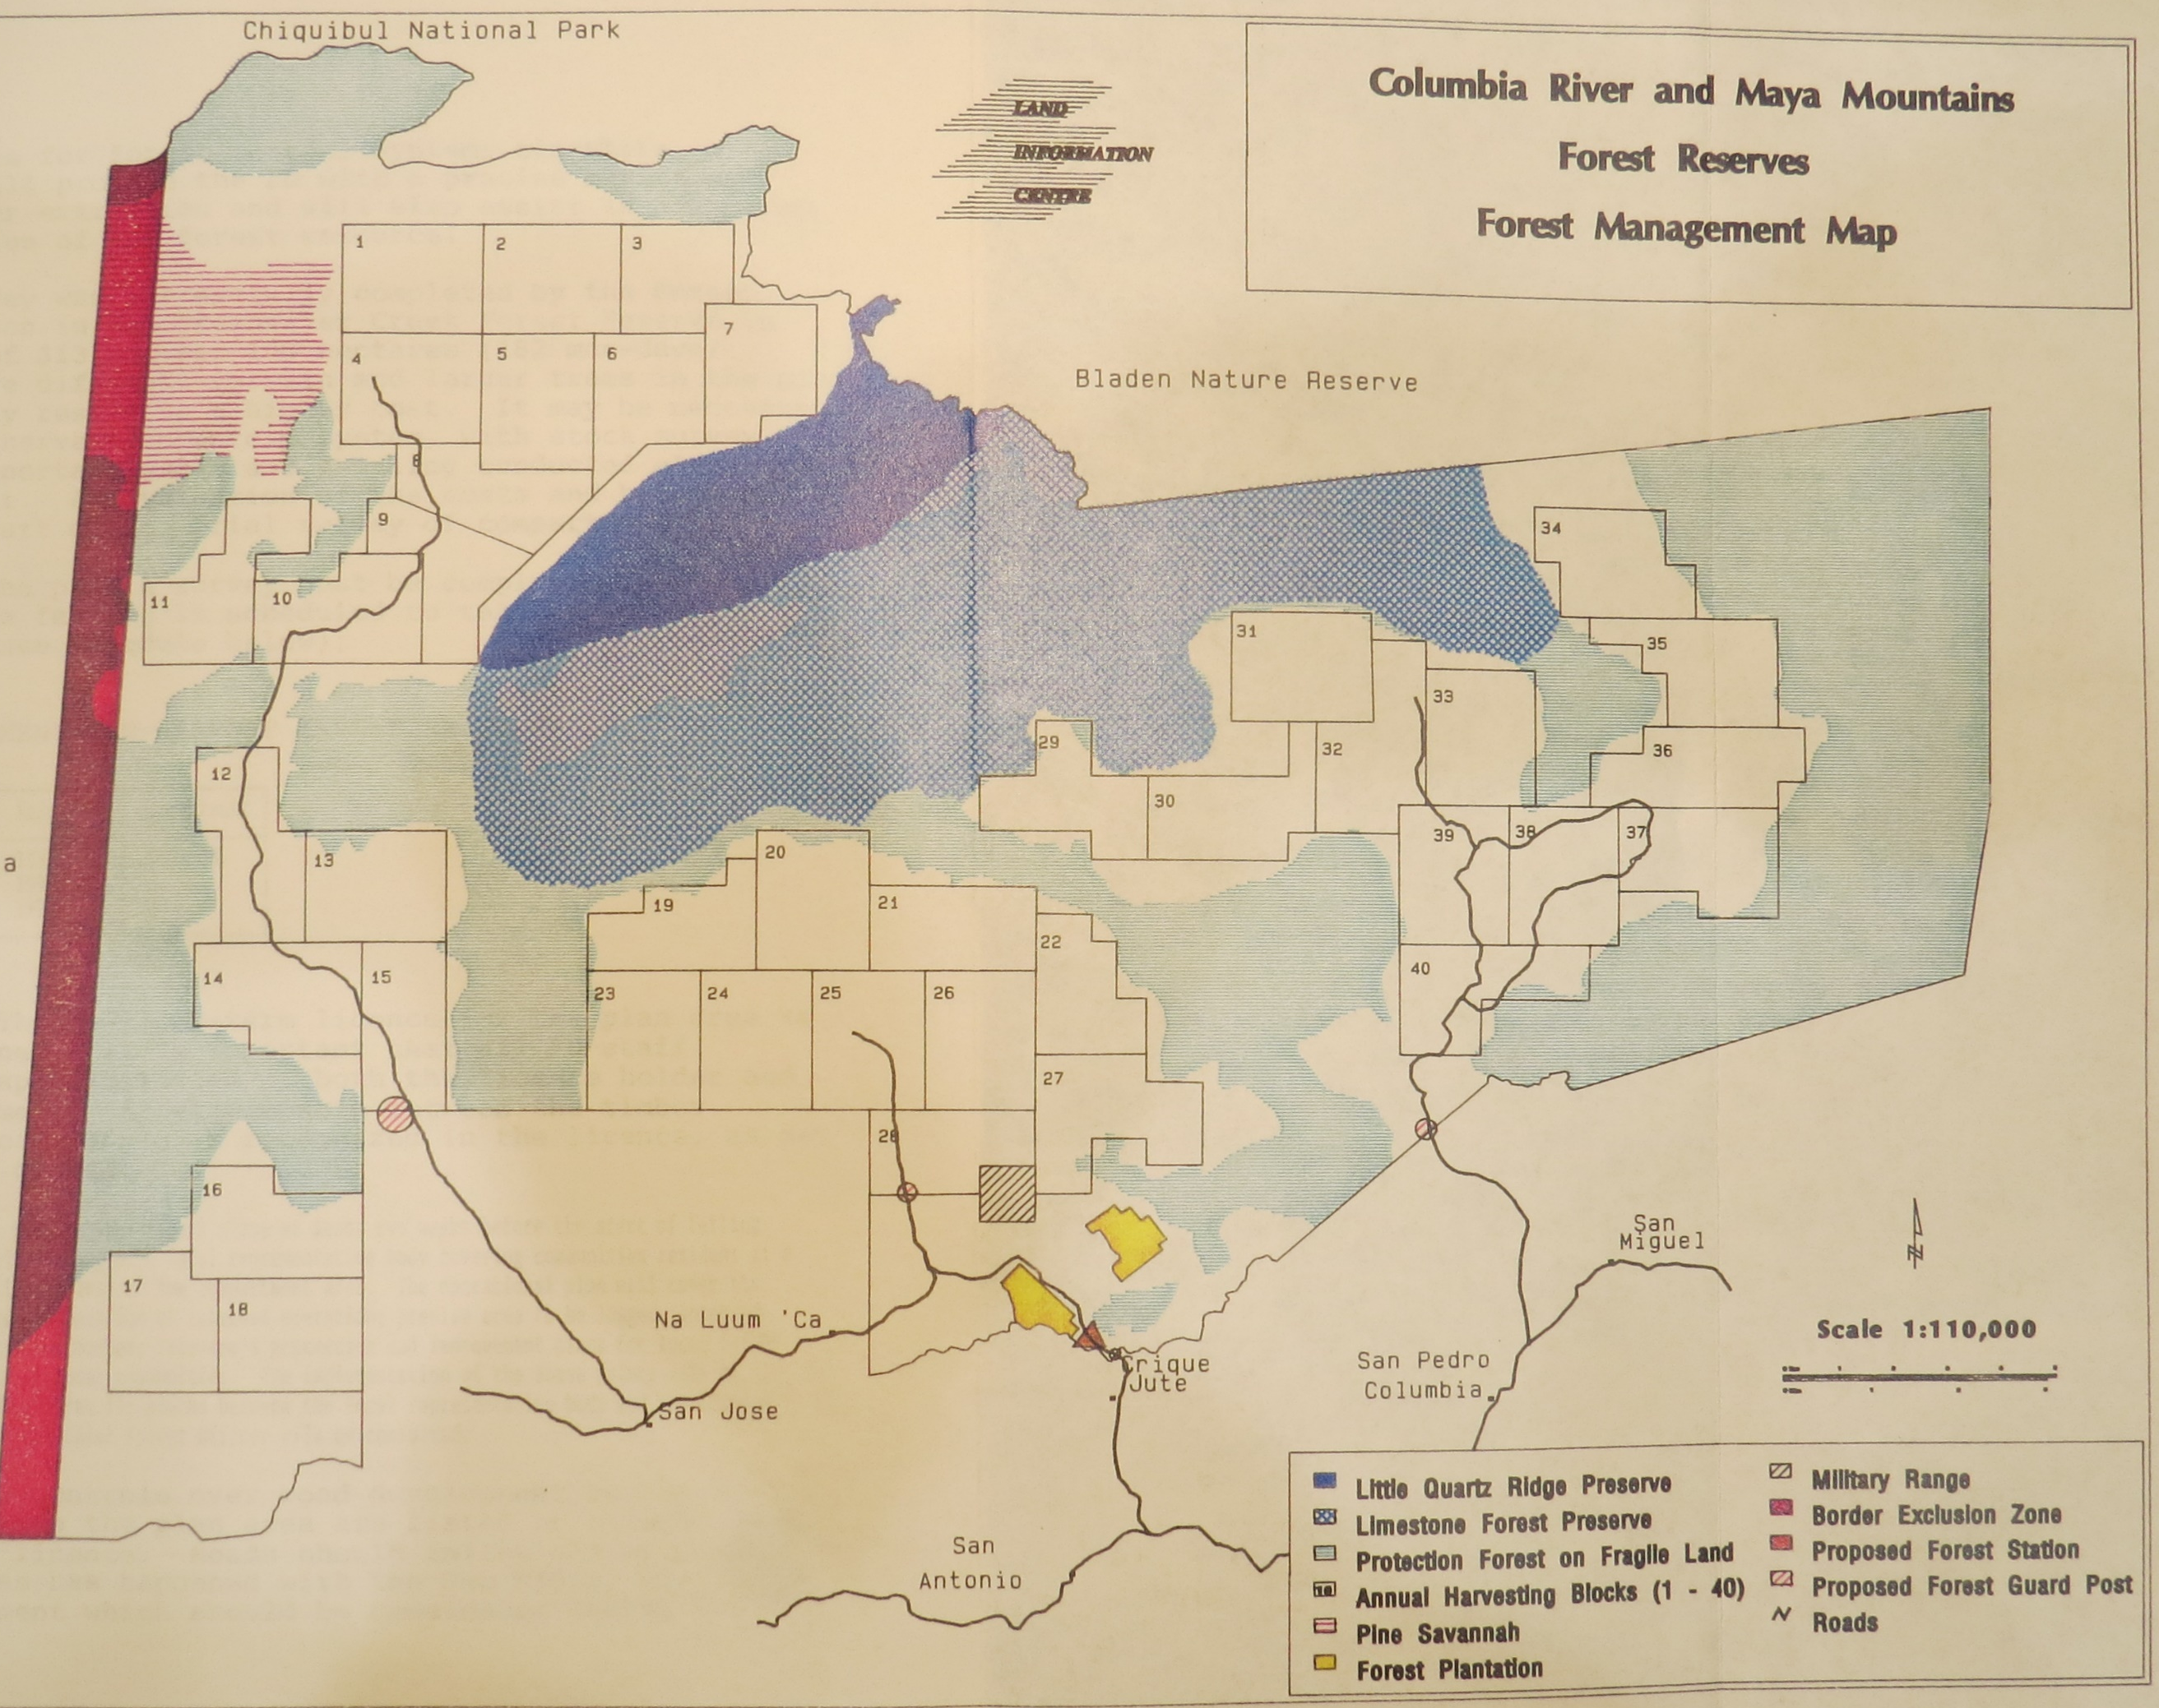
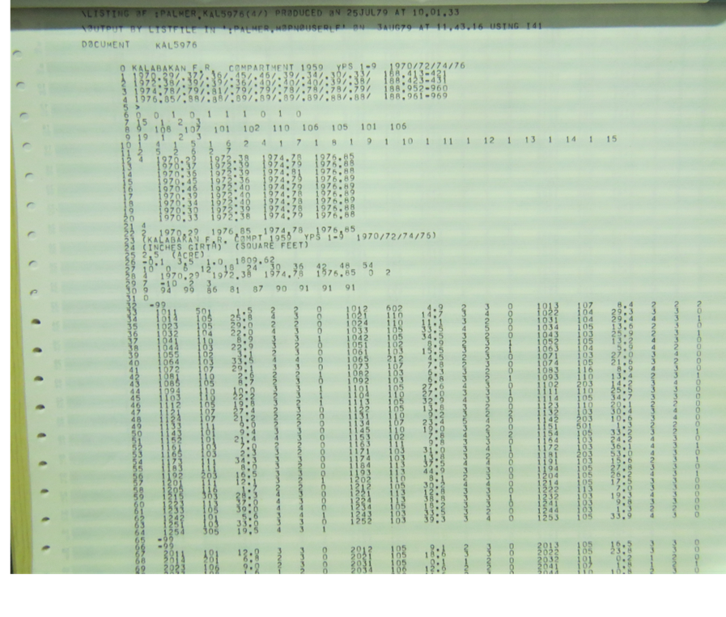
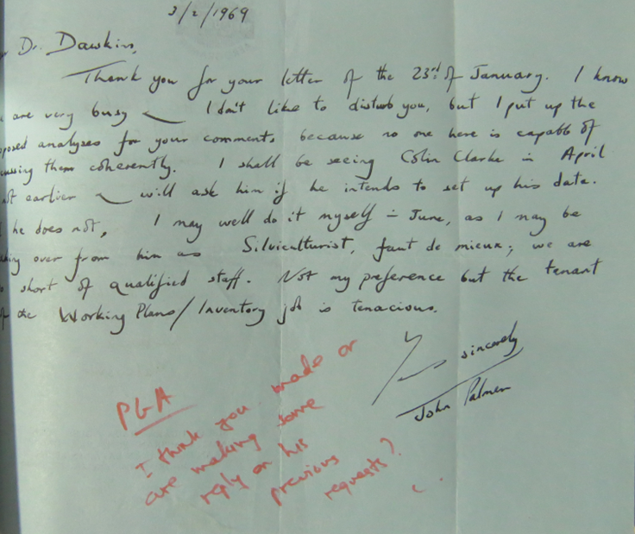
What are legacy datasets?
Datasets that are not properly curated
From late 1900s or earlier
May exist only on paper
May exist in outdated digital format
May have been part of a project, but no funding for long term storage

Slide 3
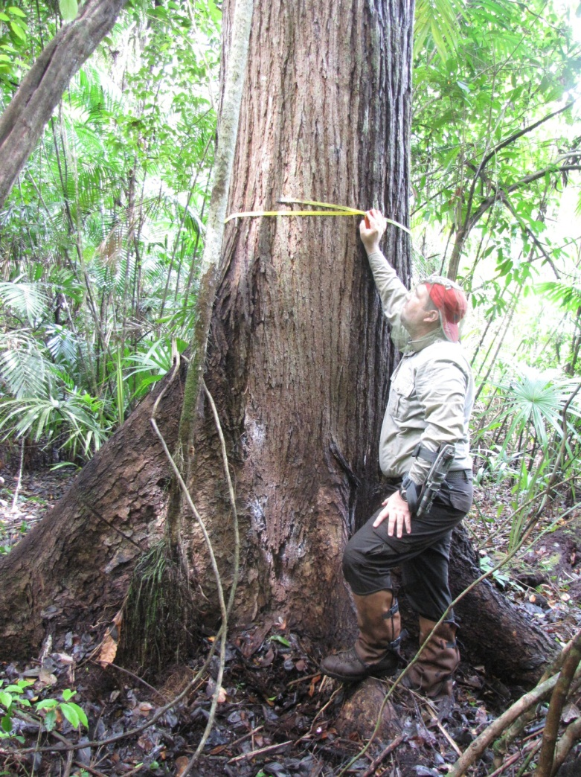
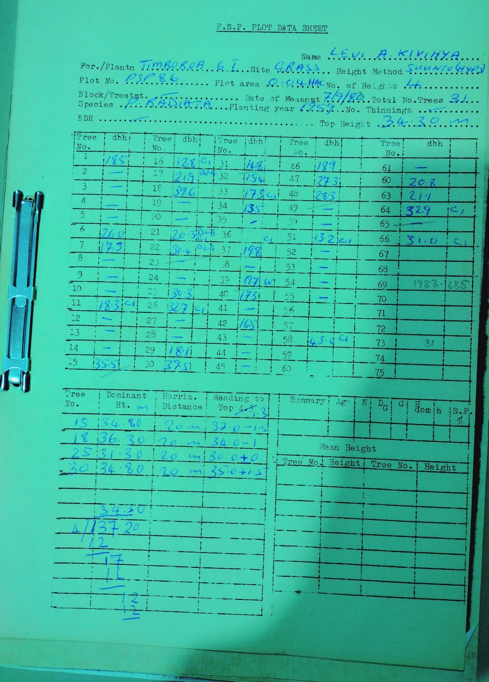
Types of legacy datasets
One-time inventory
Permanent plots with remeasurement
Volume studies
Presence/absence data
Raw data/summary tables
Others, even photographic records

Slide 4
What can we do with legacy forest datasets?
Global and local applications
Baseline information for human impacts and climate change
  → Changes in species composition, distributions, size
  → Changes in forest structure, biomass, and carbon
Species mapping
Habitat characterization/quality for fauna/flora
Forest management
  Best practices
  Forest growth and yield
Training/verification data for modeling

Slide 5
Goals for legacy tropical forest datasets
1) Produce catalogue on tropical datasets and other resources
2) Resolve where these should be stored
3) Resolve issues on use of such datasets
4) Get funding for their curation
5) Get the datasets proper homes!

Slide 6
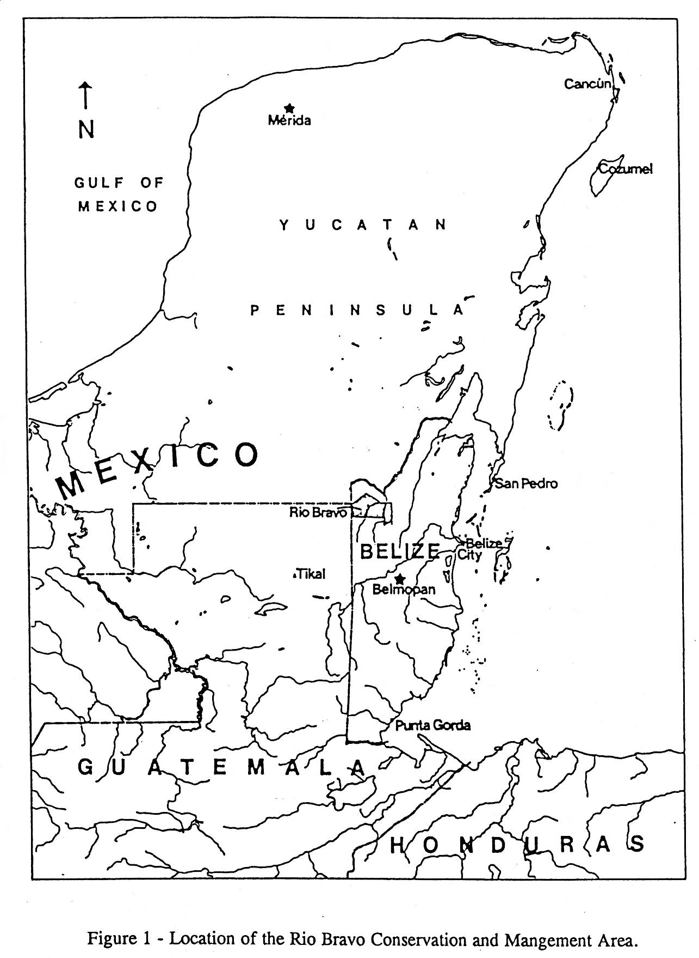
Datasets and resources on Belize forests

Slide 7
Forest inventories
1969-1981
Digitized, but in older format, Alder 1993

Slide 8
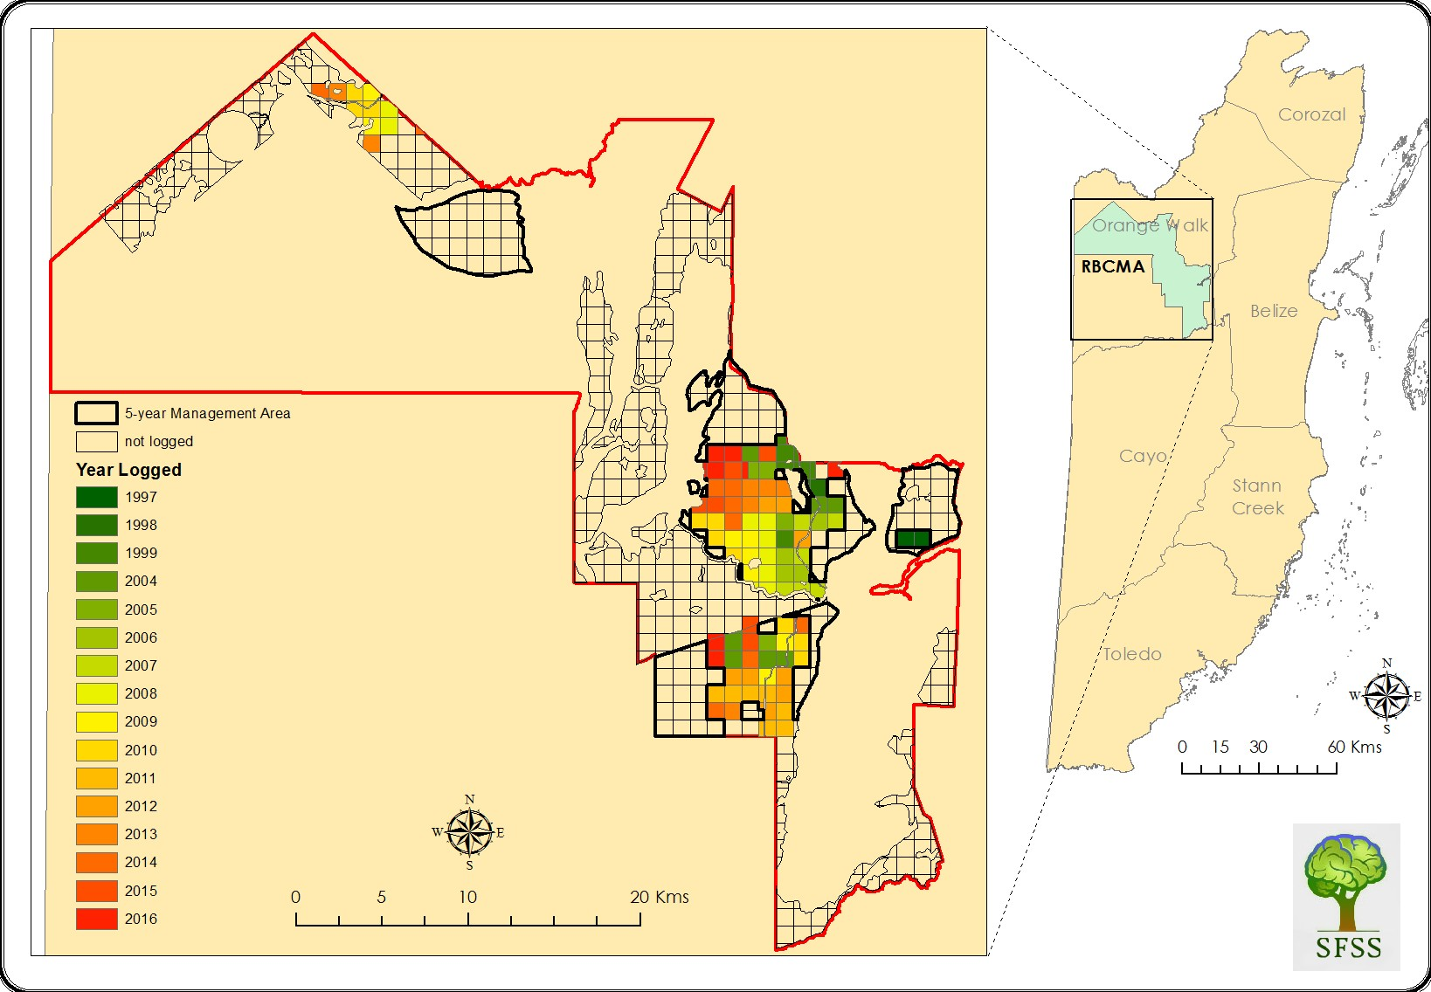

Rio Bravo Conservation and Management Area (RBCMA)
Programme for Belize (PFB; NGO) holds the RBCMA (~100,000 ha of forest)
Tree measurements on 5-year cycles since ~1995, but no time or resources to curate
2010 hurricane, flood, much data lost in Belize City
We visited the PfB office, many records 1998-2013 still extant.
Cho 2014

Slide 9
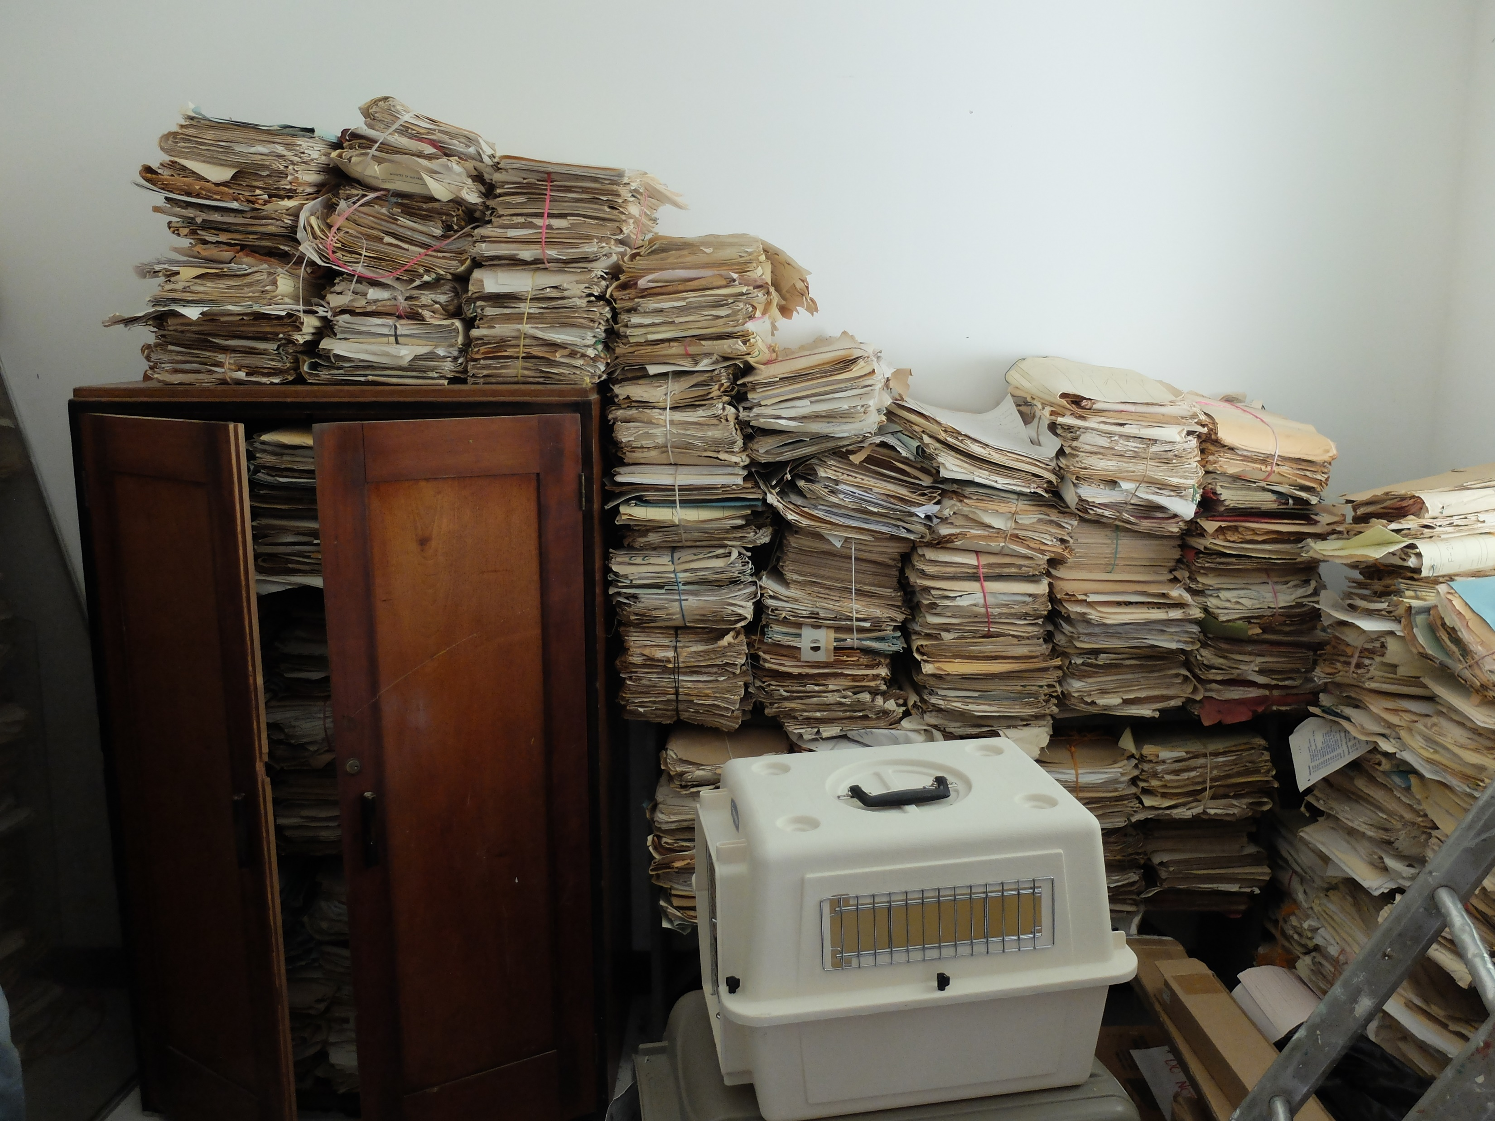
Other “endangered species” in Belize
Many copies of Land in British Honduras lost in Belize City under Hurricane Hattie, 1961.
Field notebooks at a Belize field station – limited time, funding, personnel to deal with them.

Slide 10
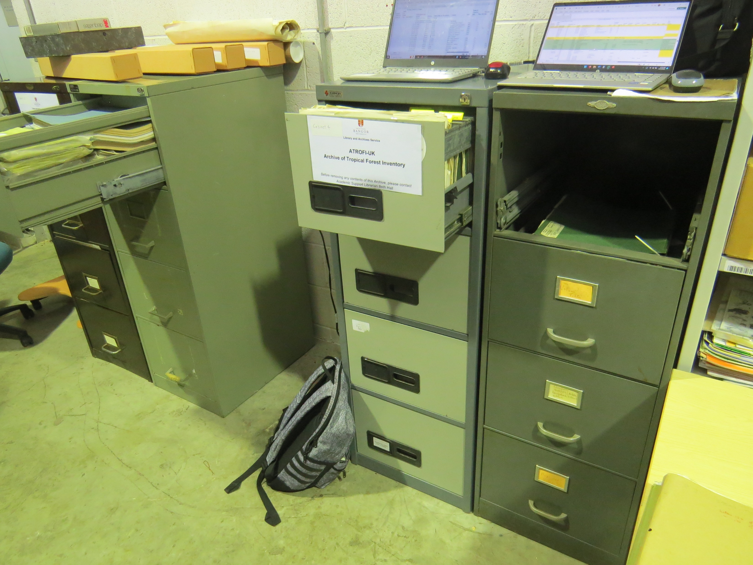
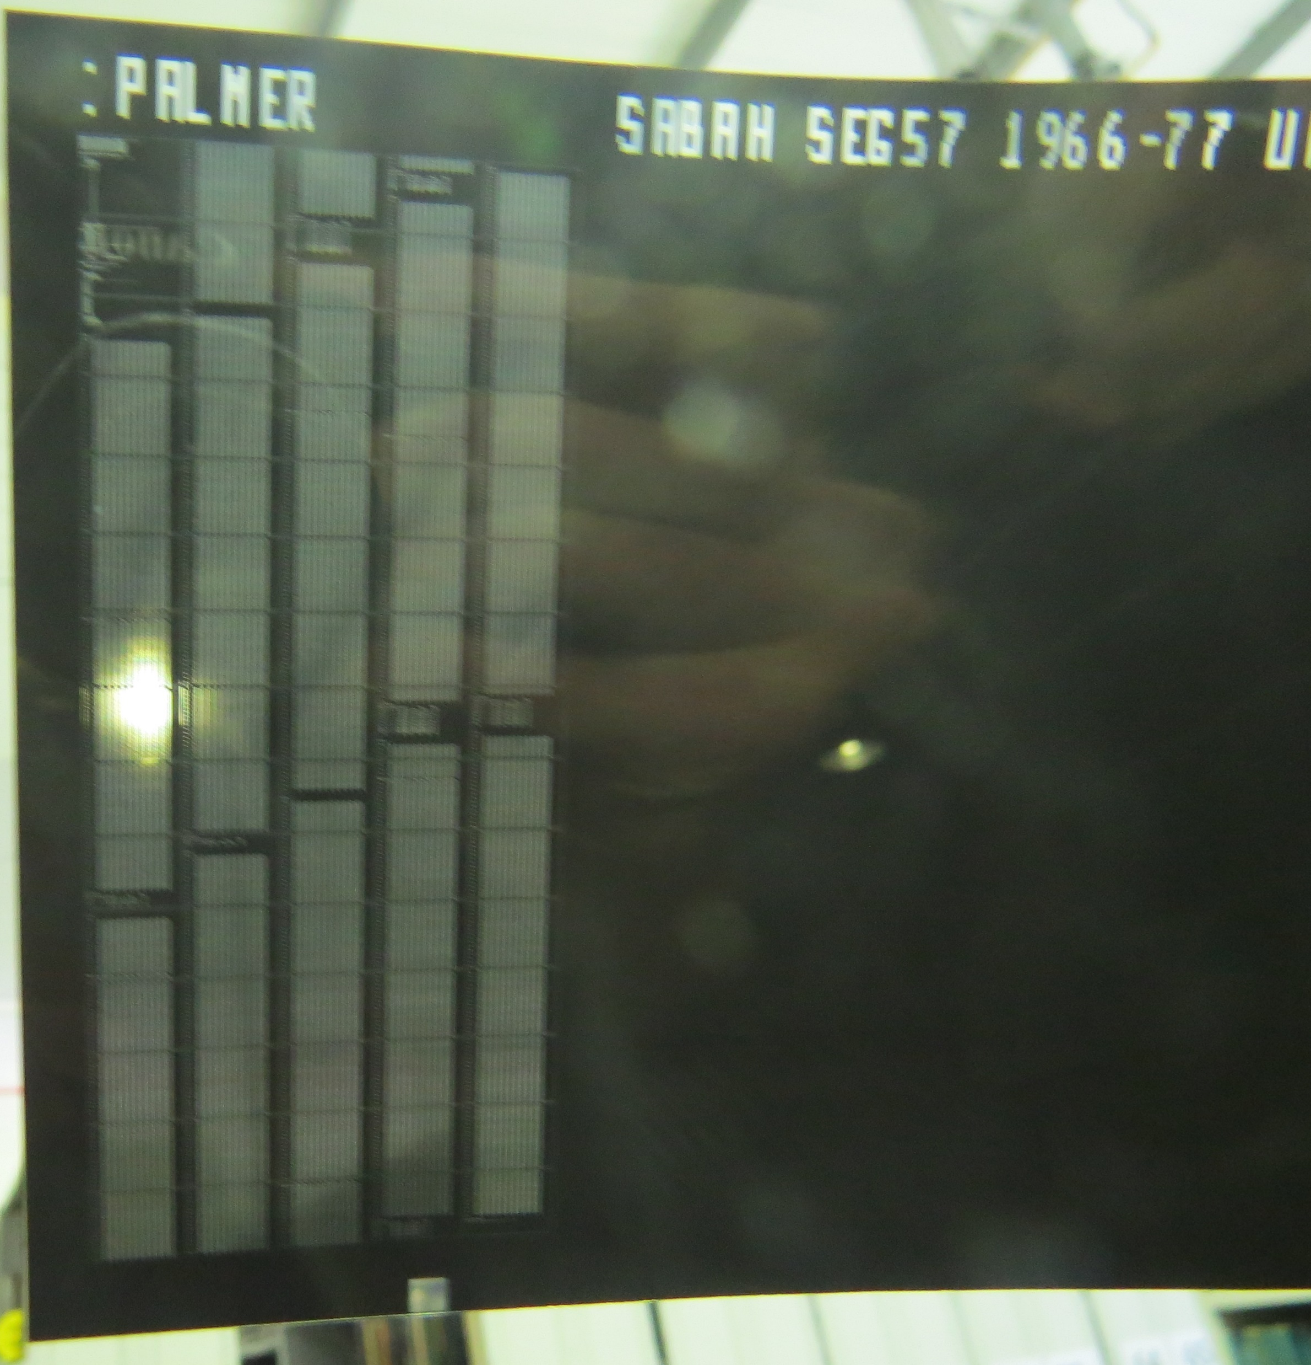
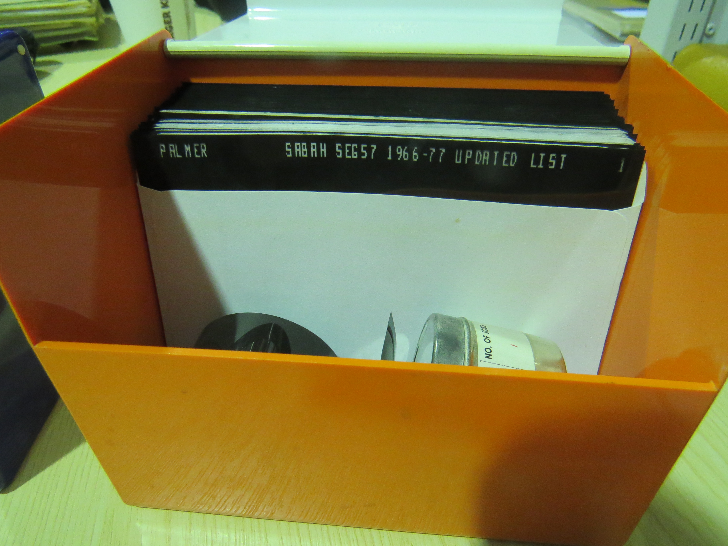
Oxford Forestry Institute (OFI) Studies on Belize
OFI closed in 2006; key filing cabinets moved to Bangor, Wales. Holdings on Belize include complete or partial:
Pinus caribaea growth study, and inventory
Inventories for Mountain Pine Ridge, Cockscomb Basin, Shale type forest, Limestone type forest, Chiquibul, Belize Estates and Produce Company
Volume tables
Data on microfiche (another endangered format)

Slide 11
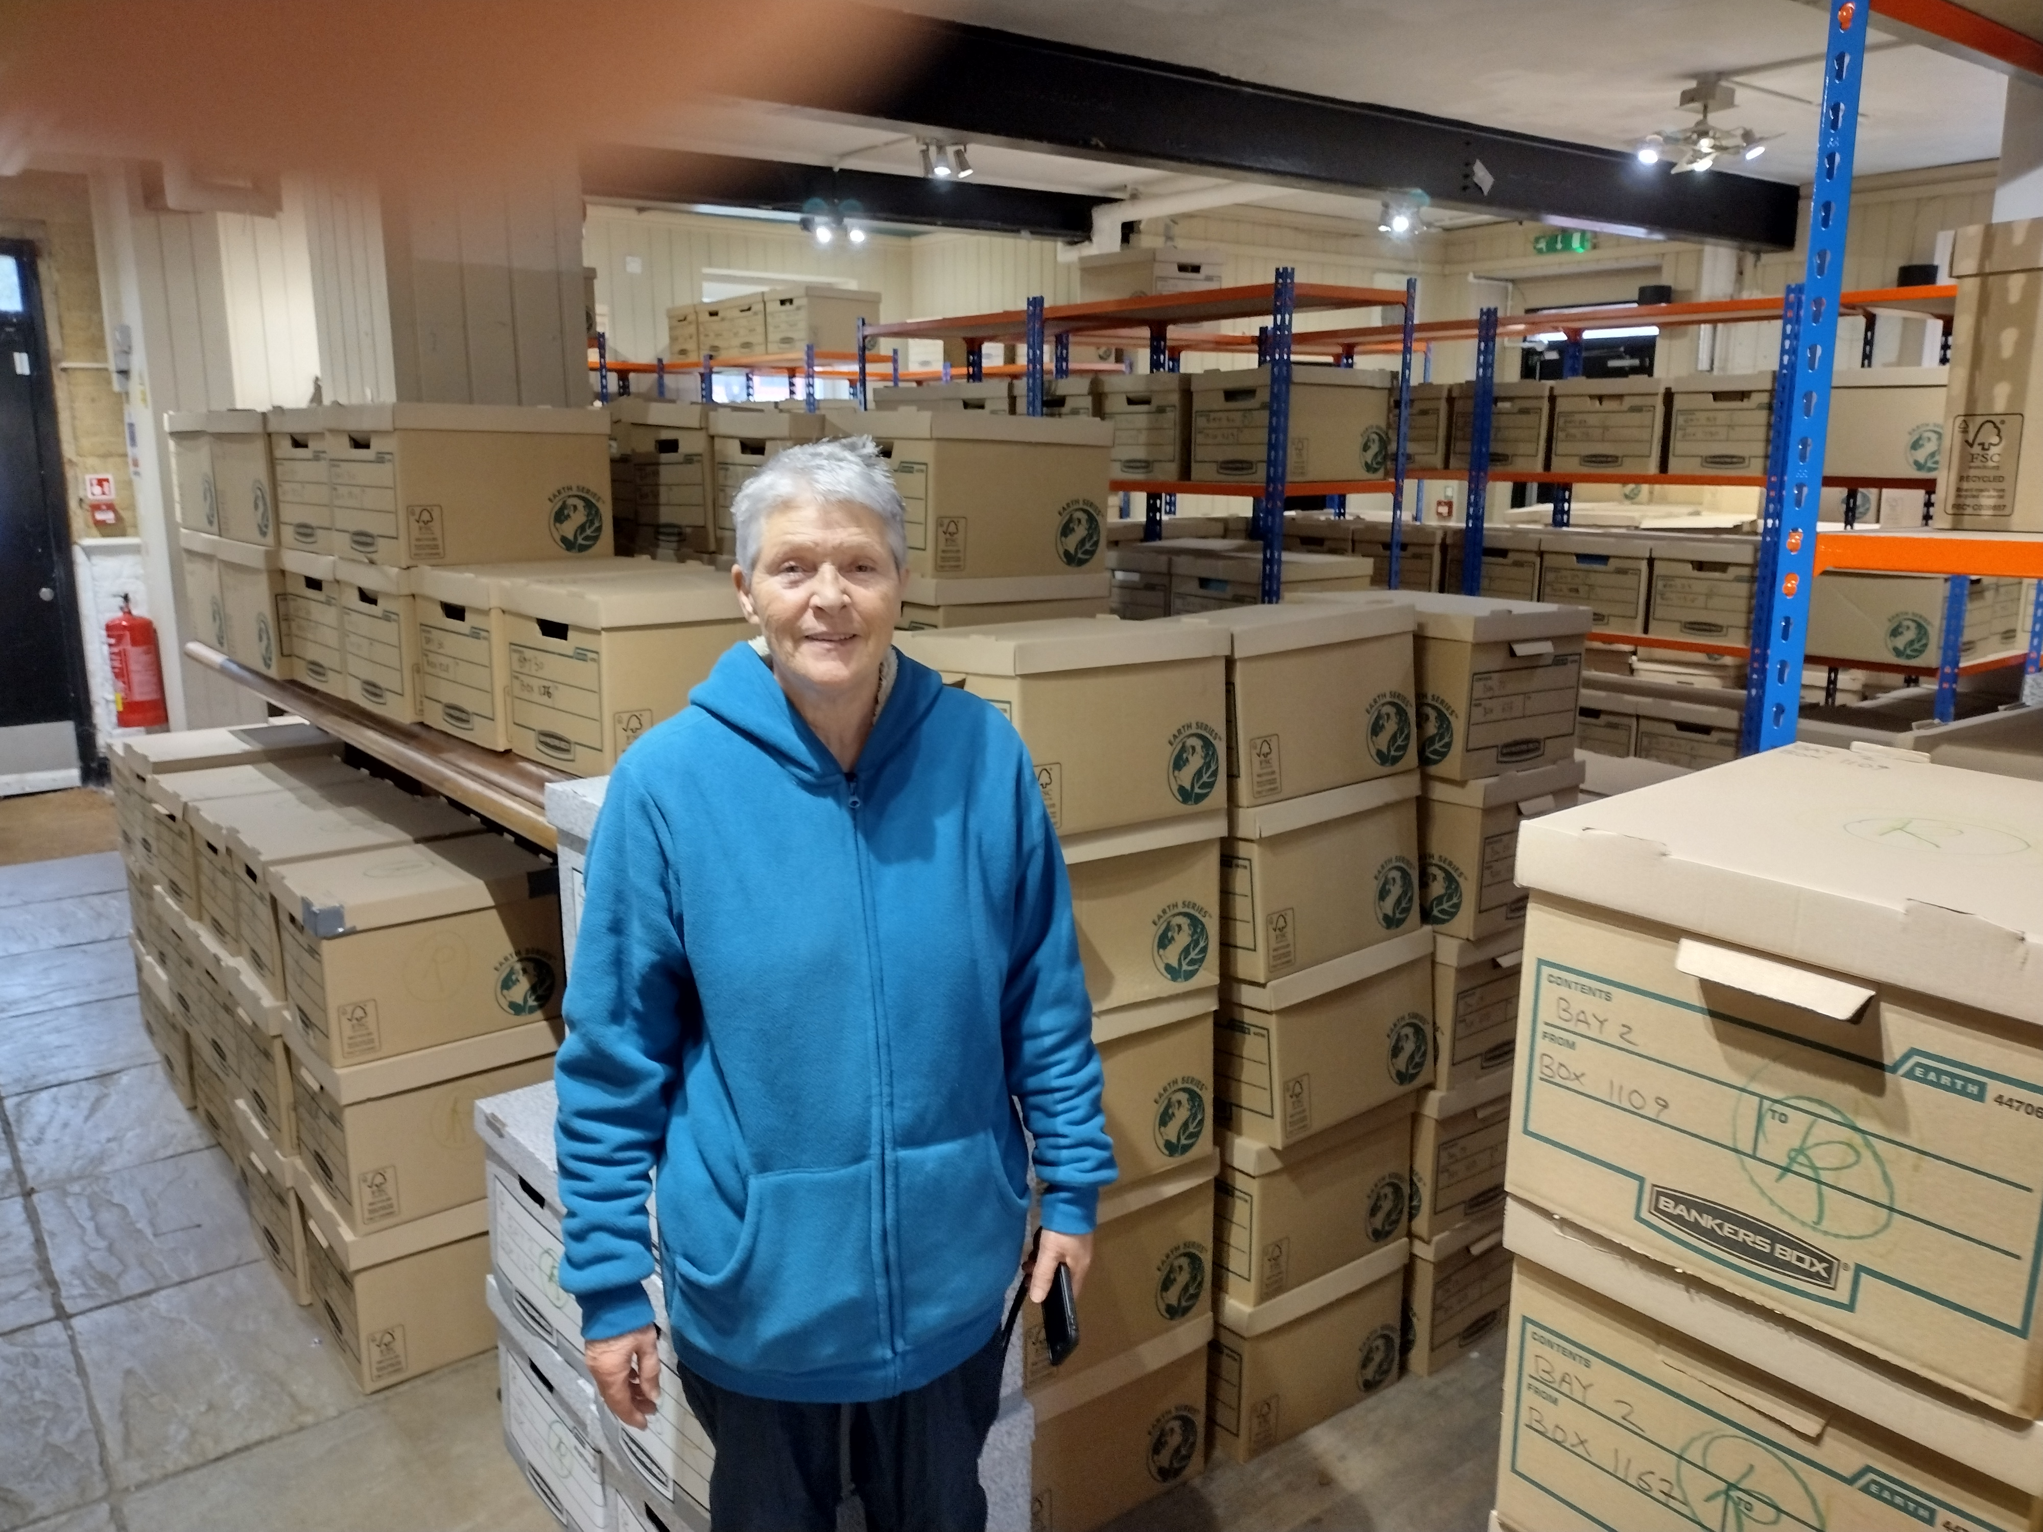
Land Resources Institute
(now with University of Greenwich)
Natural Resources Institute has existed under various titles since late 1800s
1200 boxes being catalogued
Belize studies include Land Resource Studies, consultancy reports, forestry reports, project reports, etc.
Evie Keane, NRI

Slide 12
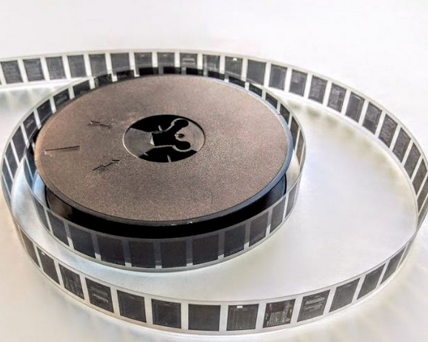
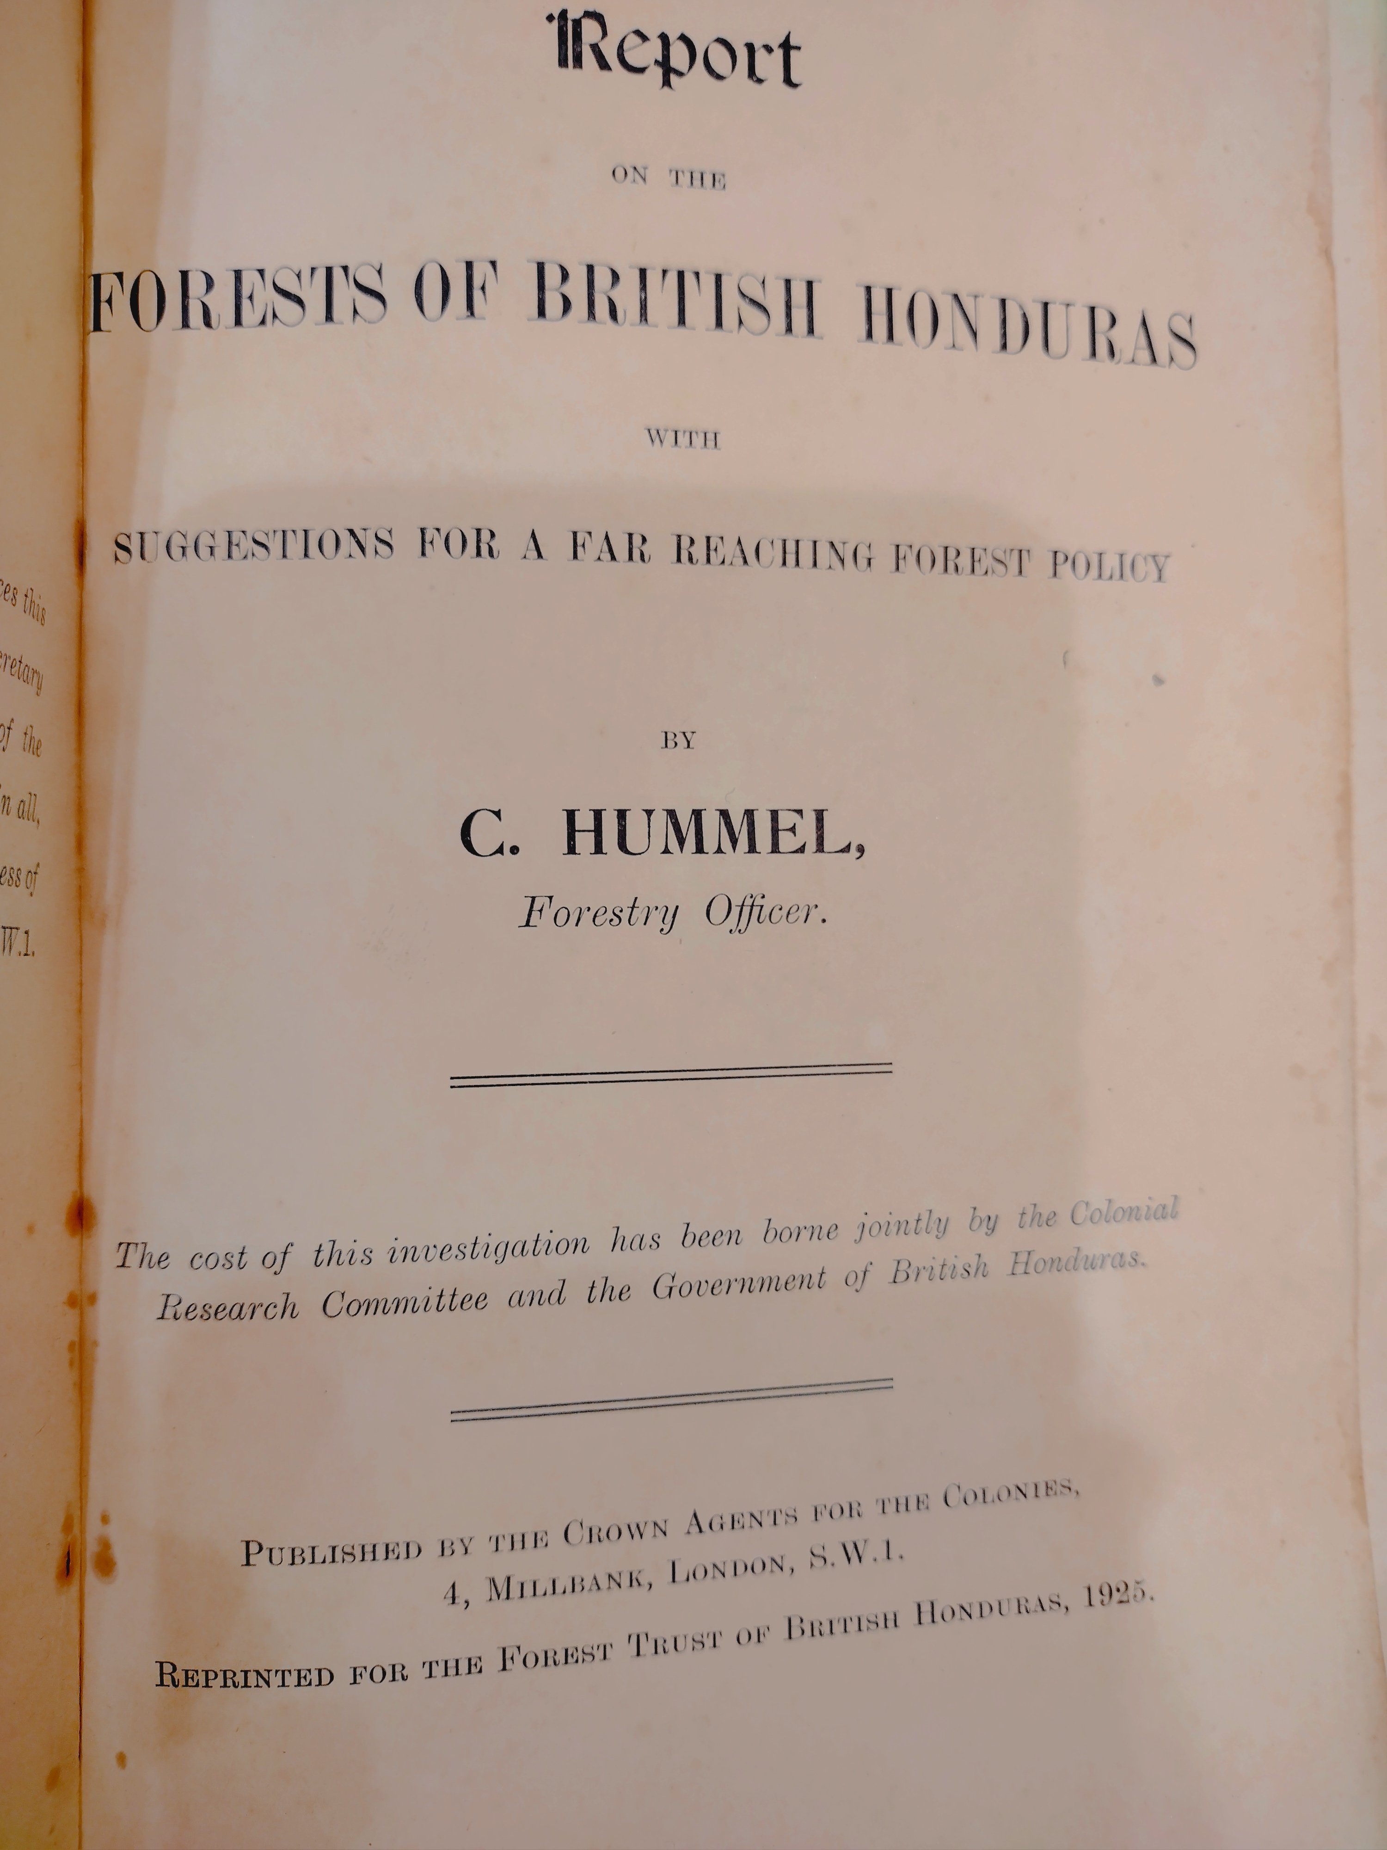

Oxford University
Endangered microfilm: Annual reports of Forestry Department, British Honduras, 1924-….
Oliver Bridle, Bodleian Libraries, Oxford

Slide 13
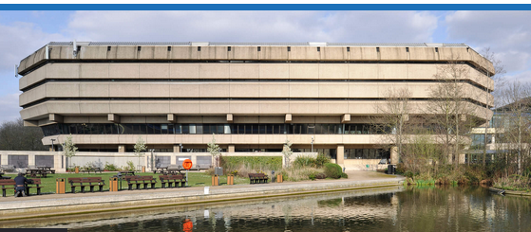
Other places to check for data and other resources on Belize forests
British Library
National Archives
World Soil Survey Archive and Catalogue, Cranfield University
More….
British National Archives, Kew

Slide 14
Next steps
Develop
Develop policy for long term curation and appropriate use
Obtain
Obtain funding to get datasets and resources electronically archived
Seek
Seek researchers to use these datasets and resources

Slide 15
If you know about legacy tropical forest datasets or resources,
Please let us know!
Sheila Ward tropfordata@gmail.com

